Slide 1
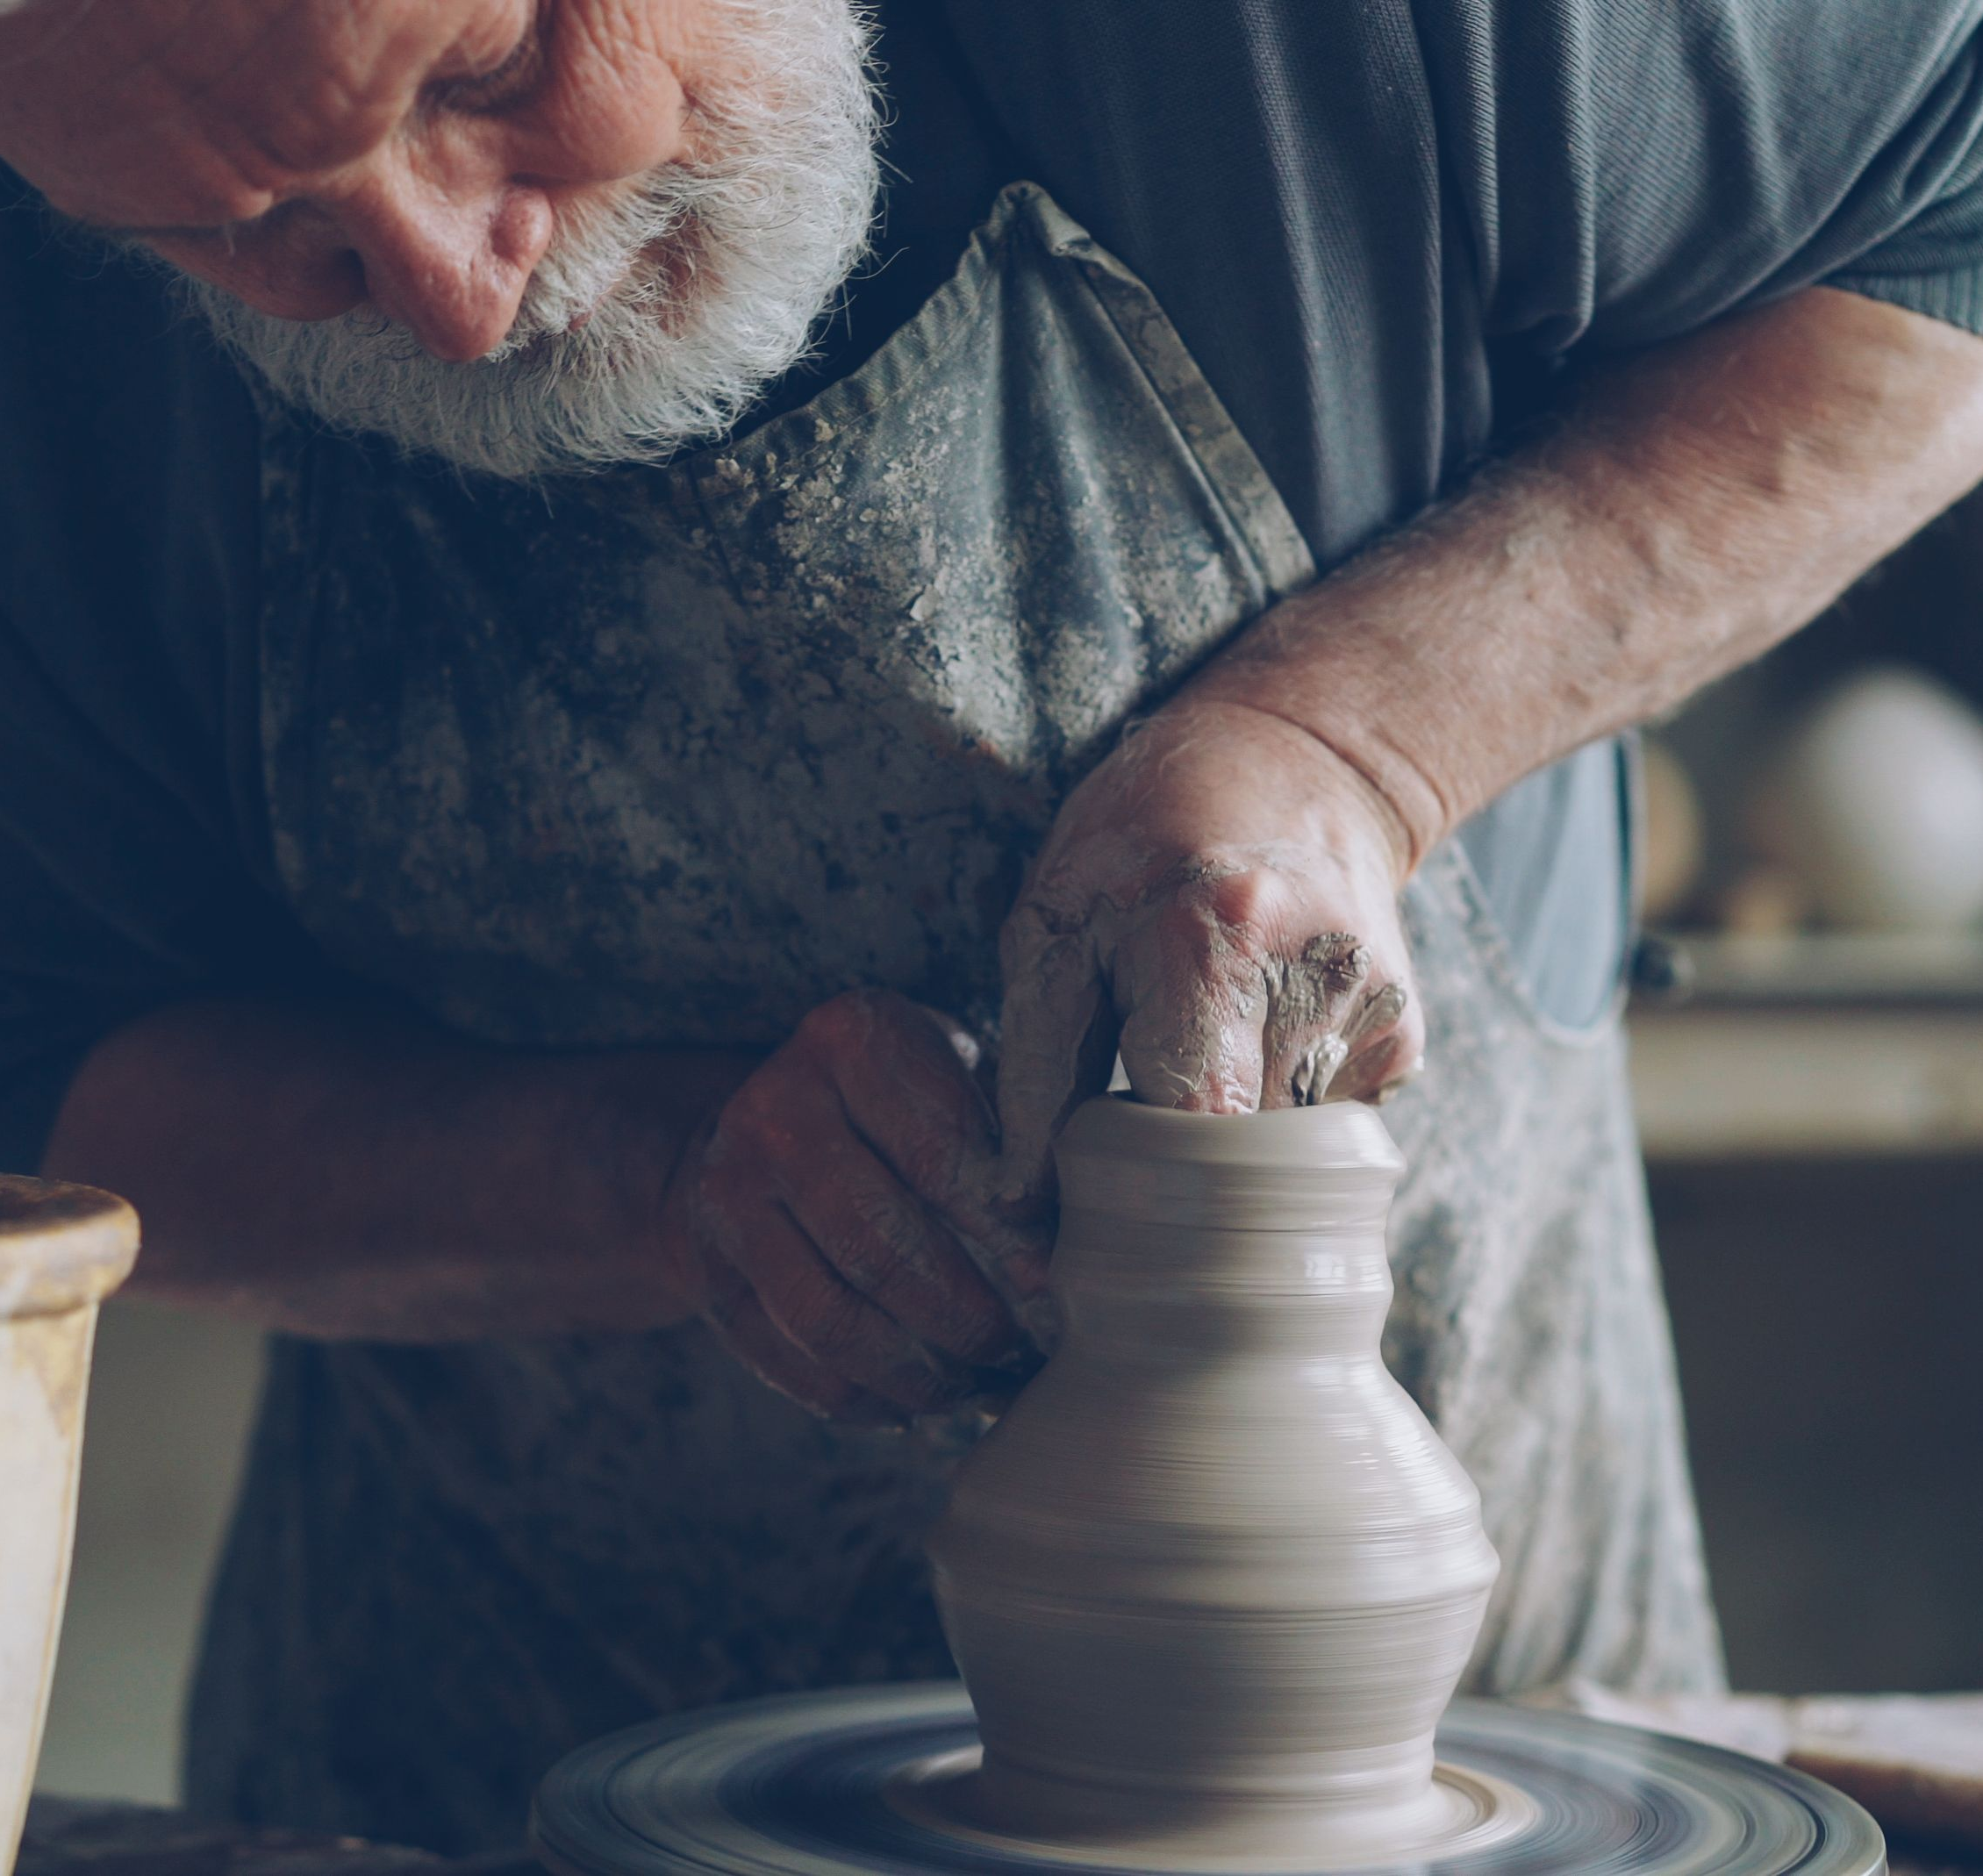

“Go out as disciples, generously offering your talents, creativity, wisdom and experience in order to bring the message of God’s tenderness and compassion to the entire human family.”
Pope Francis Message for World Mission Sunday 2016
Vitaly Gariev (n.d.)

Slide 2
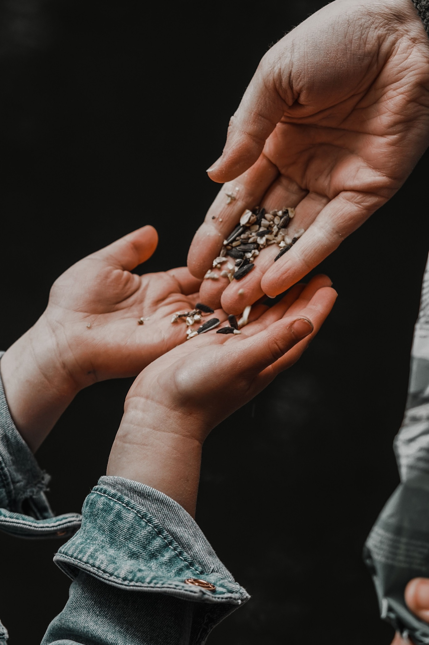
‘Go out as disciples, generously sharing your gifts to bring God’s tenderness and compassion to all.’
Message for World Mission Day 2016
Photo by Nathan J Hilton (n.d.)

Slide 3

"To have enough for oneself and nothing for anyone else is to be poor in everything that matters.”
Chittister, (1992)
Allec Gomes (n.d.)

Slide 4

‘Community is the crucible in which our individualities are purified of vanity, self-centeredness, and pride. It is where we find out if we are as holy as we think we are when we are alone.’
Chittister, (1990)
Road Ahead (n.d.)

Slide 5
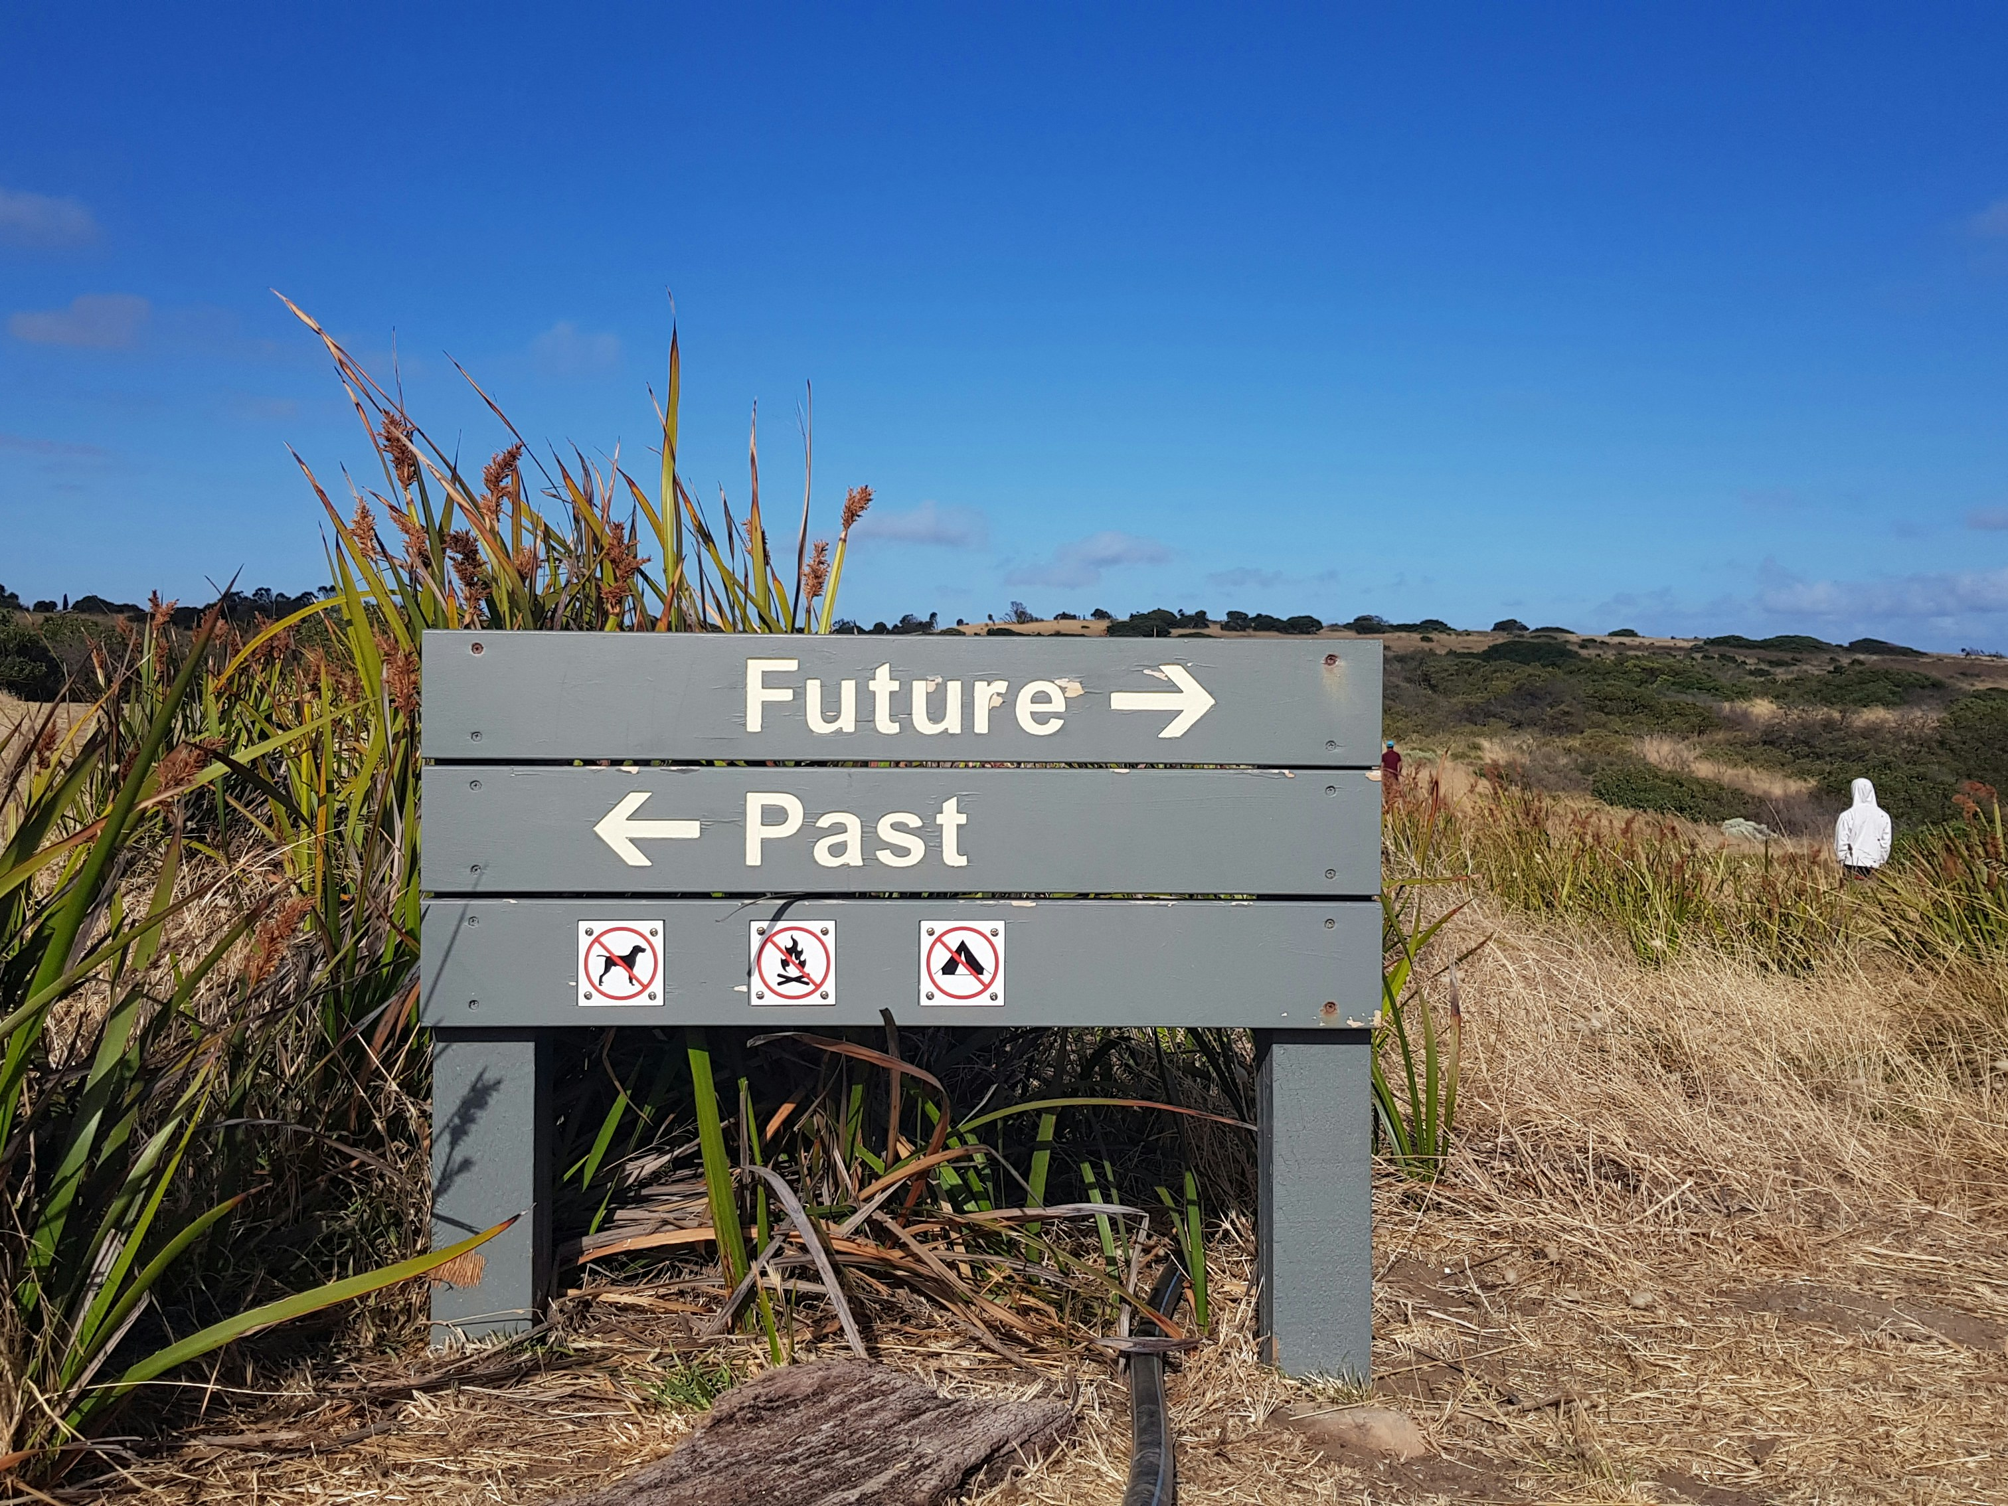
What is the VISION for our Parish?
Hadija on Unsplash (2021).

Slide 6
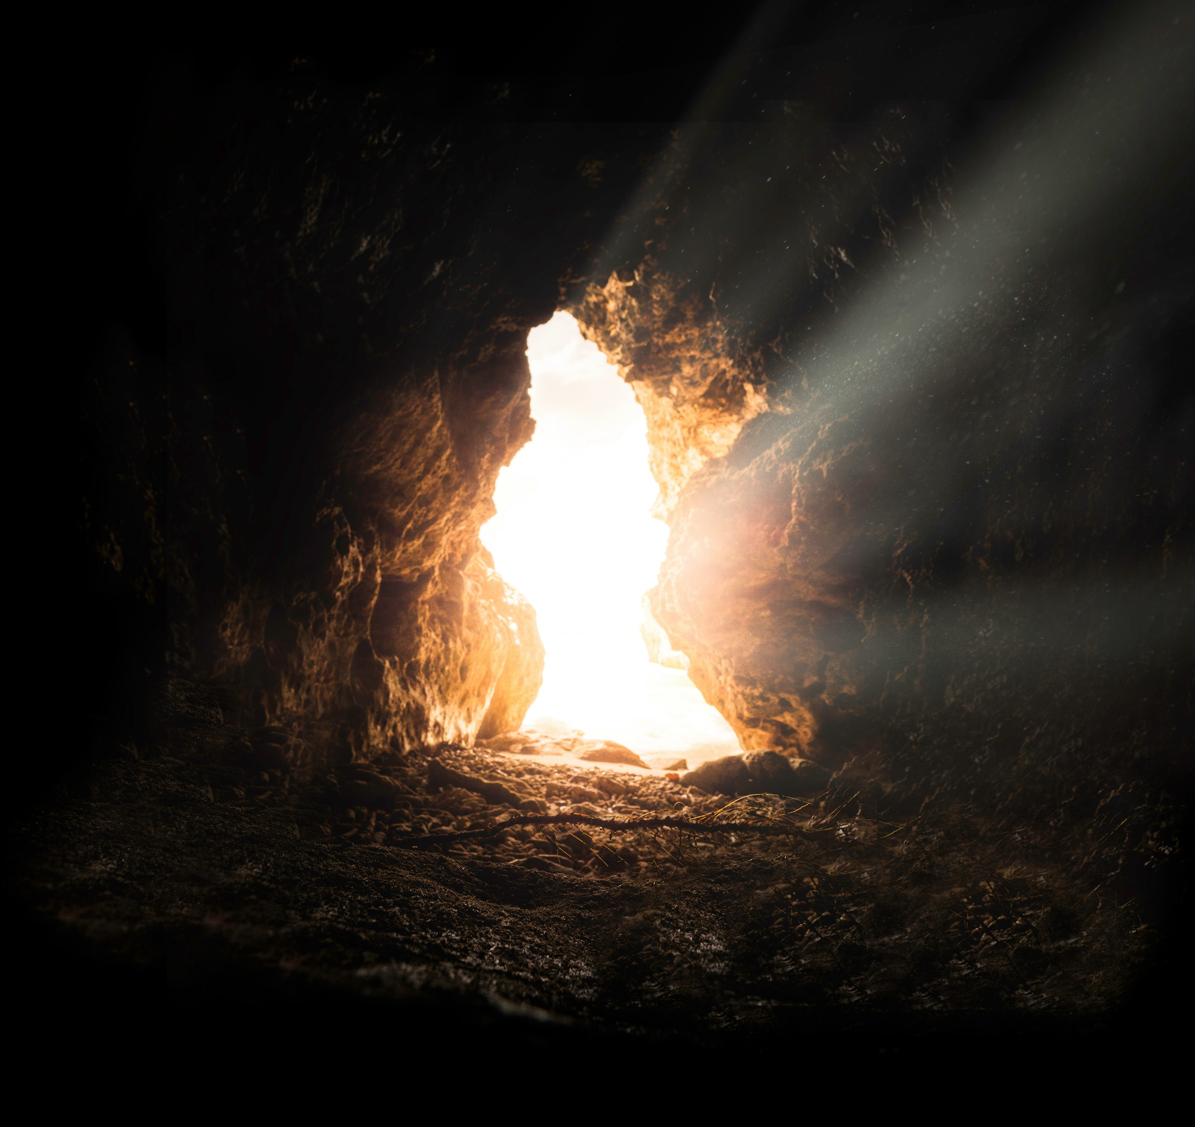
The central focus of this Parish is our relationship with Jesus.
(2018) Bruno van der Kraan on Unsplash

Slide 7
Image and Quote References
Slide one:
Best Potter Creativity Photos. (n.d.). Retrieved 10 September 2026, from https://www.pexels.com/search/potter%20creativity/
Slide two:
Message for World Mission Day 2016. (n.d.). Retrieved 10 September 2026, from https://www.vatican.va/content/francesco/en/messages/missions/documents/papa-francesco_20160515_giornata-missionaria2016.html
Best Generous Photos. (n.d.). Retrieved 10 September 2026, from https://www.pexels.com/search/generous/
Slide three:
Chittister, J. (1992). The Rule of Benedict: Insights for the Ages. Crossroad. [1] (https://psycnet.apa.org/record/2020-02352-001)
Unsplash. (2019, November 30). Photo by Allec Gomes on Unsplash. https://unsplash.com/photos/light-match-stick-fHNUi68tqu8
Slide four:
Unsplash. (2022, April 7). Photo by Road Ahead on Unsplash. https://unsplash.com/photos/a-couple-of-candles-that-are-lit-up-in-the-dark-9frkg0DSP5o
Chittister, J. (1990). Wisdom distilled from the daily: Living the Rule of St. Benedict today. HarperSanFrancisco.
Slide five:
Unsplash. (2021, January 3). Photo by Hadija on Unsplash. https://unsplash.com/photos/wooden-sign-pointing-future-and-past-9cgMKmZyhH0
Slide seven
Unsplash. (2018, March 15). Photo by Bruno van der Kraan on Unsplash. https://unsplash.com/photos/sun-rays-inside-cave-v2HgNzRDfII

