Slide 1


‘For theirs is a community composed of people.
United in Christ, they are led by the Holy Spirit in their journey to the Kingdom of their Father…’
Gaudium et Spes.
Photo by Erik Mclean on Unsplash

Slide 2

‘The Holy Spirit guides God’s people towards Jesus our hope.’
General Audience of 29 May 2024
Photo by Rydale Clothing on Unsplash

Slide 3

‘The Church is not a community of the perfect, but a community of disciples on a journey.’
Pope Francis during the General Audience on April 13, 2016.

Slide 4
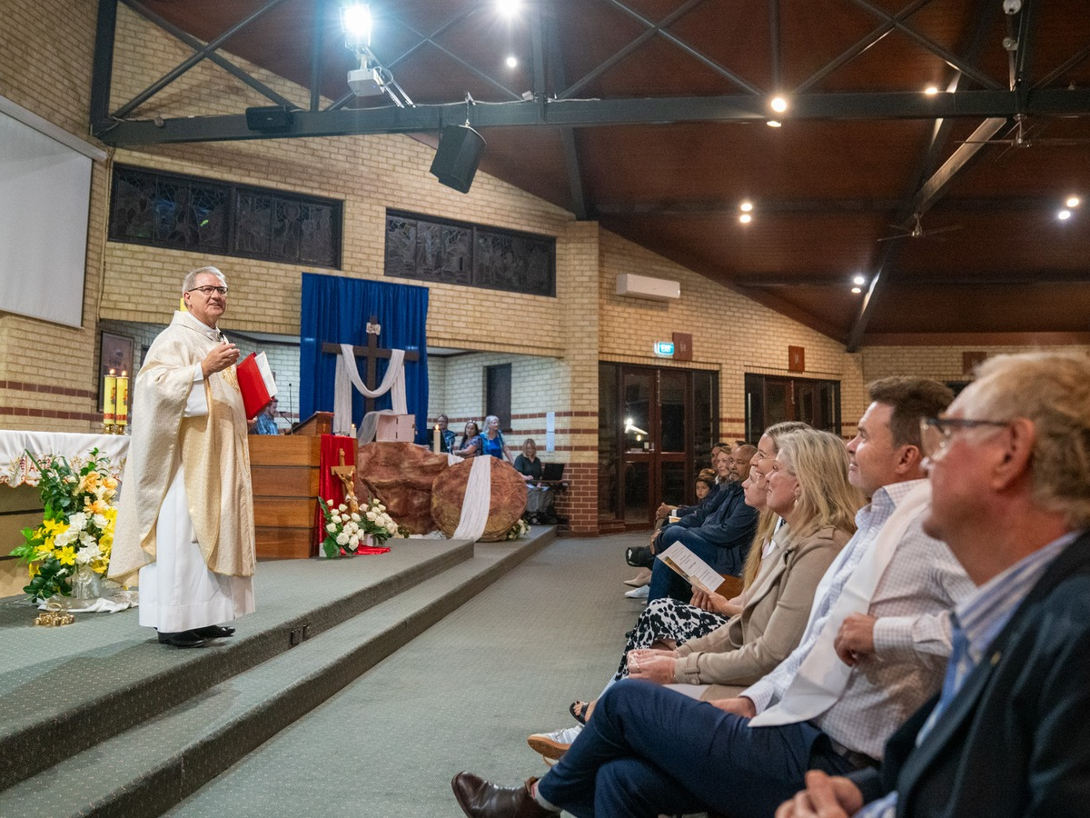
What is a parishioner and what does it mean to me personally?
cottonbro studio

Slide 5
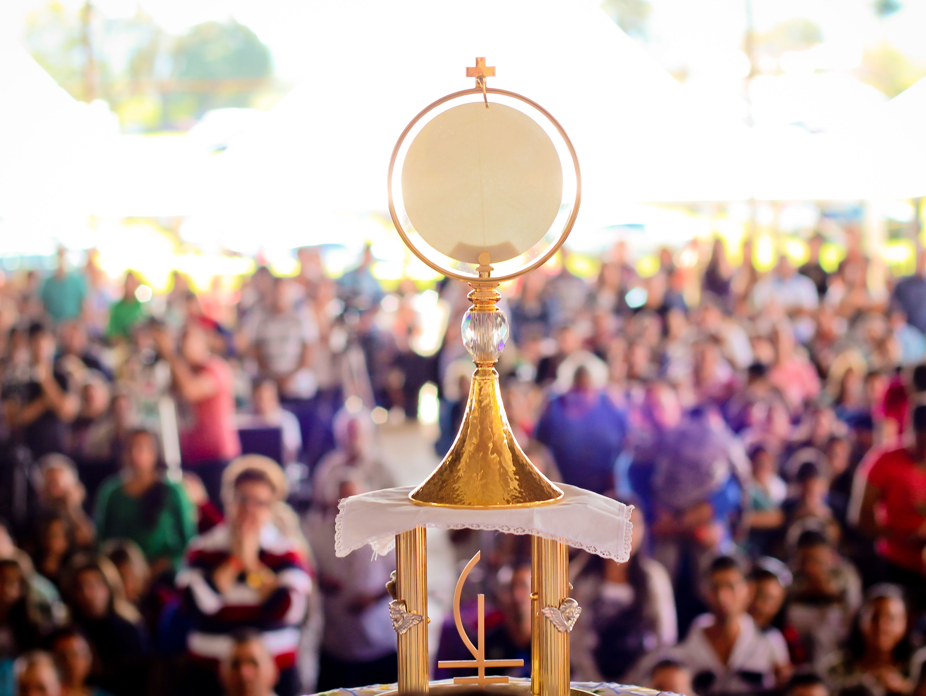
A parish is at its best when it becomes a communion of communities: a people gathered in peace, strengthened by charity, and made one in the love of Christ.
Comunidade Javé Nissi

Slide 6
Image and Quote References
Slide one:
Pastoral Constitution on the Church in the Modern Word-Gaudium et Spes. (n.d.). Retrieved 4 September 2026, from https://www.vatican.va/archive/hist_councils/ii_vatican_council/documents/vat-ii_cons_19651207_gaudium-et-spes_en.html
Unsplash. (2021, March 15). Photo by Erik Mclean on Unsplash. https://unsplash.com/photos/yellow-and-black-no-smoking-sign-9R4KTUjsY2M
Slide two:
General Audience of 29 May 2024—Cycle of Catechesis. The Spirit and the Bride. The Holy Spirit guides. The people of God towards Jesus our hope. 1. The Spirit of God was hovering over the waters. (n.d.). Retrieved 4 September 2026, from https://www.vatican.va/content/francesco/en/audiences/2024/documents/20240529-udienza-generale.html
Unsplash. (2024, May 22). Photo by Rydale Clothing on Unsplash. https://unsplash.com/photos/a-black-dog-sitting-on-the-side-of-a-dirt-road-gUrqe-GoSVU
Slide three:
General audience: There is no saint without a past, nor sinner without a future. (n.d.). Retrieved 4 September 2026, from https://press.vatican.va/content/salastampa/en/bollettino/pubblico/2016/04/13/160413a.html
Best Journey Photos. (n.d.). Retrieved 4 September 2026, from https://www.pexels.com/search/journey/
Slide four:
The Record – St Simon Peter Parish, Ocean Reef
Slide six:
Best Communion Of Communities Photos. (n.d.). Retrieved 4 September 2026, from https://www.pexels.com/search/communion%20of%20communities/

