Slide 1


As disciples, we are called to love God and serve one another — and there is a place for each of us in this shared journey.
Plavalaguna, D. (2020)

Slide 2
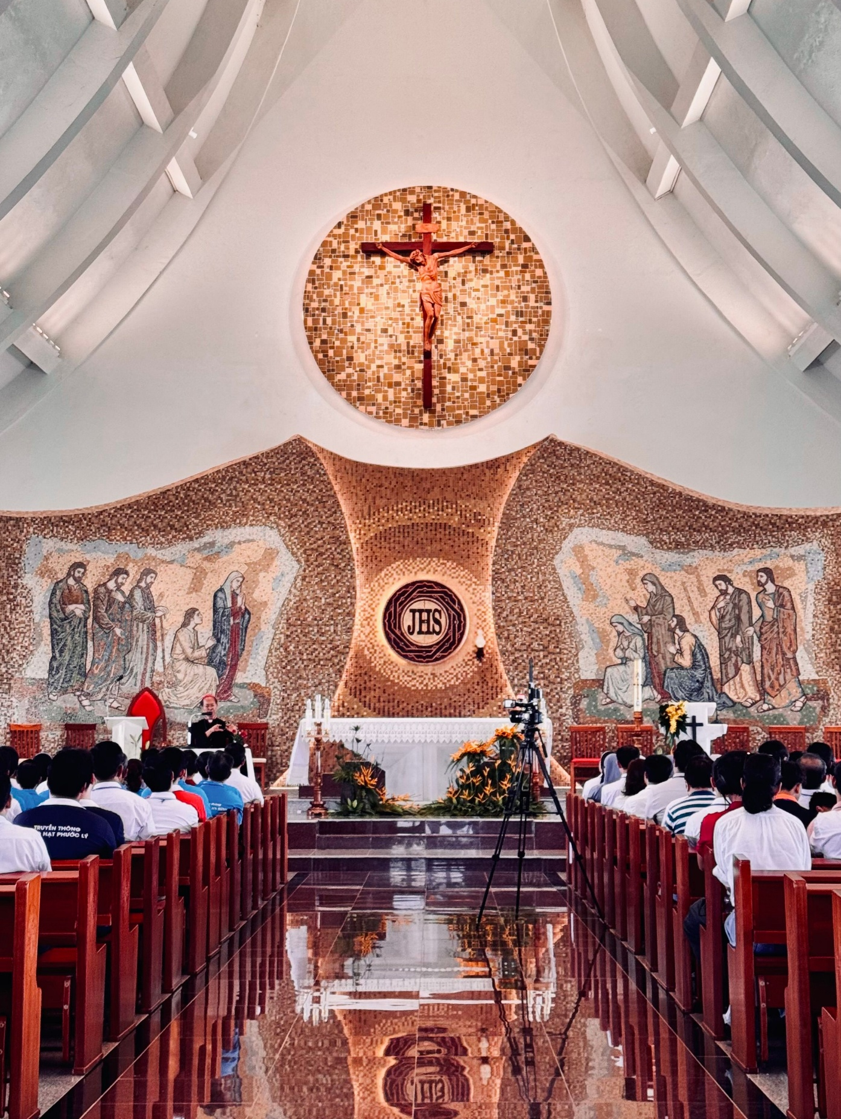
Adsumus connects the life of the Church today with the renewal, hope, and openness that began with Vatican II.
Thach, J. (2024)

Slide 3
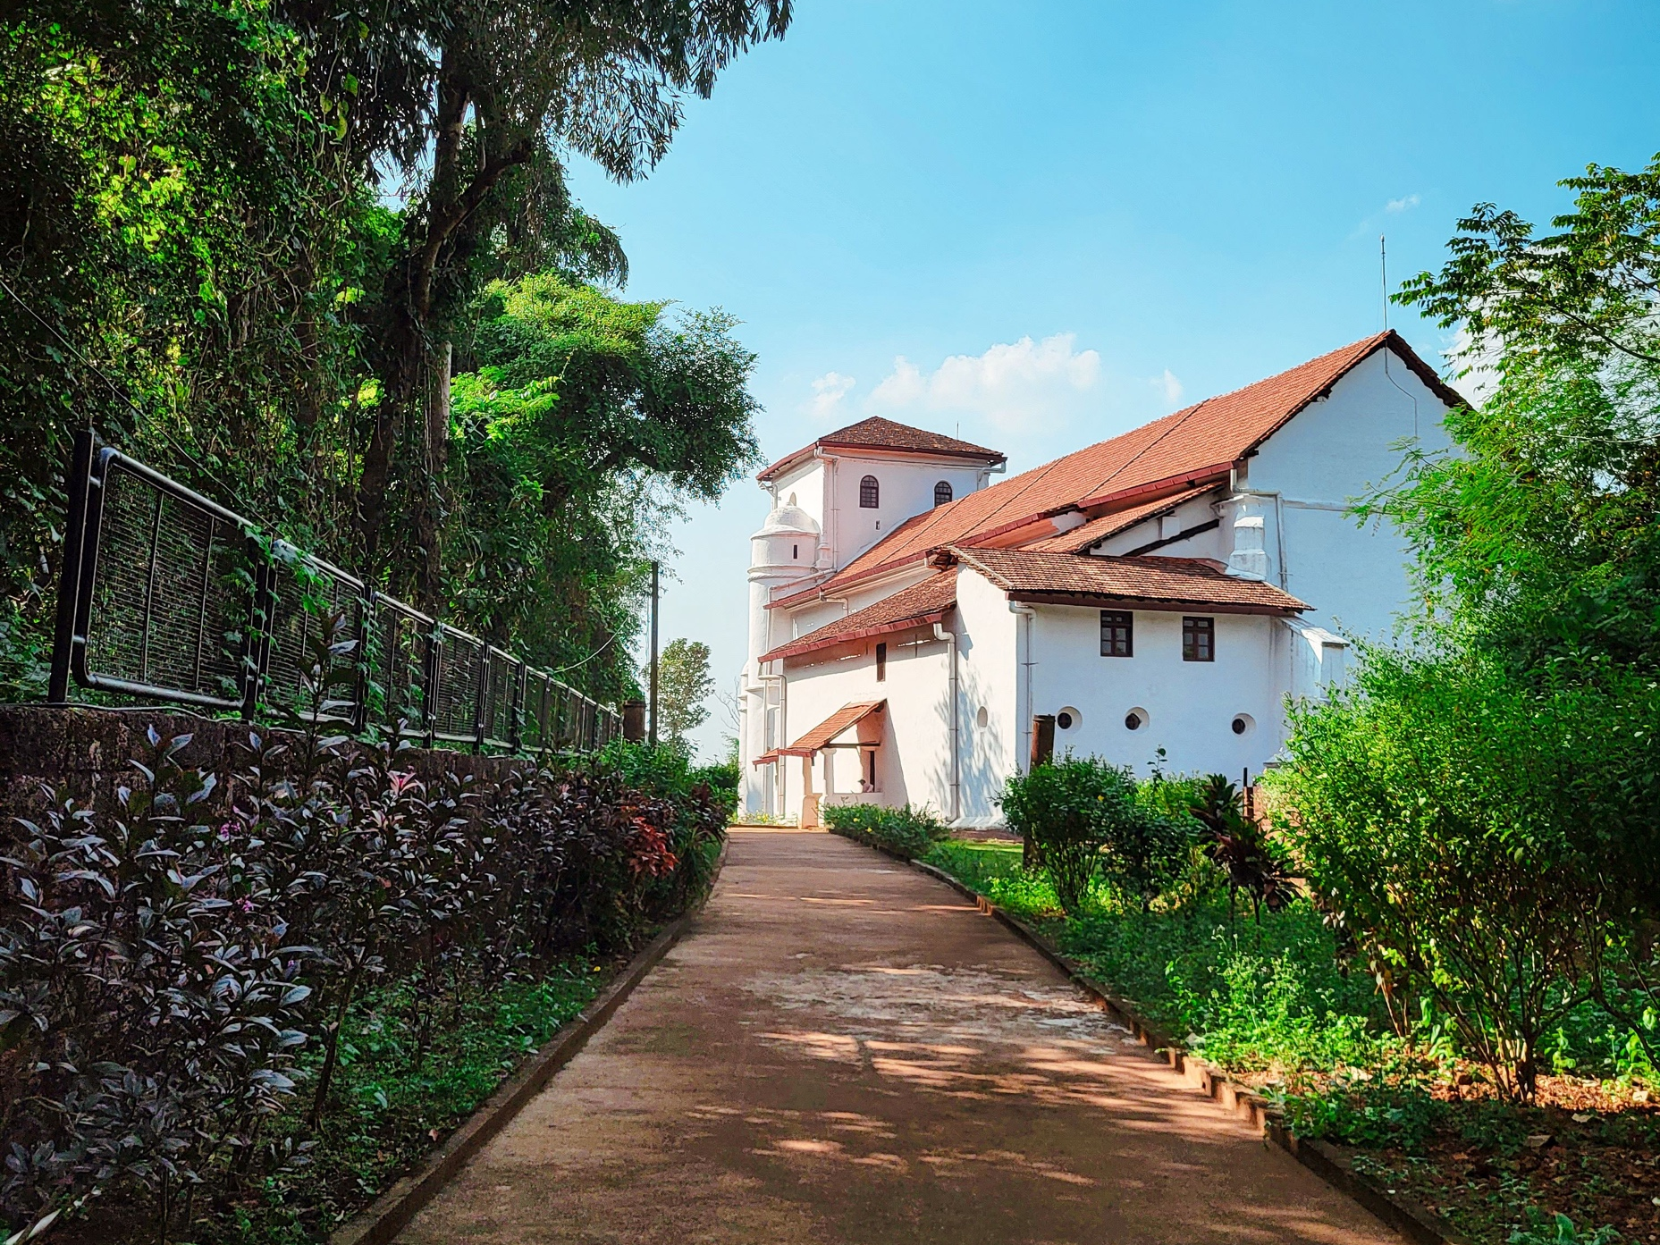
When Jesus asks, ‘Who do you say I am?’, he is not only inviting a response but gently calling us to walk ‘The Way.’
Thakur, G. (2023)

Slide 4

What is Adsumus inviting me to do?
Bertelli, M. (2022)

Slide 5

‘A vocation is not a place, but a journey.’
— Sr. Joan Chittister
Pexels. (n.d.).

Slide 6
Image References:
Slide one
Plavalaguna, D. (2020, December 10). High five hands [Photograph]. Pexels. https://www.pexels.com/photo/high-five-hands-6146822/
Slide two
Thach, J. (2024, December 27). Stunning interior of a Milan church [Photograph]. Pexels. https://www.pexels.com/photo/stunning-interior-of-a-milan-church-29925968/
Slide three
Thakur, G. (2023, December 11). Footpath leading toward a church [Photograph]. Pexels. https://www.pexels.com/photo/footpath-leading-toward-a-church-19437358/
Imgage four
Bertelli, M. (2022, October 3). Silhouette of a child with arms raised [Photograph]. Pexels. https://www.pexels.com/photo/silhouette-of-a-child-with-arms-raised-13872522/
Image five
Pexels. (n.d.). Family walking with picnic basket [Photograph]. https://www.pexels.com/search/family%20walking/

