Slide 1


When we become our best selves—we help build our community.
Pflueger, G. A. (2022)

Slide 2

Adsumus:
Our parish turns love into action, together.
Fewings, N. (2022)

Slide 3
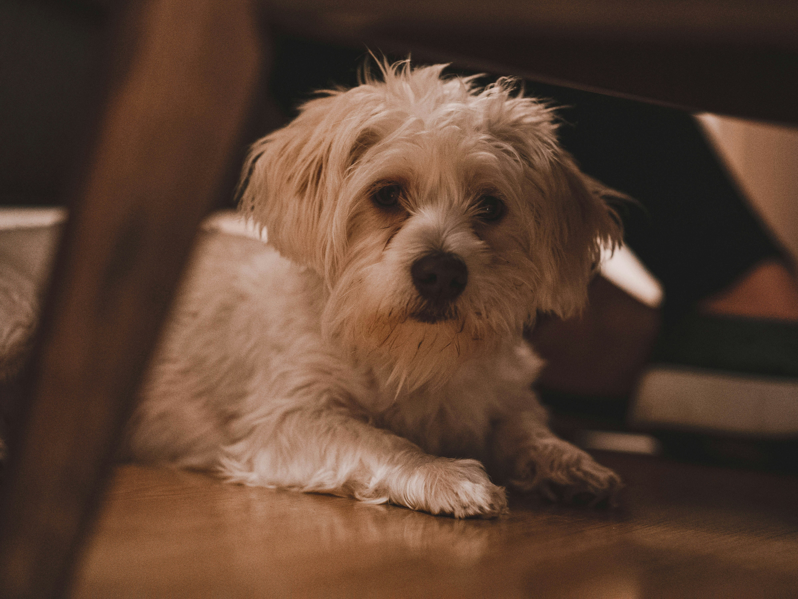
Even puppies get to eat the crumbs that fall from their master’s table.
Reed, J. (2020)

Slide 4
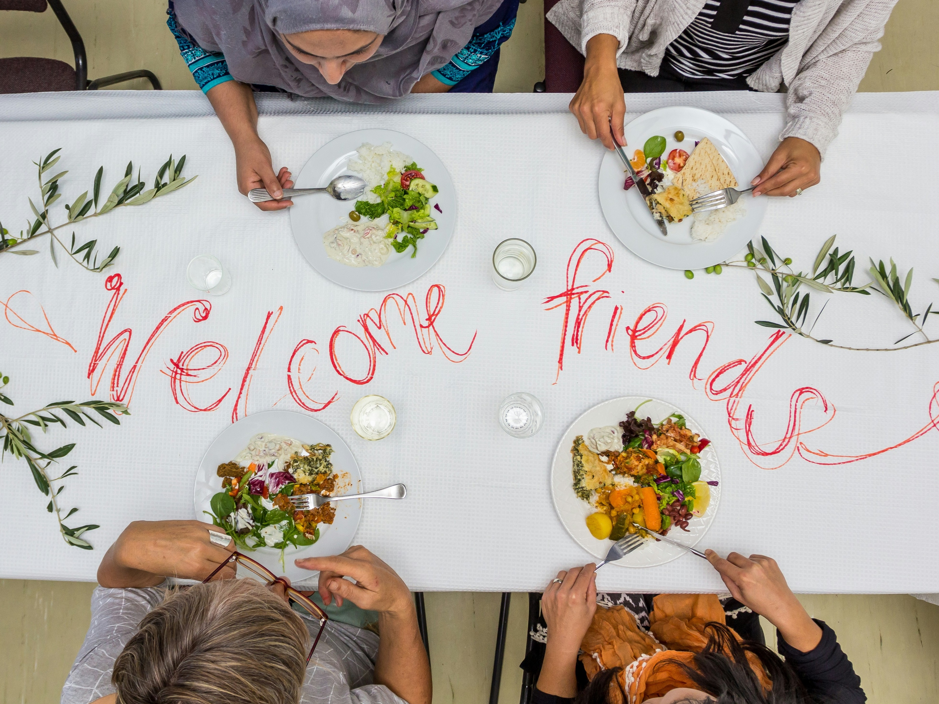
The grace and mercy of Christ are never limited by ethnicity, background, or social status.
Paine, D. J. (2024)

Slide 5

The Holy Spirit draws a community together by turning our attention away from labels and differences
Nikolina. (n.d.)

Slide 6
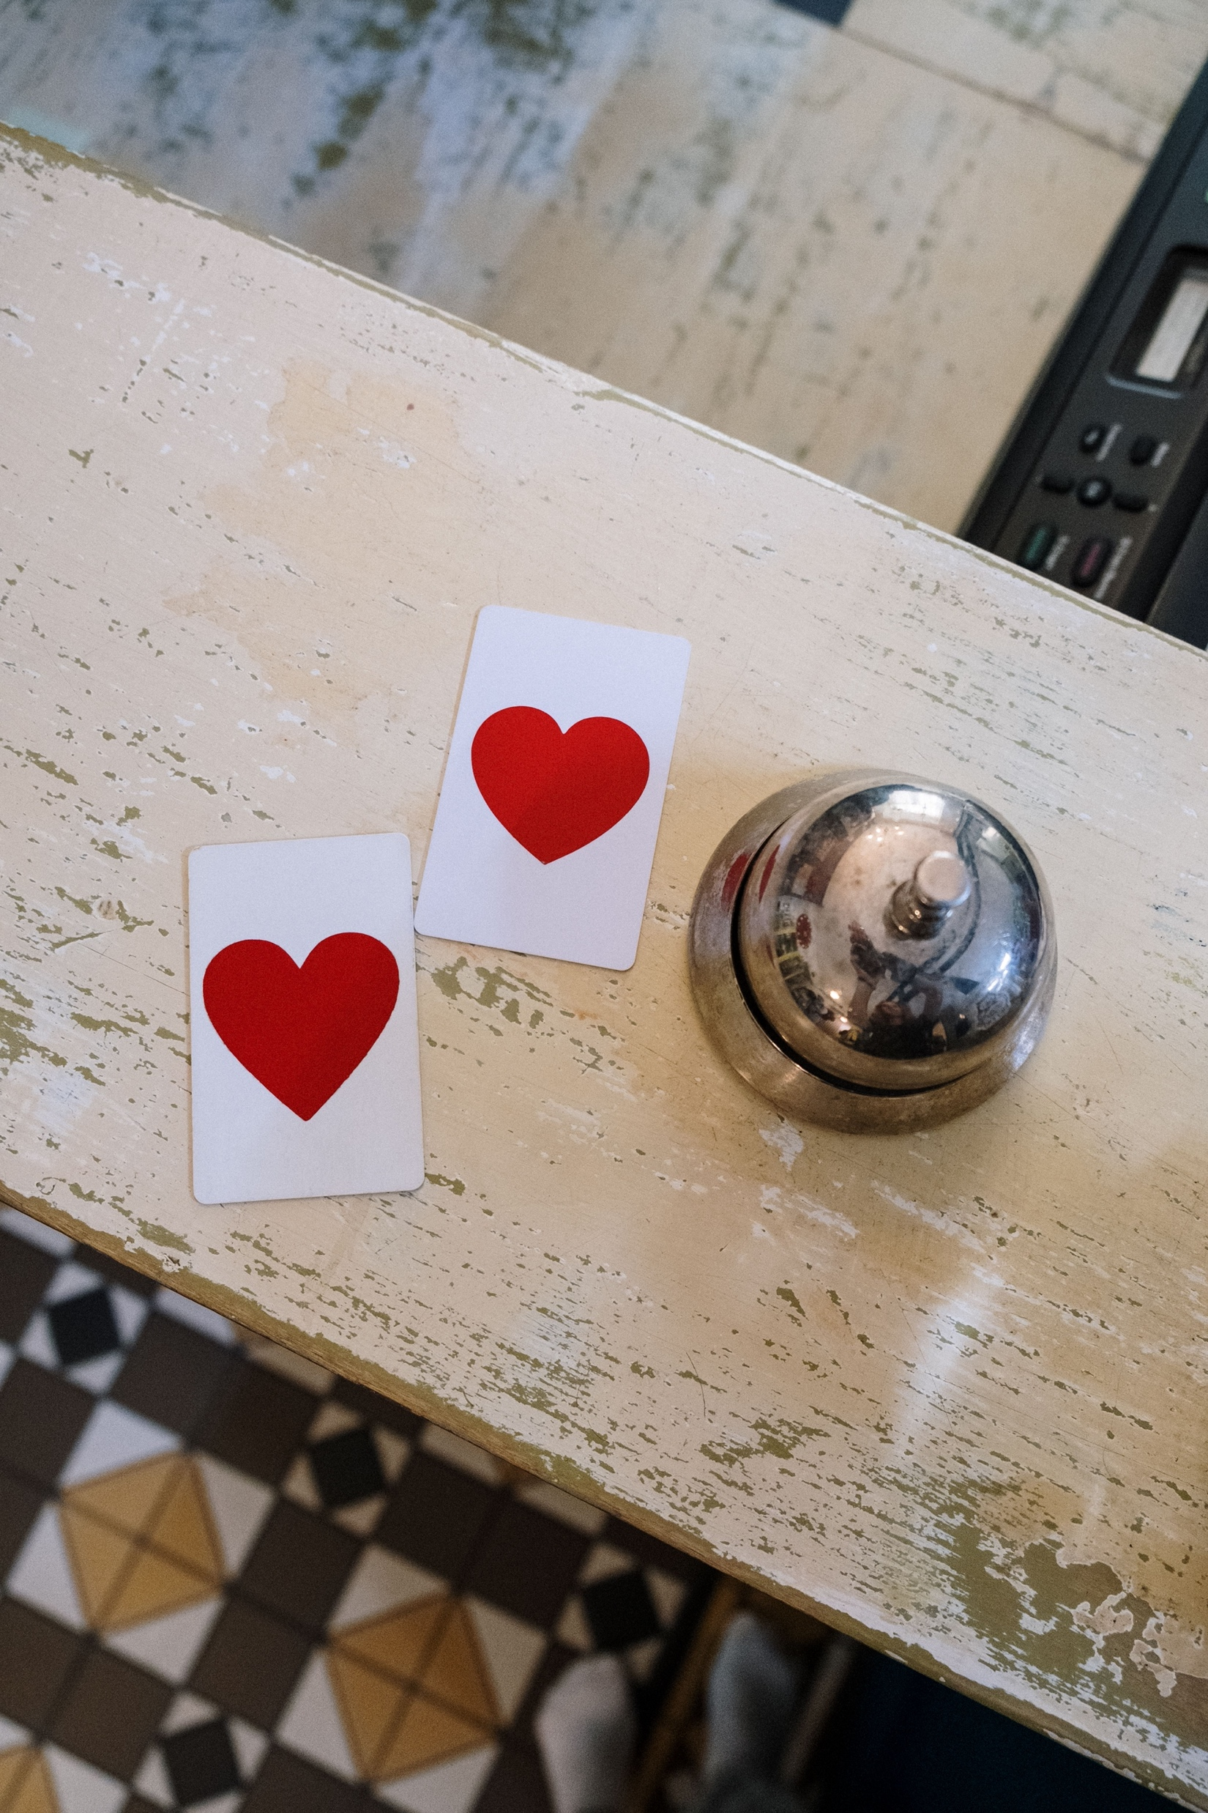
‘Hospitality means we take people into the space that is ourselves—our lives, our minds, our hearts, our work, and our efforts. Hospitality is simply love on the loose.’
Joan Chittister
cottonbro studio (n..d..)

Slide 7
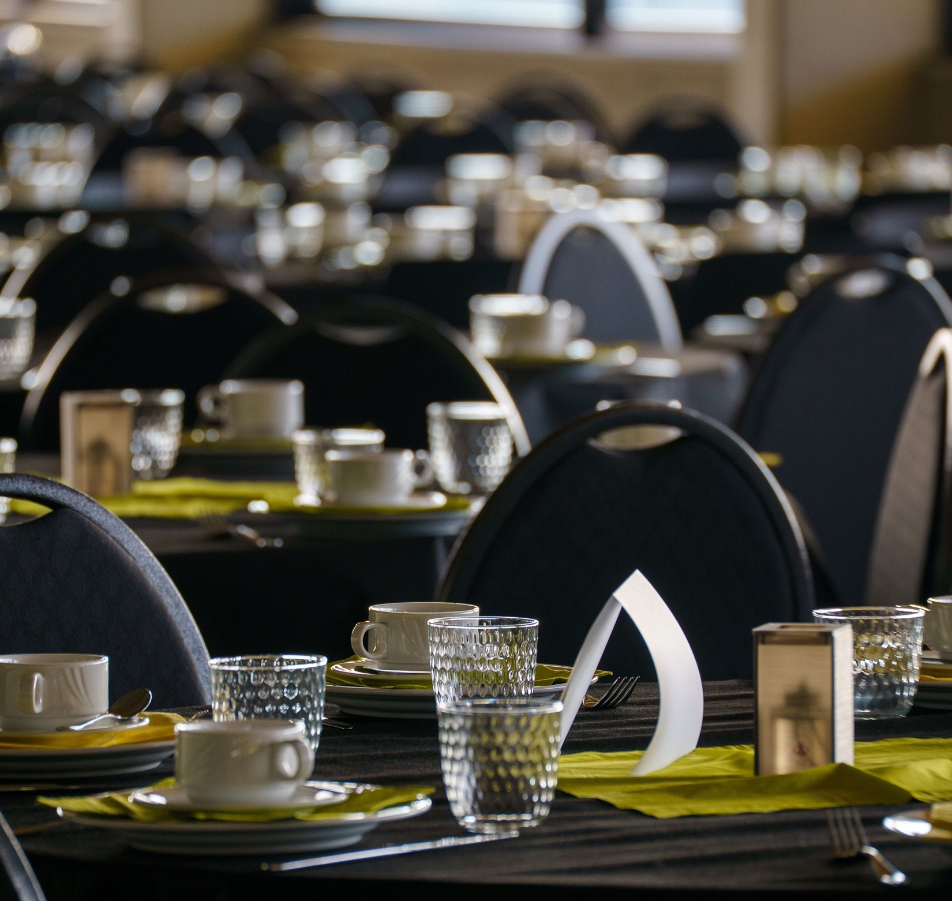
What practical steps can we take to make room for everyone at the table?
Ceulemans, M. (2026)

Slide 8
Image References
Image one
Pflueger, G. A. (2022, July 25). A metal structure with many beams [Photograph]. Unsplash. https://unsplash.com/photos/a-metal-structure-with-many-beams-iDO2IbbR-2c
Image two
Fewings, N. (2022, November 26). Teamwork makes the dreamwork quote on a chalk board [Photograph]. Unsplash. https://unsplash.com/photos/text-b8AYYOCUSkQ
Image three
Reed, J. (2020, April 4). White long coat small dog sitting on floor [Photograph]. Unsplash. https://unsplash.com/photos/white-long-coat-small-dog-sitting-on-floor-xK0KQwyqb10
Image four
Paine, D. J. (2024, July 16). A group of people sitting around a table with plates of food [Photograph]. Unsplash. https://unsplash.com/photos/a-group-of-people-sitting-around-a-table-with-plates-of-food-nOVt9Yeo9Xc
Slide five
Nikolina. (n.d.). [Couple reaching for each other's hands] [Photograph]. Pexels. https://www.pexels.com/search/hands%20ring/
Slide six
Pexels (n.d.).. Retrieved from; https://www.pexels.com/photo/hearts-on-cards-near-bell-5137960/
Slide seven
Ceulemans, M. (2026, May 11). Elegant Table Setting with Porcelain Dishes [Photograph]. Pexels. https://www.pexels.com/photo/elegant-table-setting-with-porcelain-dishes-37521060/

