Slide 1
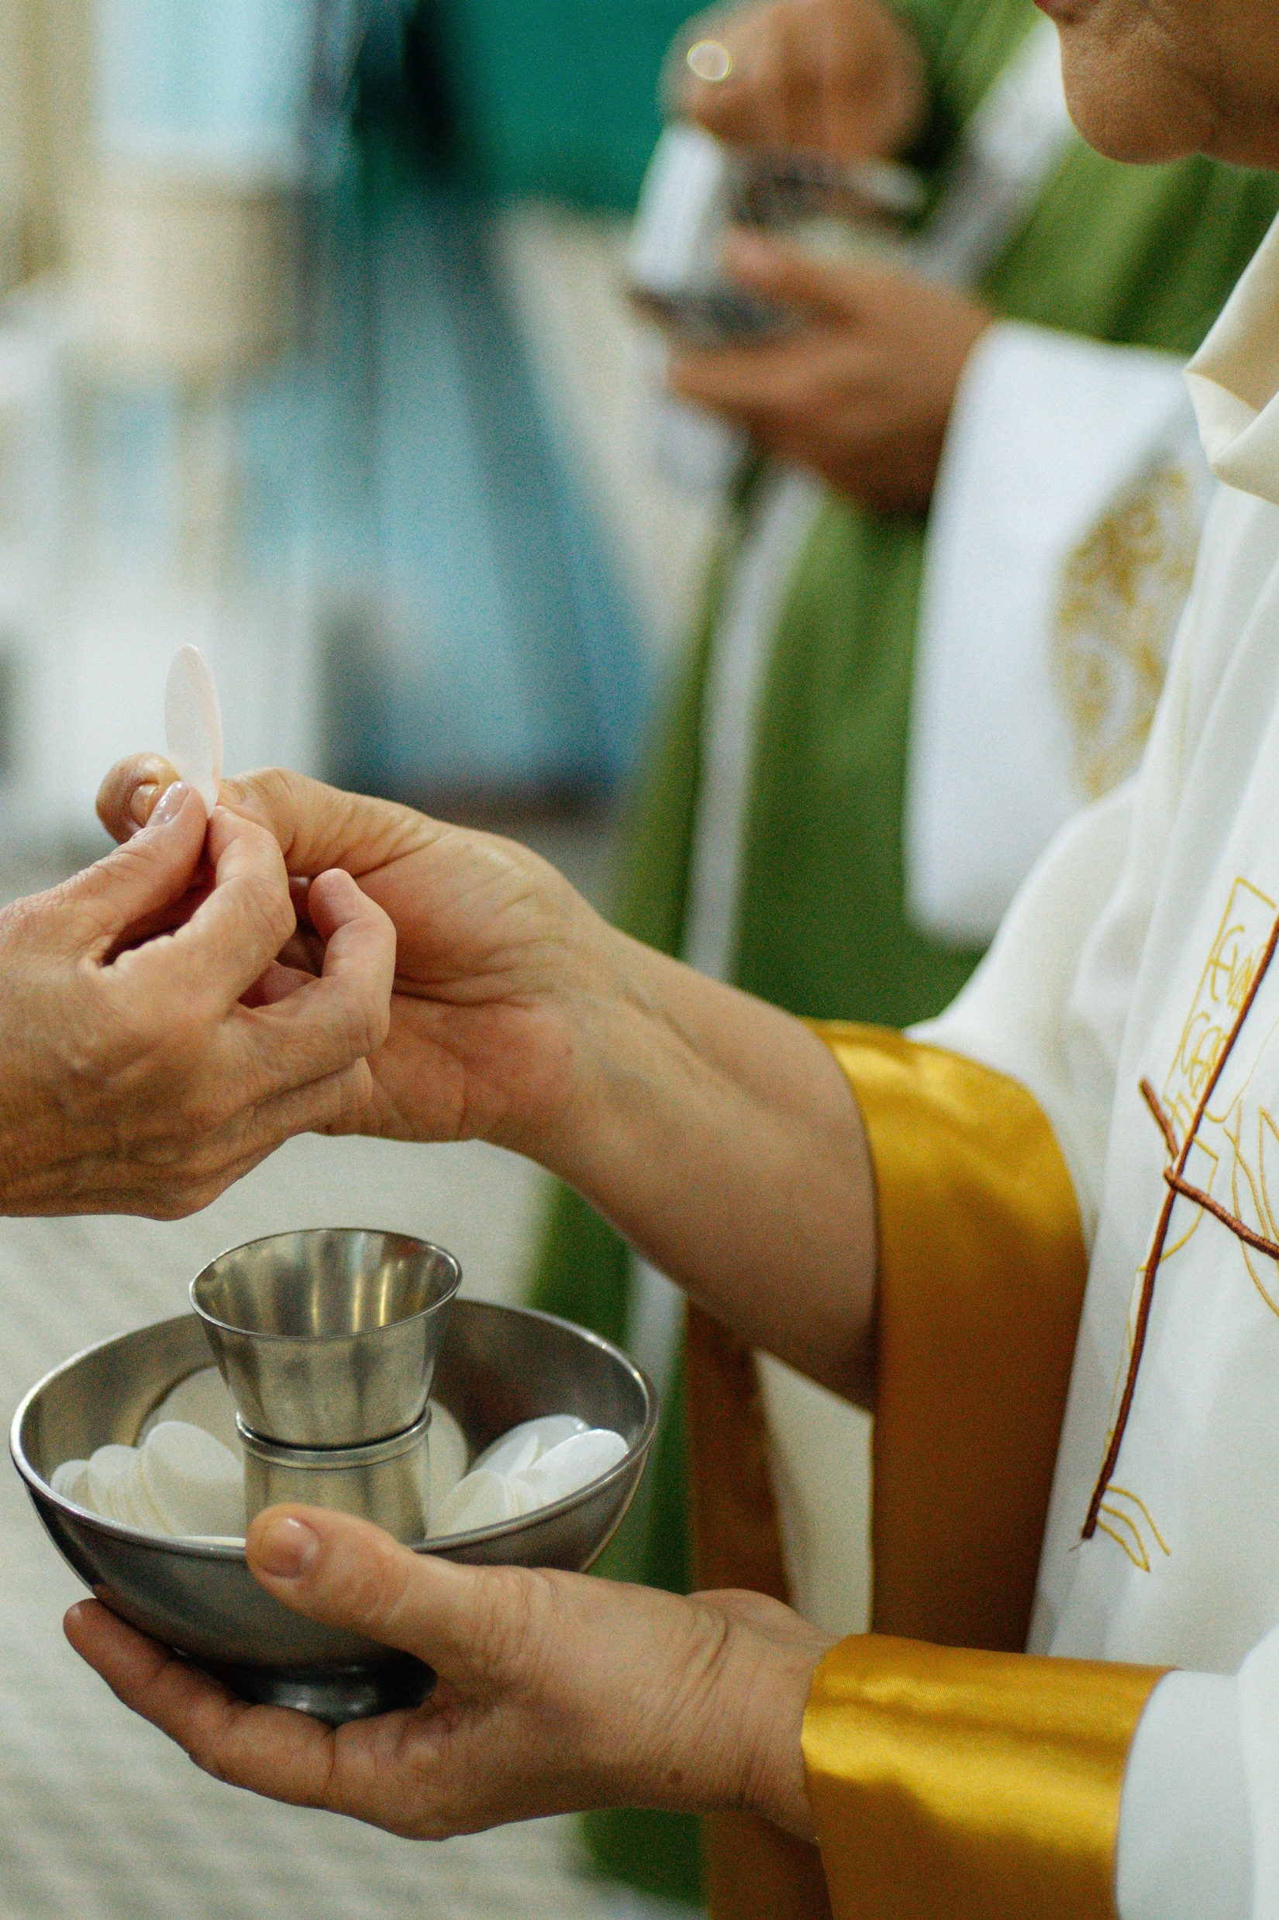

The Church must be a place of mercy freely given, where everyone can feel welcomed, loved, forgiven, and encouraged.
Pope Francis
Thays Orrico (@thaysnphotography)

Slide 2
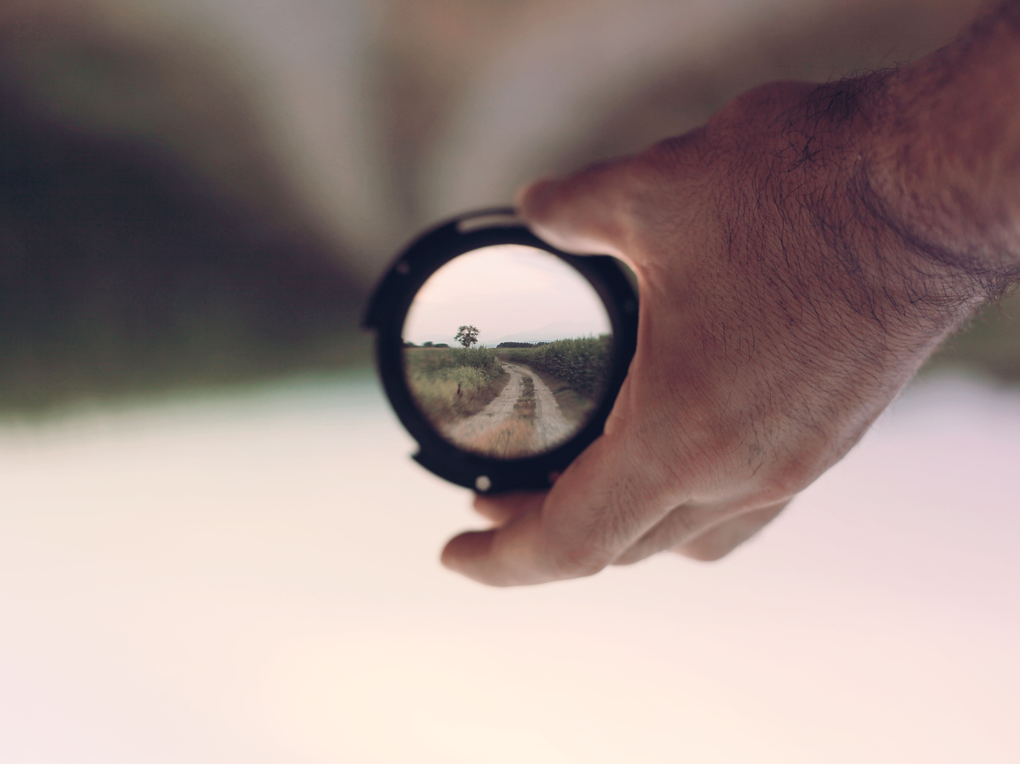
Adsumus is a journey of renewal that helps us better understand what our Baptism means.
SplitShire. (2014, June 26)

Slide 3

The peace of Christ calms life's storms, helps us go forward without fear. Pope Leo
Plenio (2019)

Slide 4
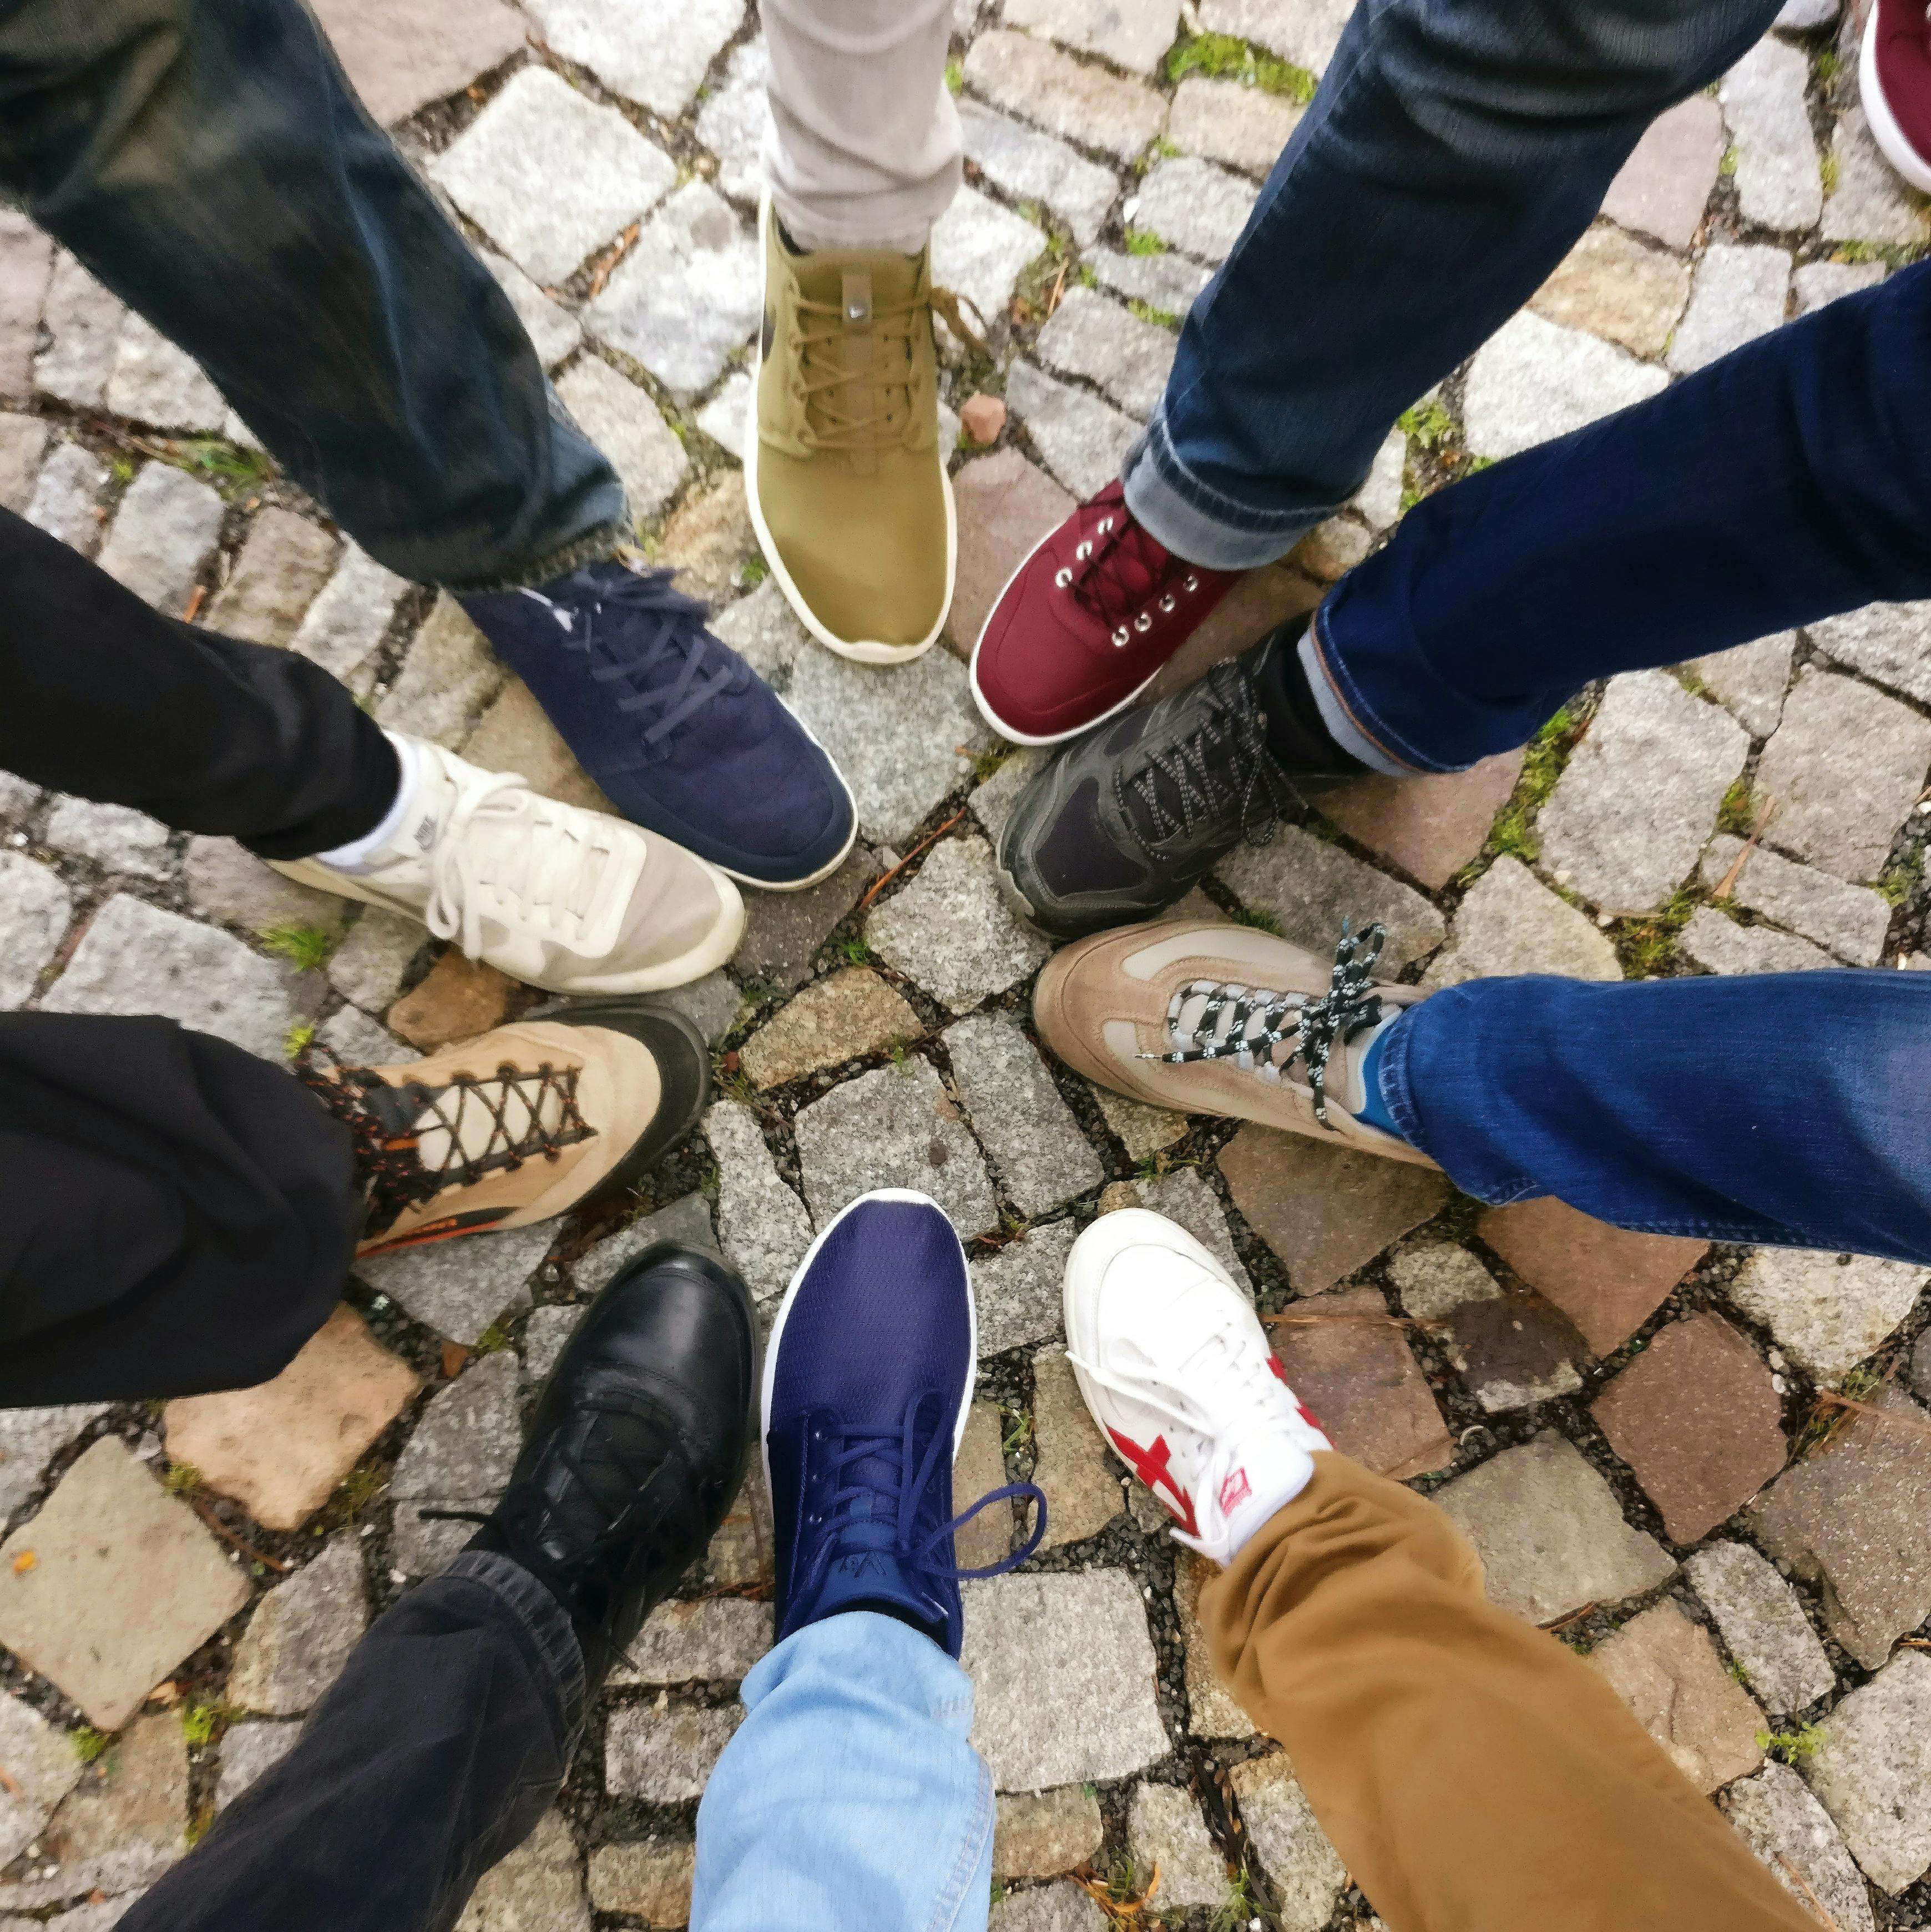
The Adsumus Initiative calls us to develop a real sense of community among each other in this - OUR Parish.
Joseph, I. (2017)

Slide 5

The heart of the Adsumus Initiative is the call to join our unique gifts to those of others and so bring God’s love to the world.
Pixabay. (2016)

Slide 6

We all possess unique gifts that, when combined, are powerful. It is together that we contribute to the greater good.
Skyrius (2019)

Slide 7
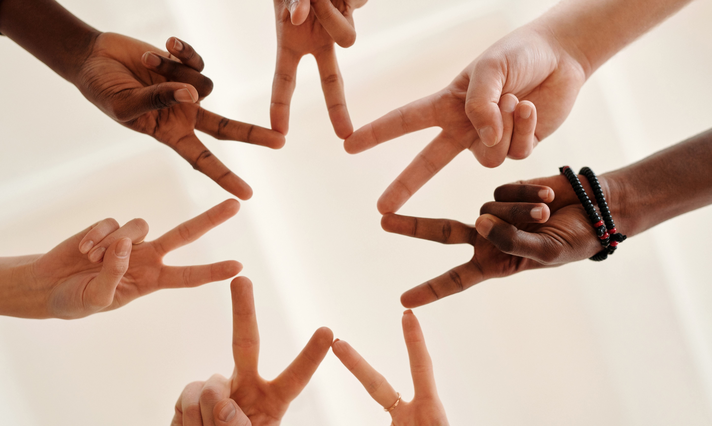
Follow Christ. Live His mission.
Plavalaguna, D. (2020)

Slide 8

What is Adsumus asking of me?
Singh, Y. (2020)

Slide 9
Picture Reference:
Image one
Thays Orrico (@thaysnphotography). (2024, March 23). A priest is holding a tablet in his hand [Photograph]. Unsplash. https://unsplash.com/photos/a-priest-is-holding-a-tablet-in-his-hand-VsmDIZU0zA4
Image two
SplitShire. (2014, June 26). Person holding lens focus photography. Pexels. https://www.pexels.com/photo/binocular-country-lane-filter-focus-1421/
Slide three
Plenio, J. (2019, April 17). Boat out at sea at dusk [Photograph]. Pexels. https://www.pexels.com/photo/boat-out-at-sea-at-dusk-2128161/
Slide four
Joseph, I. (2017, October 24). People forming round by shoes [Photograph]. Pexels. https://www.pexels.com/photo/people-forming-round-by-shoes-609771/
Slide four
Pixabay. (2016, September 24). Tree with brunch and green leaves during sunset [Photograph]. Pexels. https://www.pexels.com/photo/tree-with-brunch-and-green-leaves-during-sunset-70365/
Slide five
Skyrius, D. (2019, April 23). Silhouette of Birds Flying over Body of Water [Photograph]. Pexels. https://www.pexels.com/photo/silhouette-of-birds-flying-over-body-of-water-2129825/
Slide six
Plavalaguna, D. (2020, December 10). Hands forming a star [Photograph]. Pexels. https://www.pexels.com/photo/hands-forming-a-star-6146696/
Slide seven
Singh, Y. (2020, September 19). A smiling little girl doing a thumbs up [Photograph]. Pexels. https://www.pexels.com/photo/a-smiling-little-girl-doing-a-thumbs-up-4384676

