Slide 1
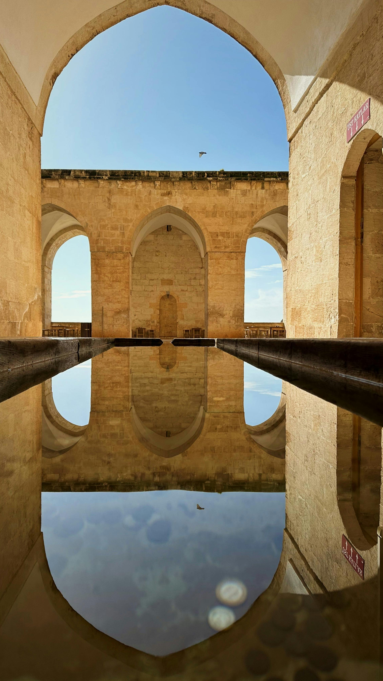

The nice thing about repetition is that it gives us an opportunity to take a second look at everything around us before we miss what it is meant to teach us.
Sr Joan Chittister
Eser Tokas (2024)

Slide 2
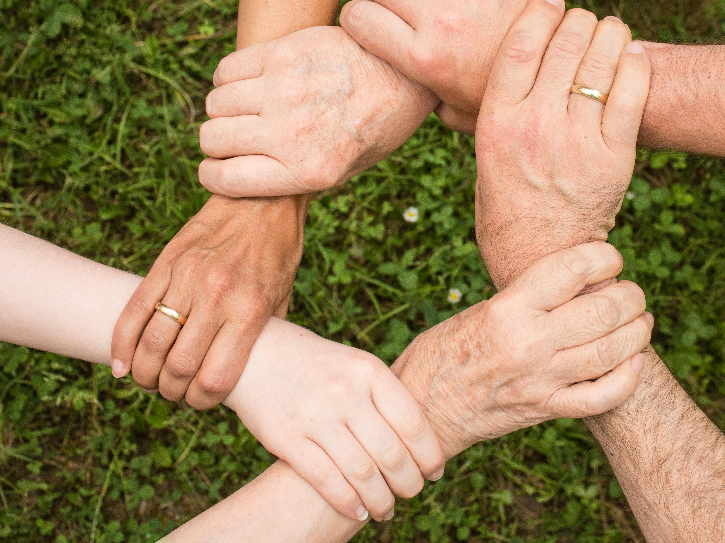
God has chosen us – Our Parish – to work with the Holy Spirit to bring love to our world
Anemone123, 2021

Slide 3

This Church family is a community for achieving together what we cannot achieve alone; for teaching the lessons of God’s love, forgiveness, and service.
Kyber, 2016

Slide 4
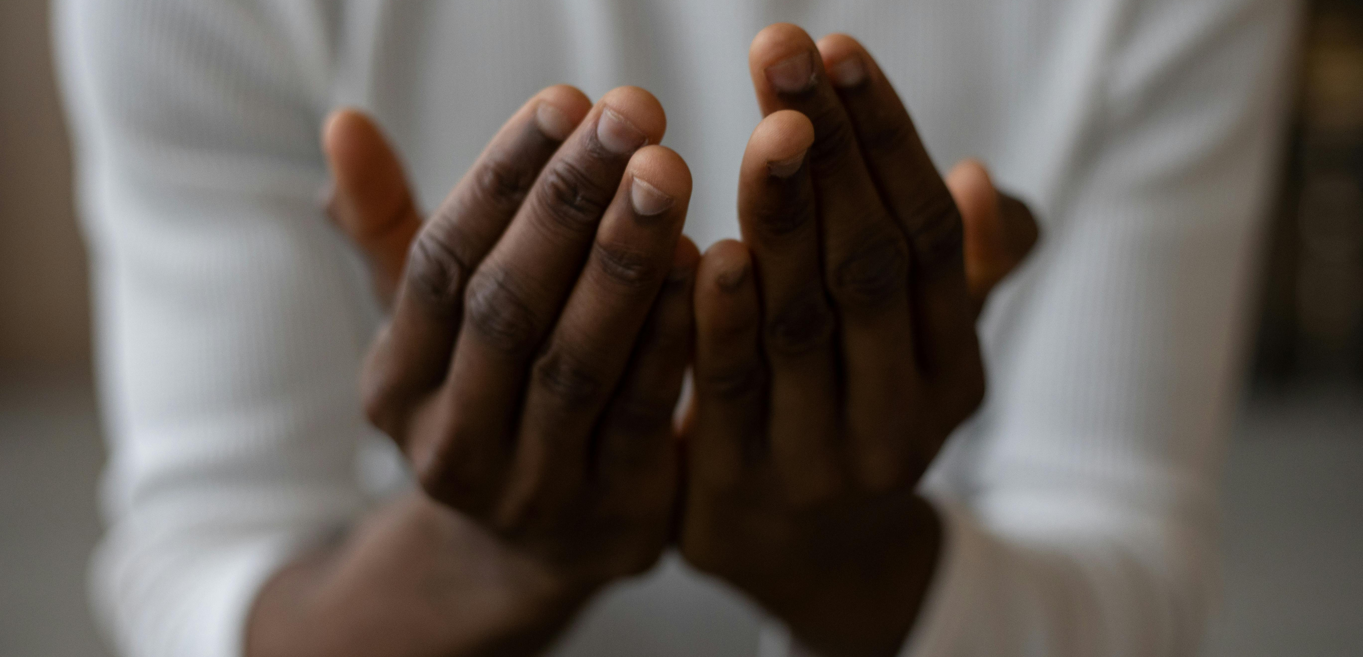
The Adsumus initiative asks us to put aside our fears and work with each other in this Parish to develop strong hands that will carry out God’s work.
Monstera. (n.d.)

Slide 5
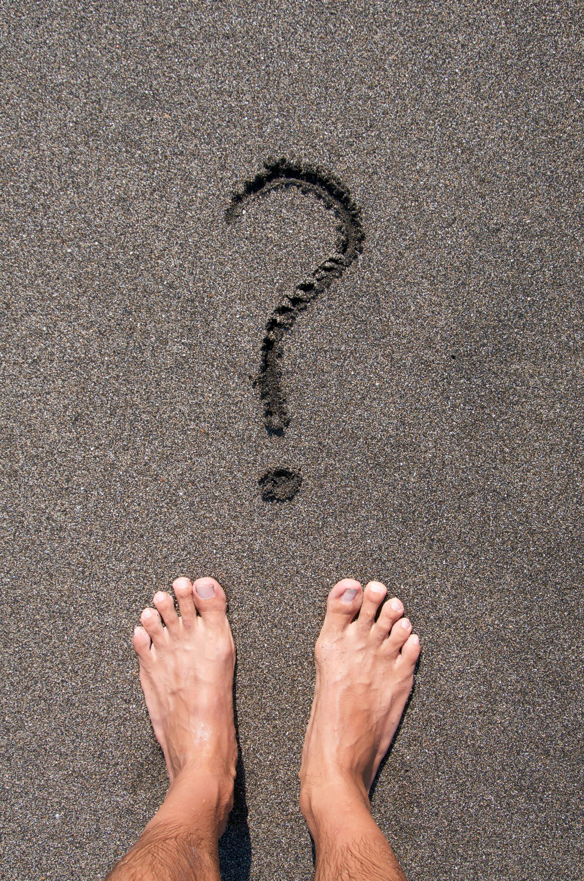
What is Adsumus asking of me?
Trottmann, M. (n.d.)

Slide 6
Image Reference
Slide one:
Eser Tokas. (2024). A reflection from the courtyard of Zinciriye Medrese. Pexels. https://www.pexels.com/photo/a-reflection-from-the-courtyard-of-zinciriye-medrese-20509971/
Slide two
Anemone123. (2021). Hands touching over grassland [Photograph]. Pexels. https://www.pexels.com/photo/hands-touching-over-grassland-10667763/
Slide three
Kyber, J. (2016, August 7). Selective focus photography of chains during golden hour [Photograph]. Pexels. https://www.pexels.com/photo/selective-focus-photoraphy-of-chains-during-golden-hour-119562/
Slide four
Monstera. (n.d.). [Person in white long-sleeved shirt with hands in prayer position] [Photograph]. Unsplash. https://unsplash.com/
Slide five
Trottmann, M. (n.d.). Person standing barefoot on black sand beach [Photograph]. Pexels. https://www.pexels.com/photo/person-standing-barefoot-on-black-sand-beach-5819302/

