Slide 1


Adsumus, Sancte Spiritus
We stand before You, O Holy Spirit, as we gather together in Your name.
With you alone to guide us, make yourself at home in our hearts.

Slide 2


Love is the only real proof you know God, because God is love.

Slide 3

Divine love flows in one constant, eternal direction.

Slide 4

God’s love is never earned, only returned—for love is repaid by love alone.

Slide 5
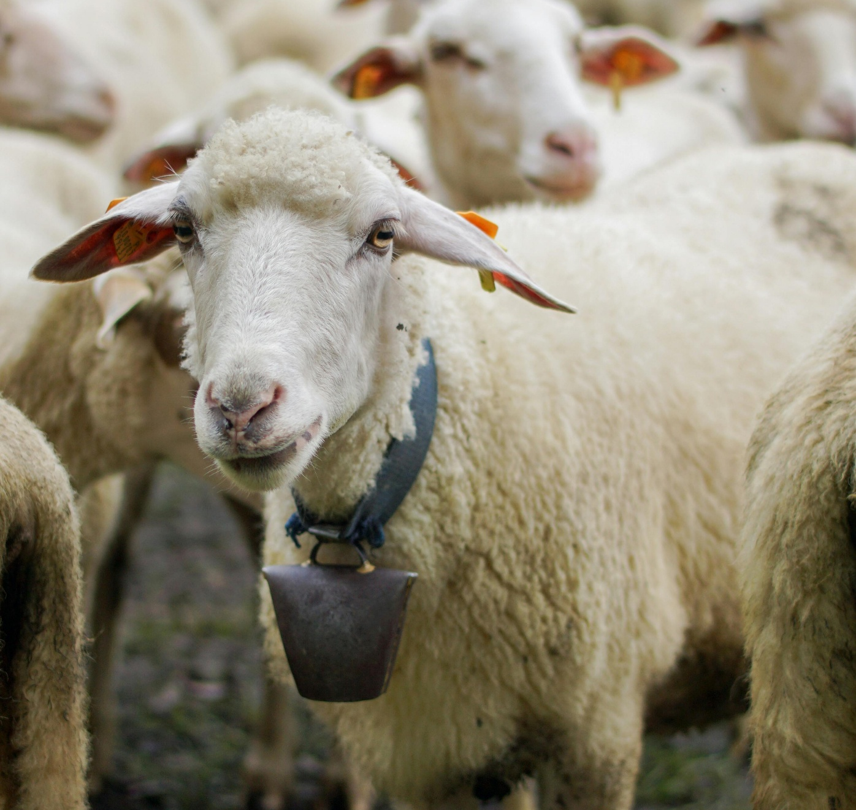
How can I share God’s love with my community?

Slide 6

How am I living and contributing as a parishioner?

Slide 7
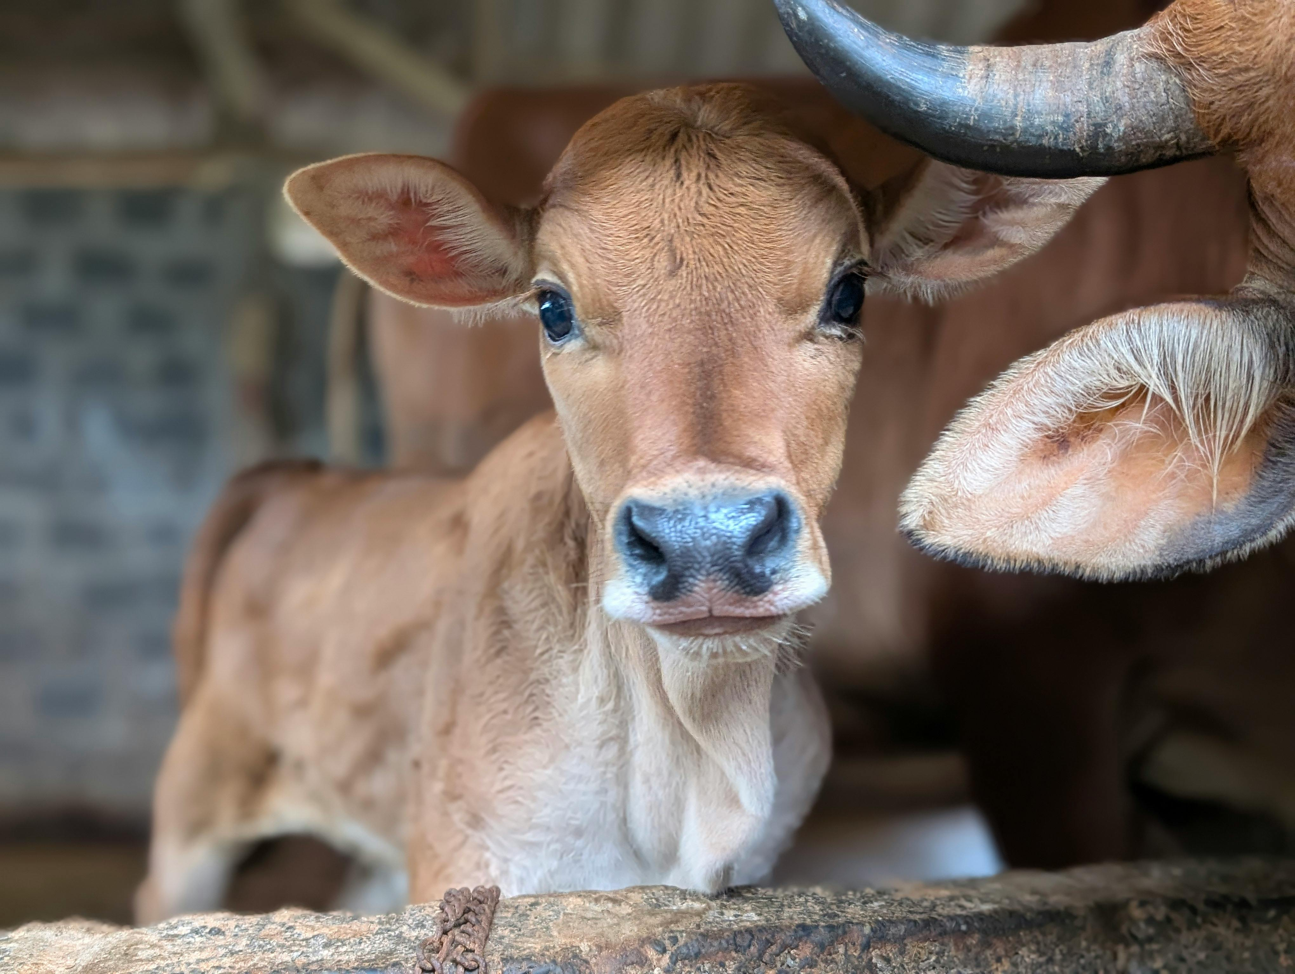
What is Adsumus asking of me?

