Slide 1


‘Adsumus, Sancte Spiritus’
‘We stand before You, O Holy Spirit, as we gather together in Your name.’

Slide 2
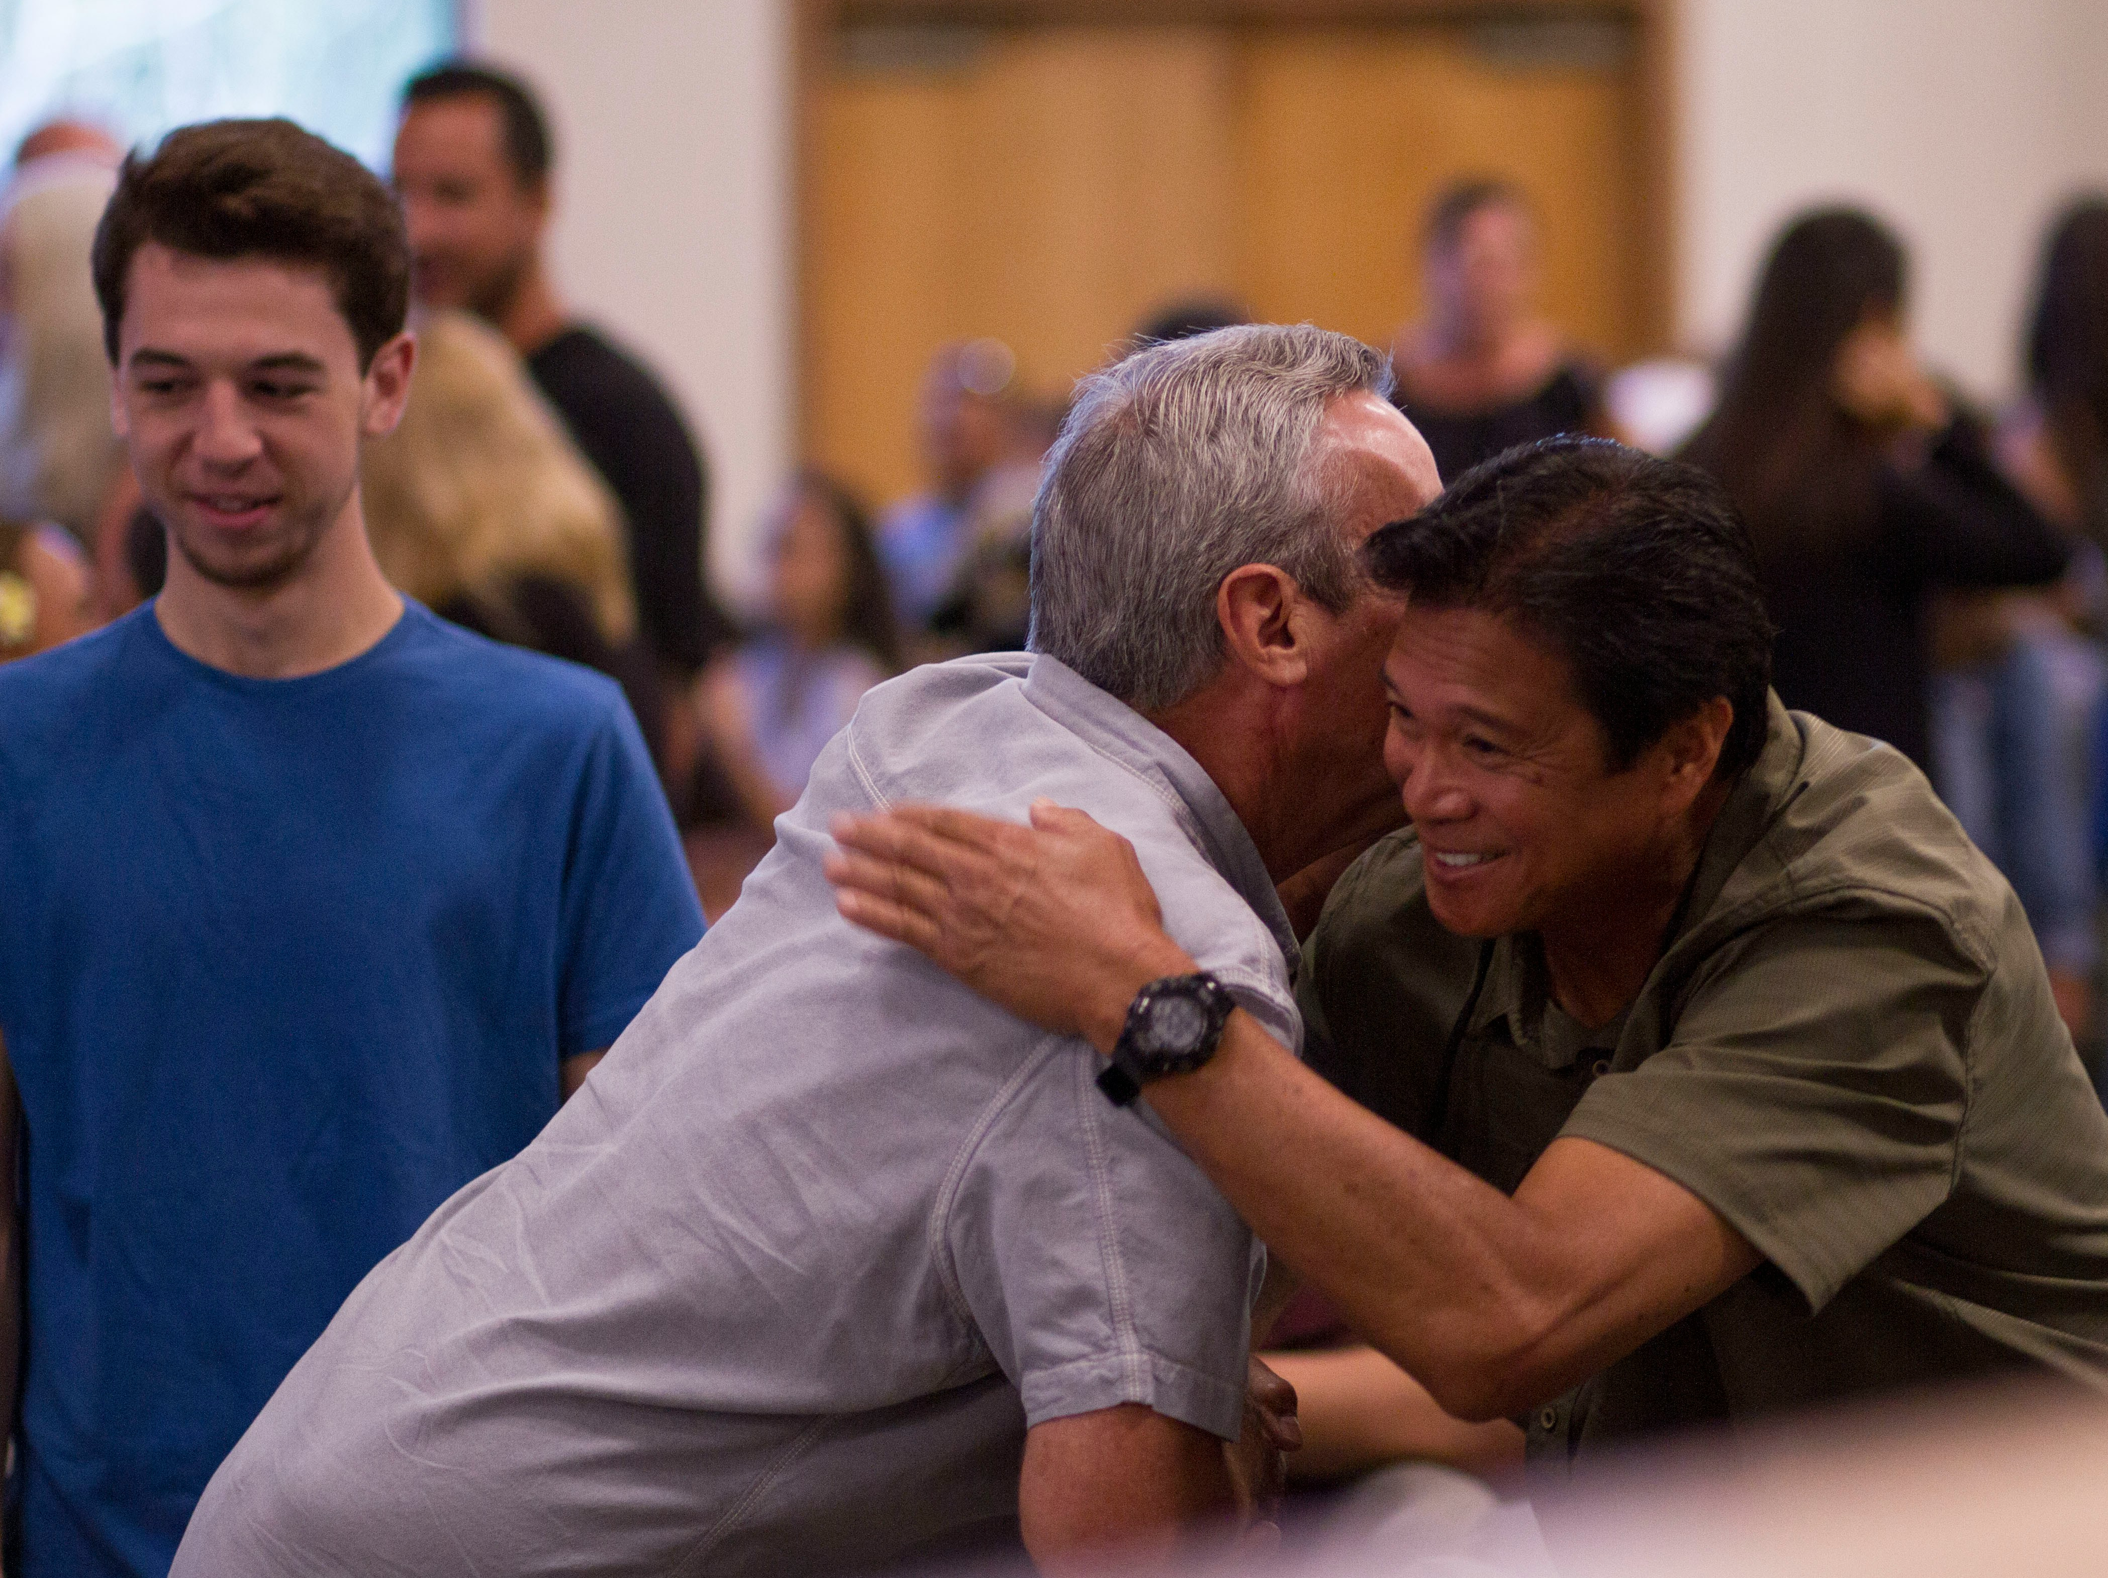
They were gathered into a unity of spirit that transcended their individualism

Slide 3
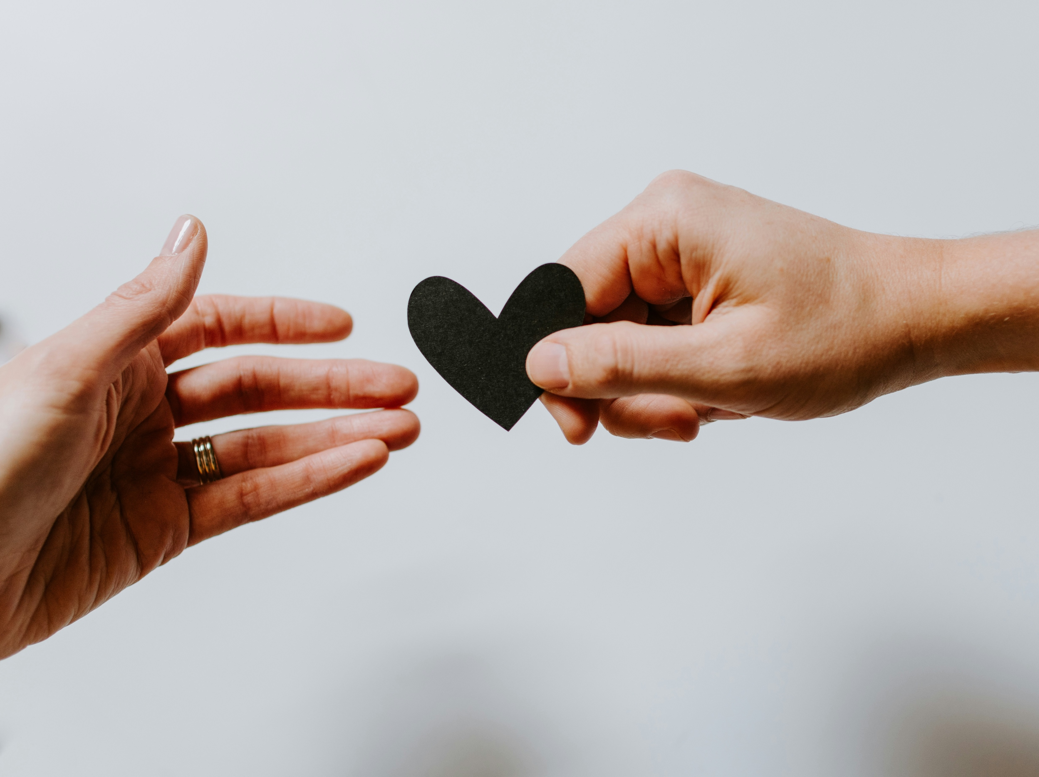
Community requires commitment.
It takes both God’s power and our effort to produce a loving Christian community

Slide 4


Only through constant, steady contact with others do we gain the self-knowledge needed to become who God calls us to be.

Slide 5
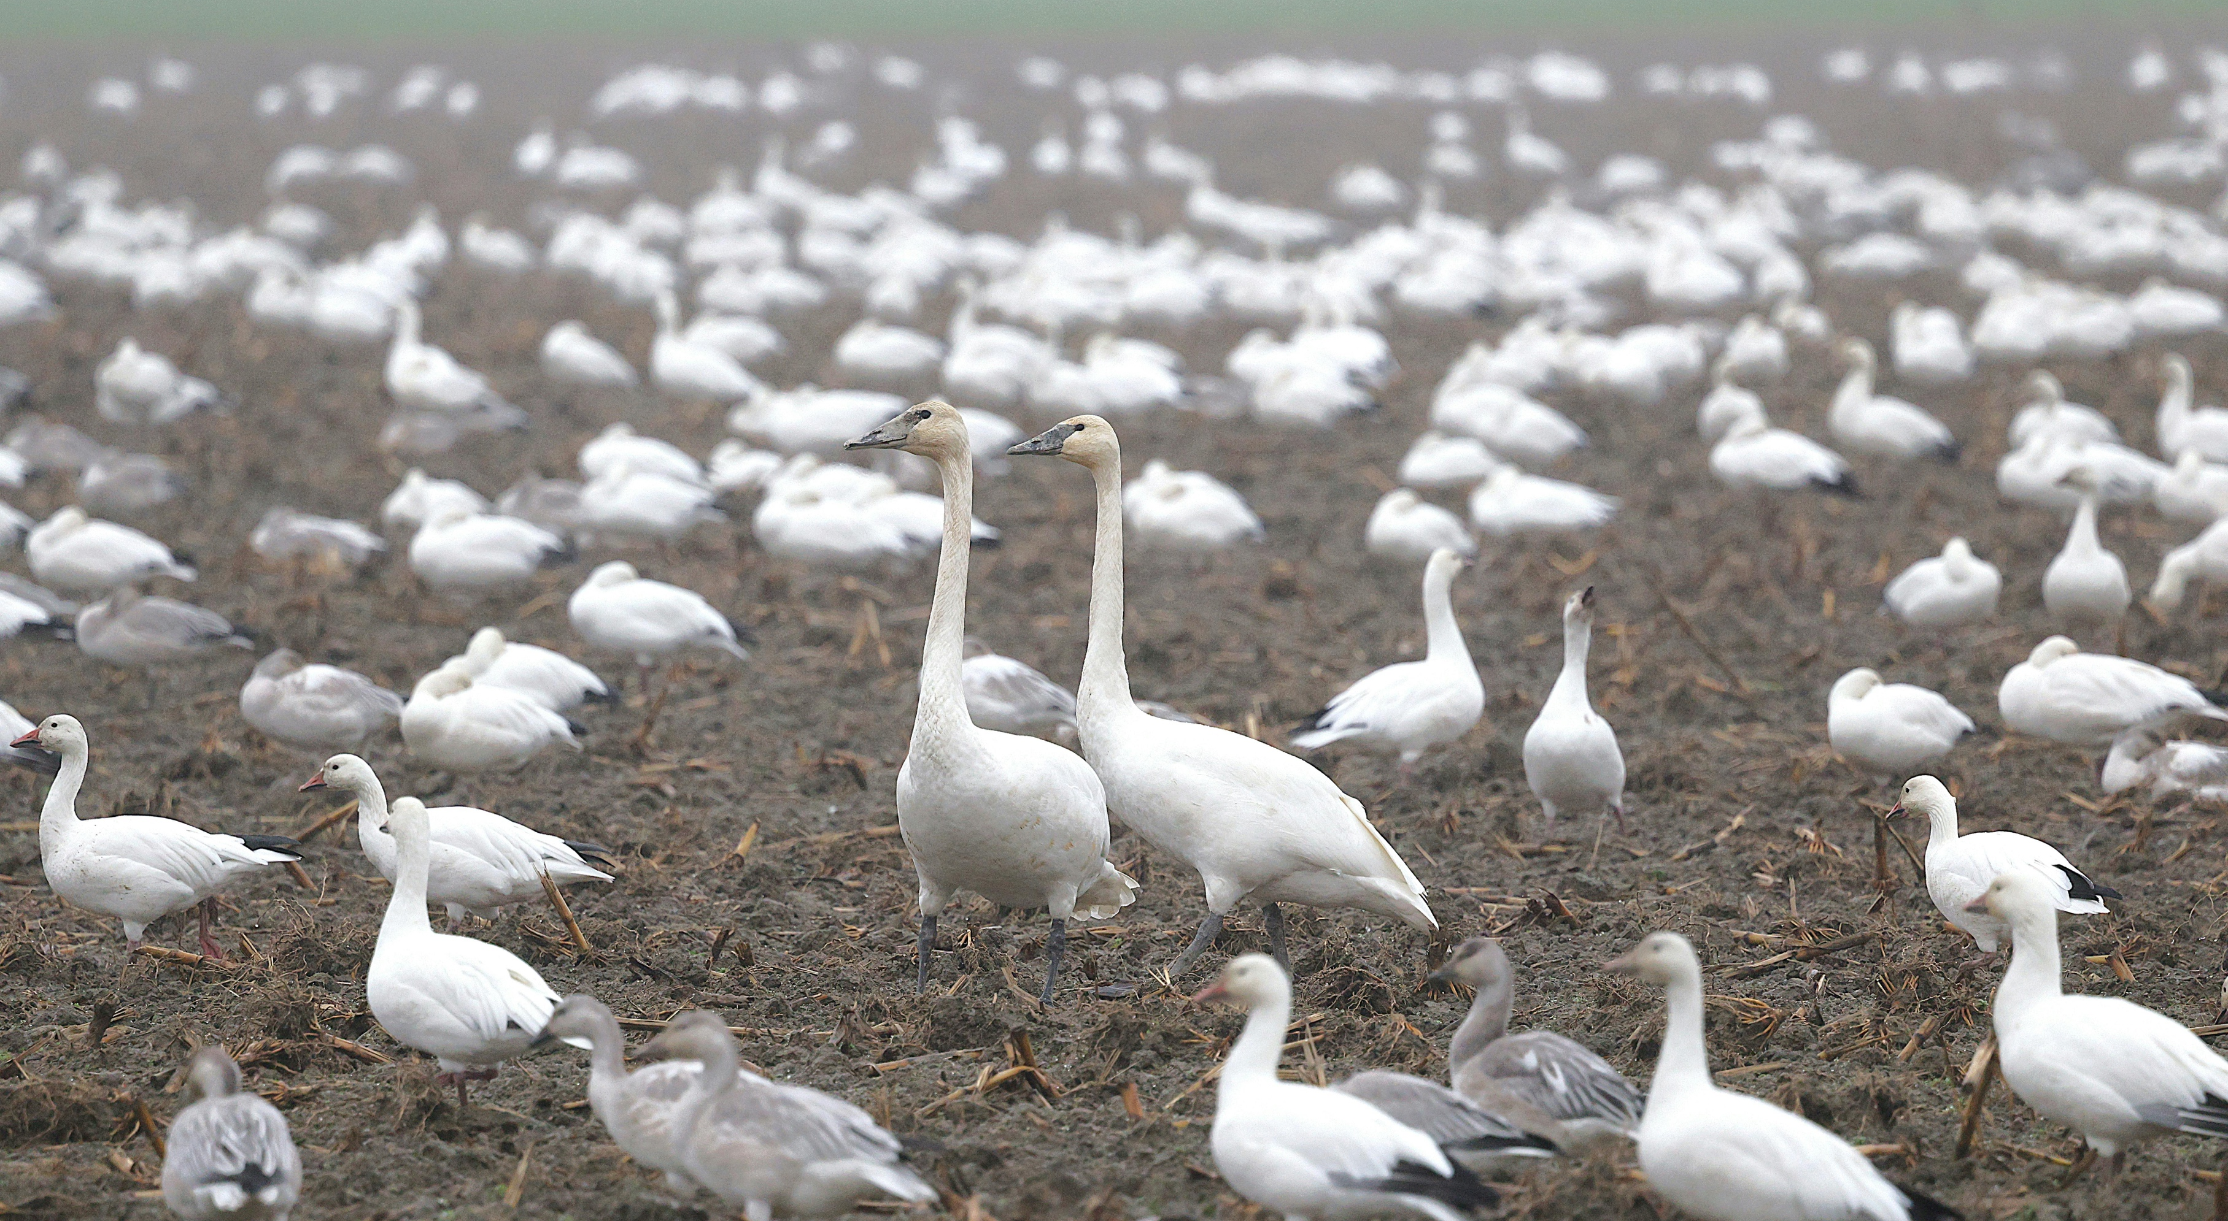
What is Adsumus asking of me?

Slide 6
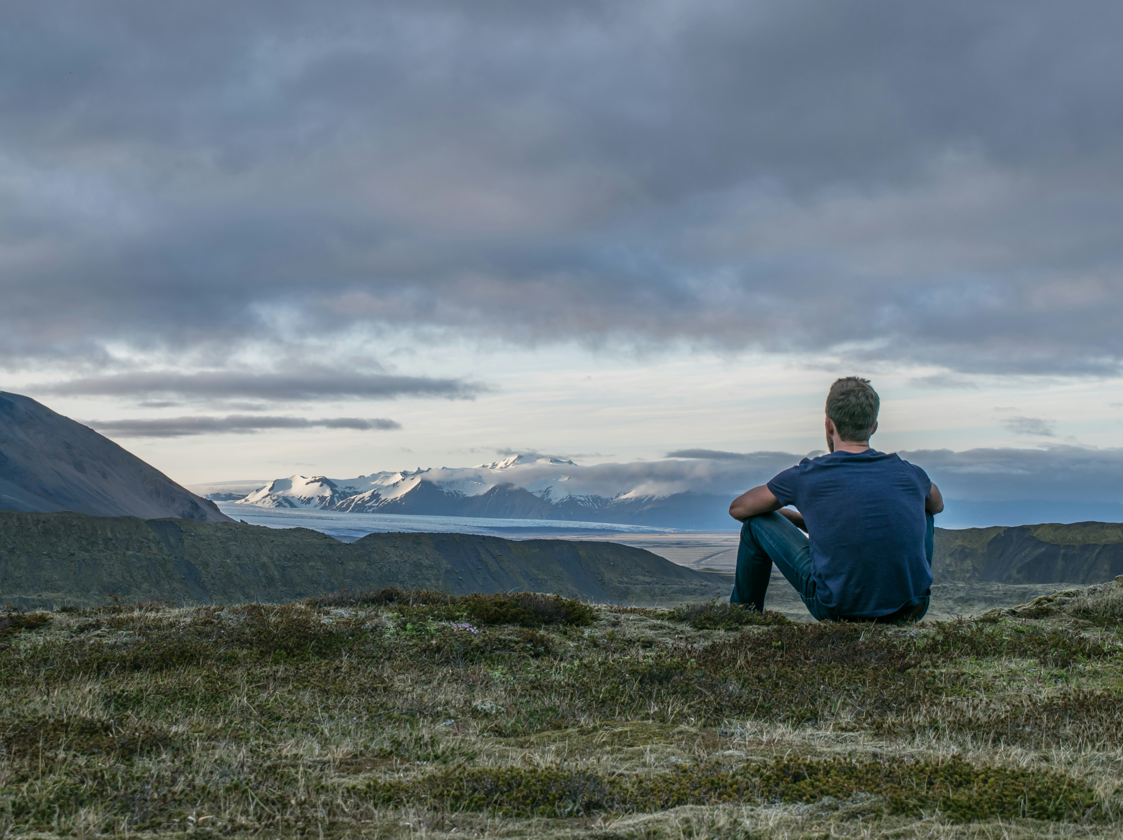
What is my role as a parishioner in this Parish?

