Slide 1


Adsumus, Sancte Spiritus
We stand before You, O Holy Spirit, as we gather together in Your name.
With you alone to guide us, make yourself at home in our hearts.
Teach us the way we must go and how we are to pursue it.
AMEN

Slide 2
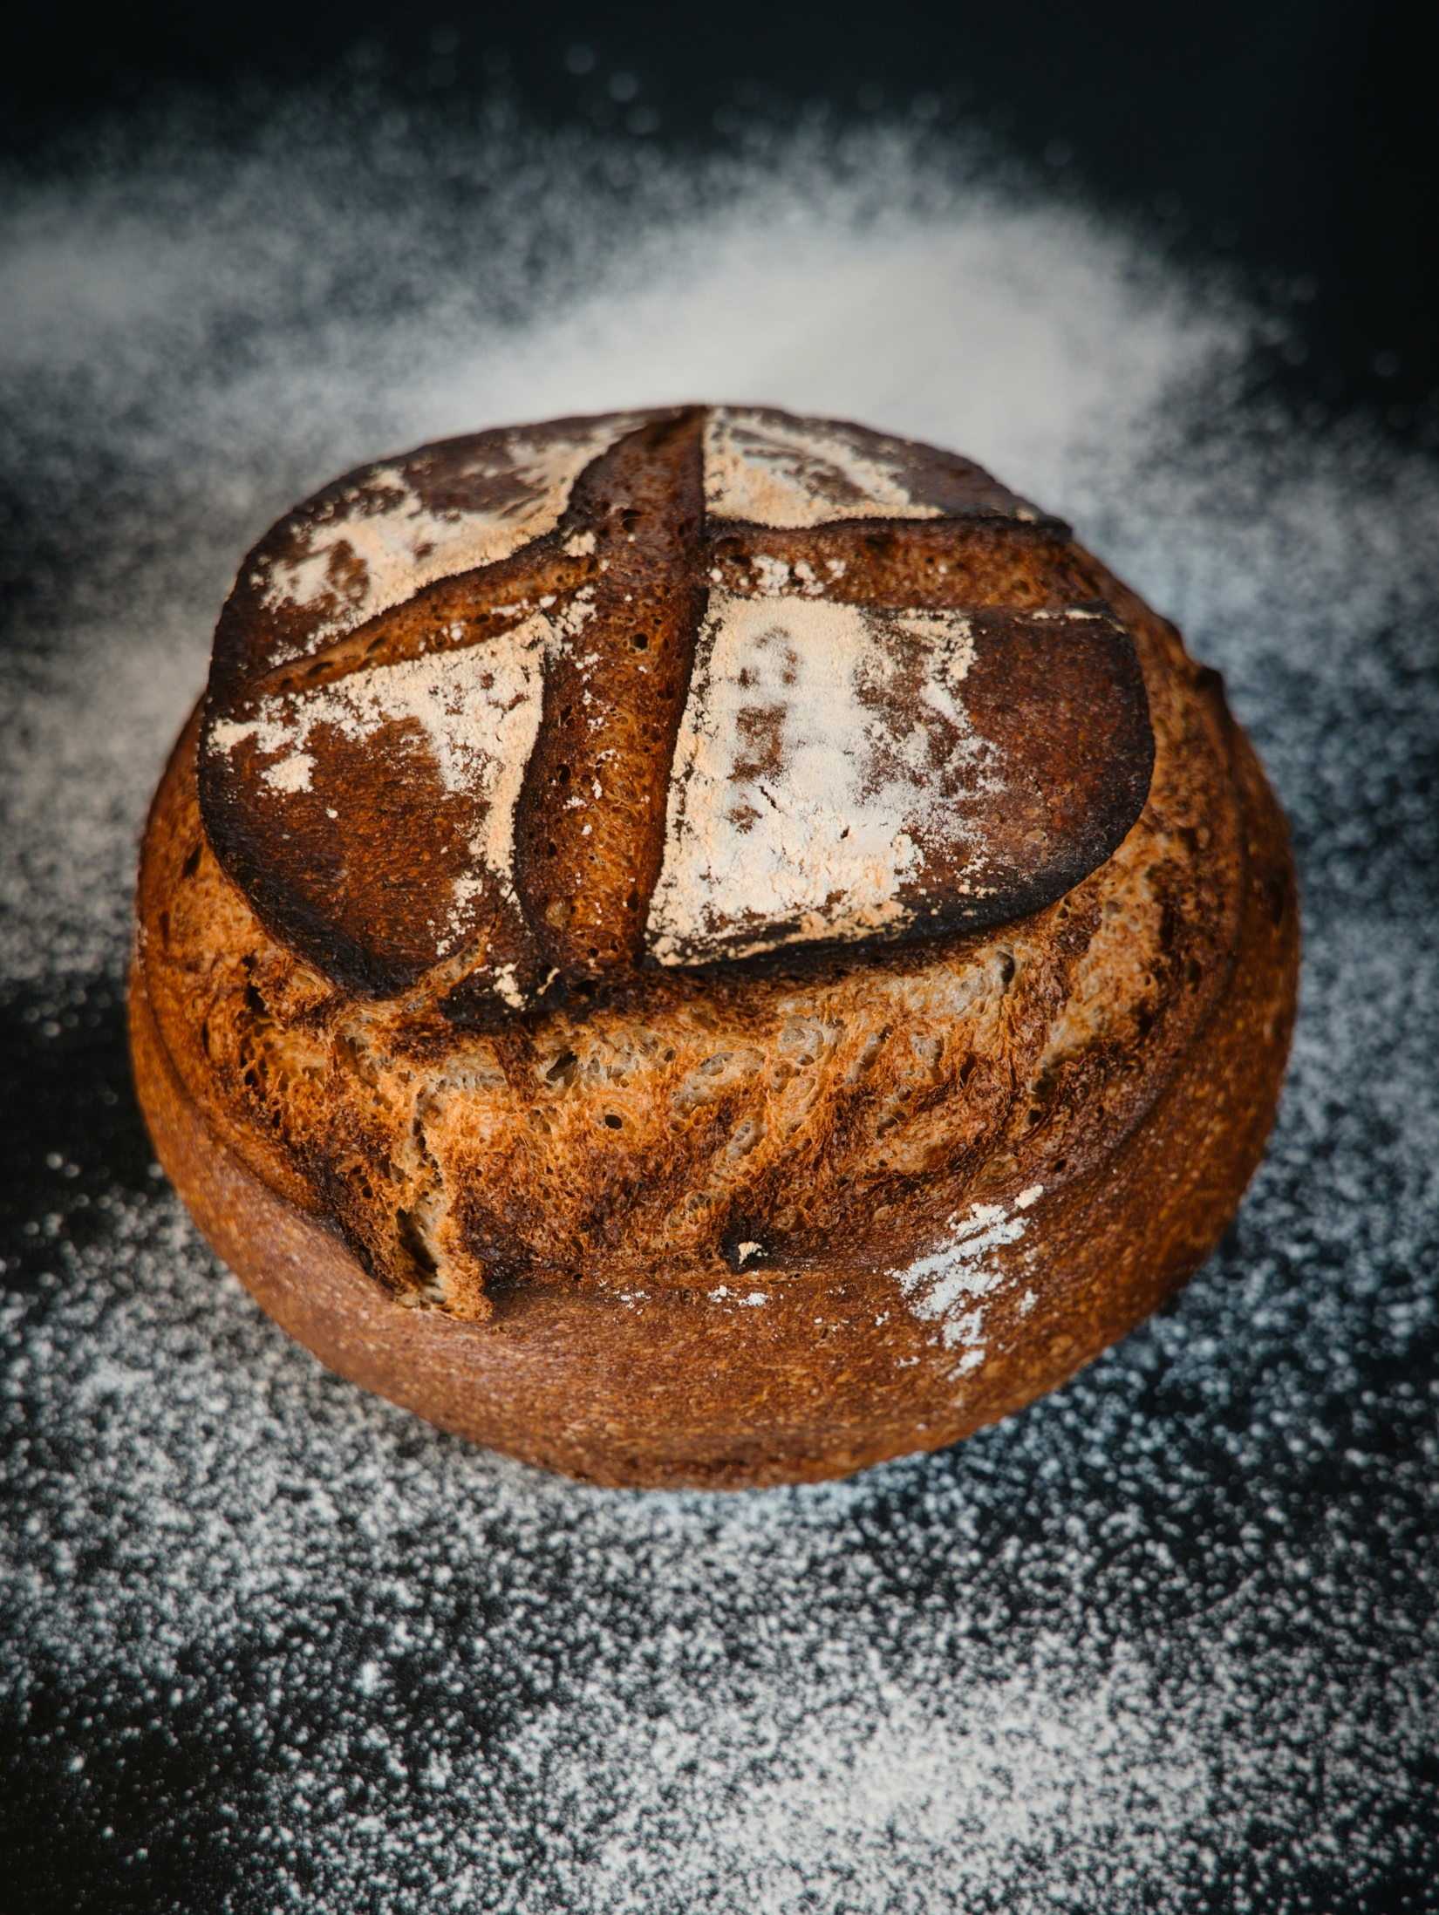
I am the Living Bread.

Slide 3
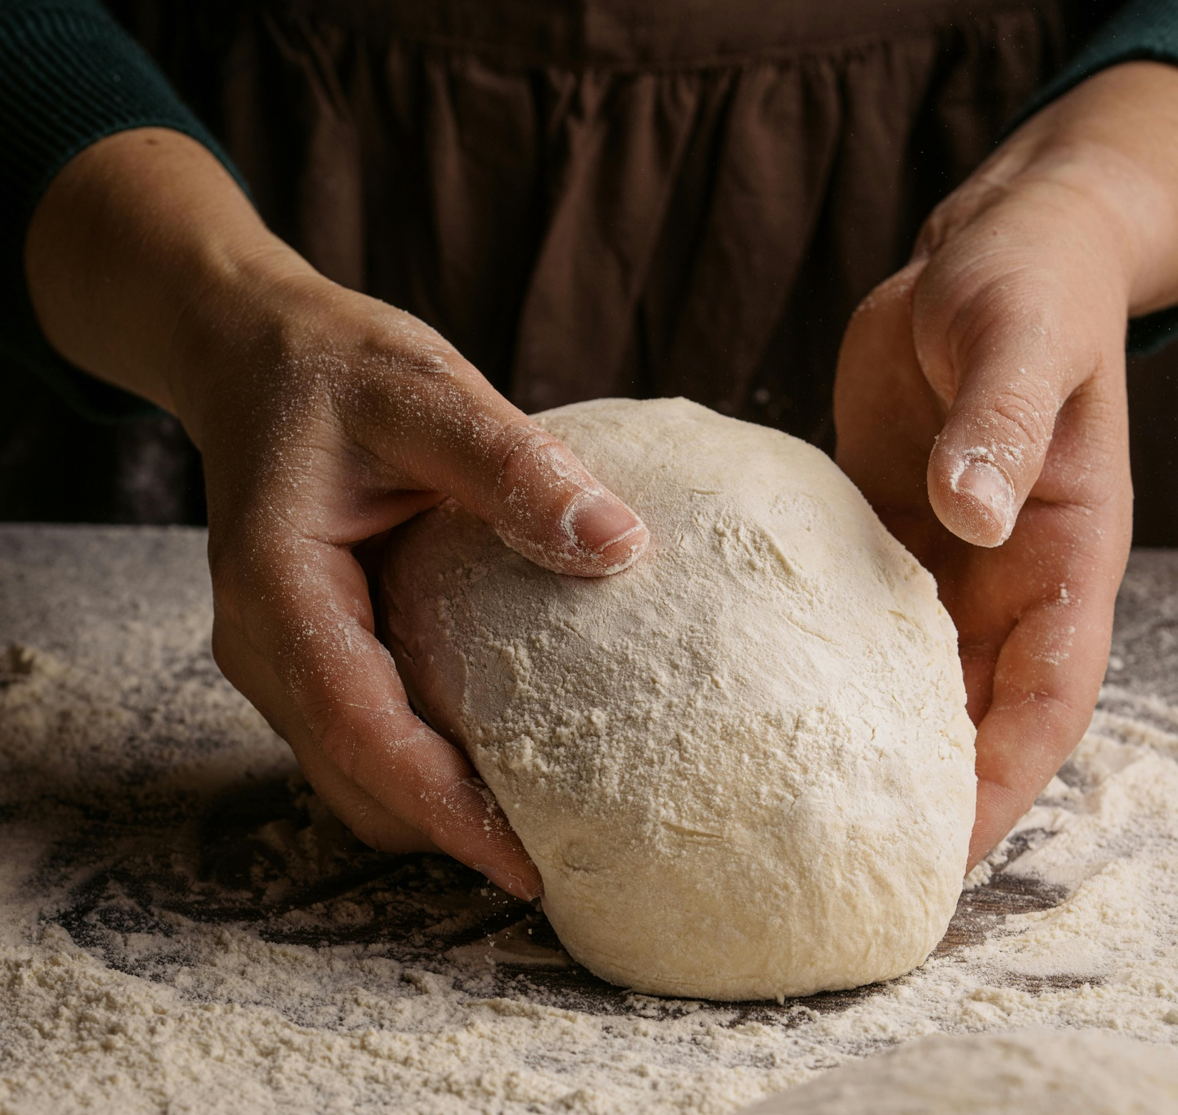
‘God provides the ingredients for our daily bread but expects us to do the baking.’
Chip Ingram

Slide 4

What are my needs on this journey with Christ?

Slide 5
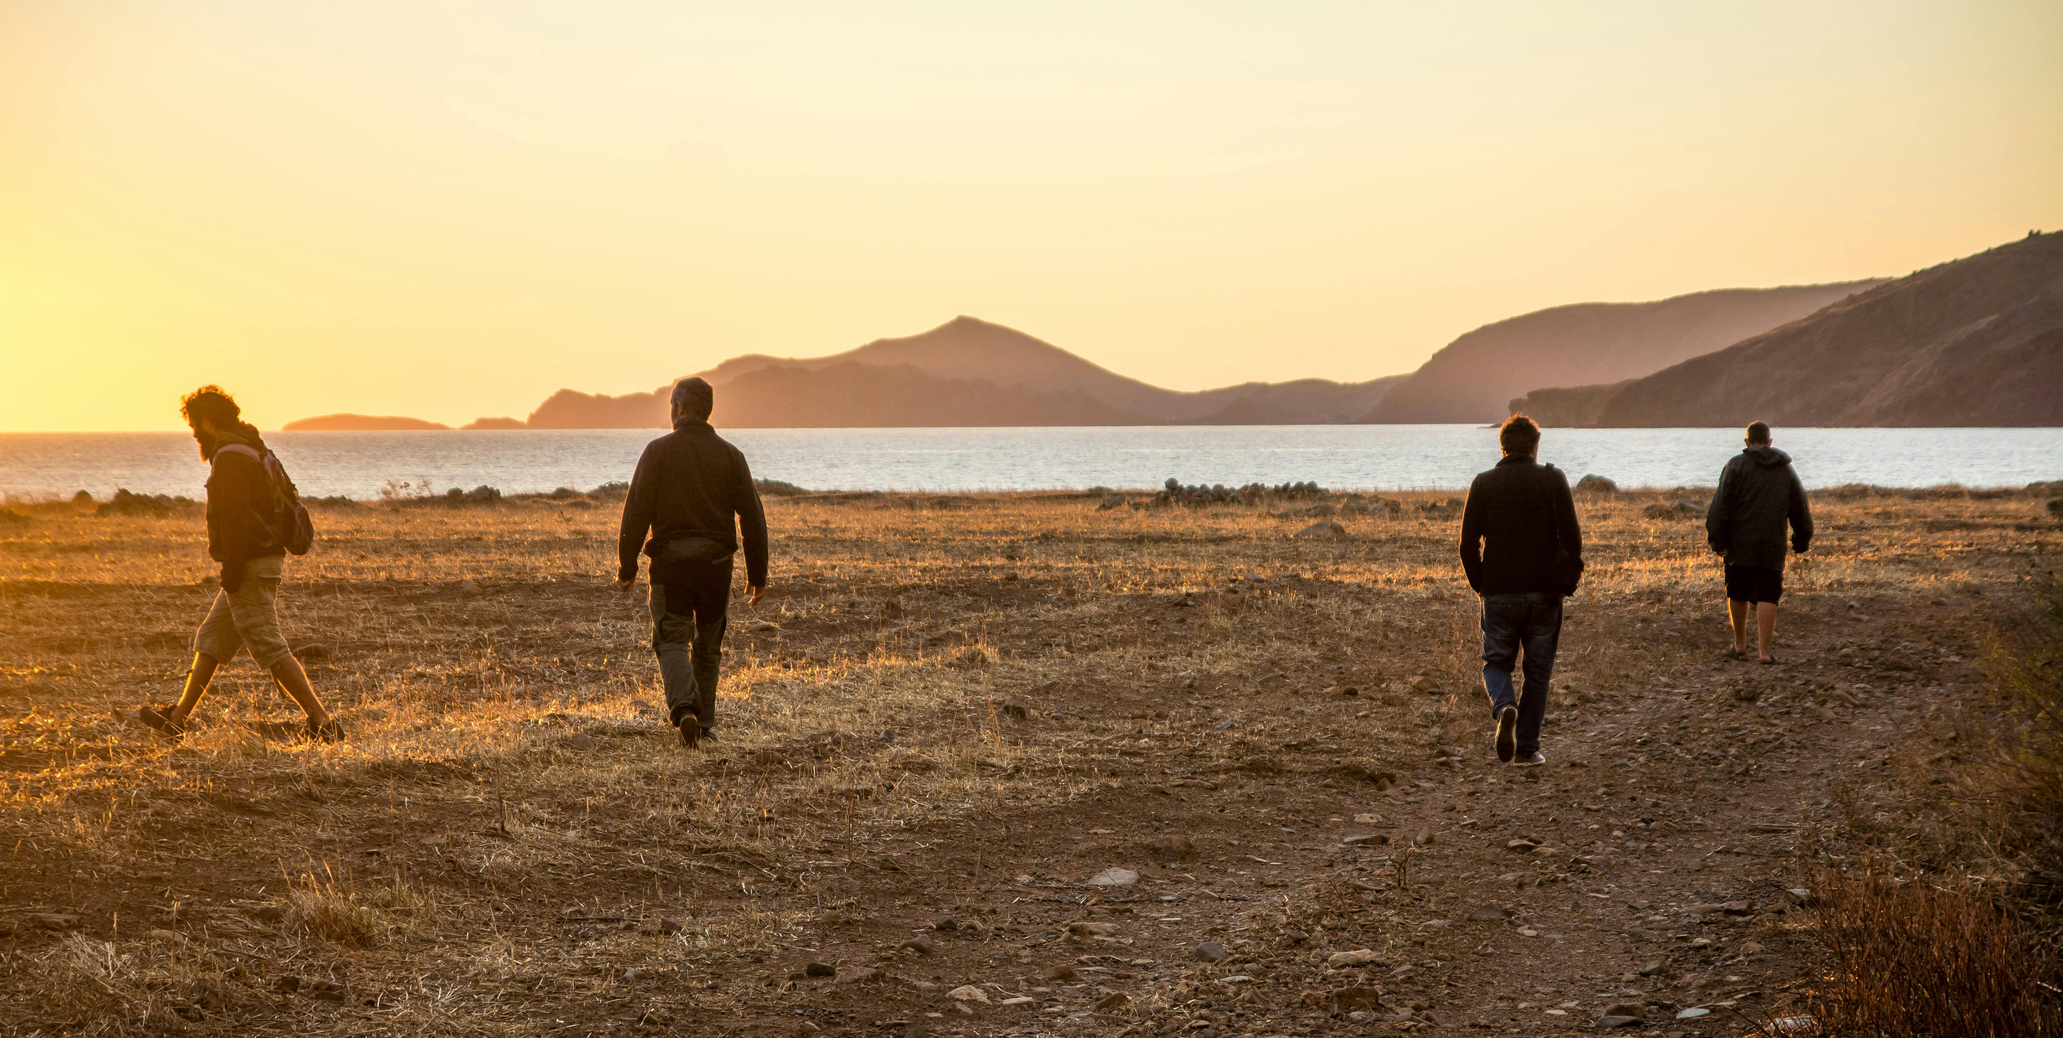
How well am I working with others on the Christian Journey?

Slide 6

What attachments currently shape my walk with Christ?

Slide 7

What is Adsumus asking of me?

Slide 8
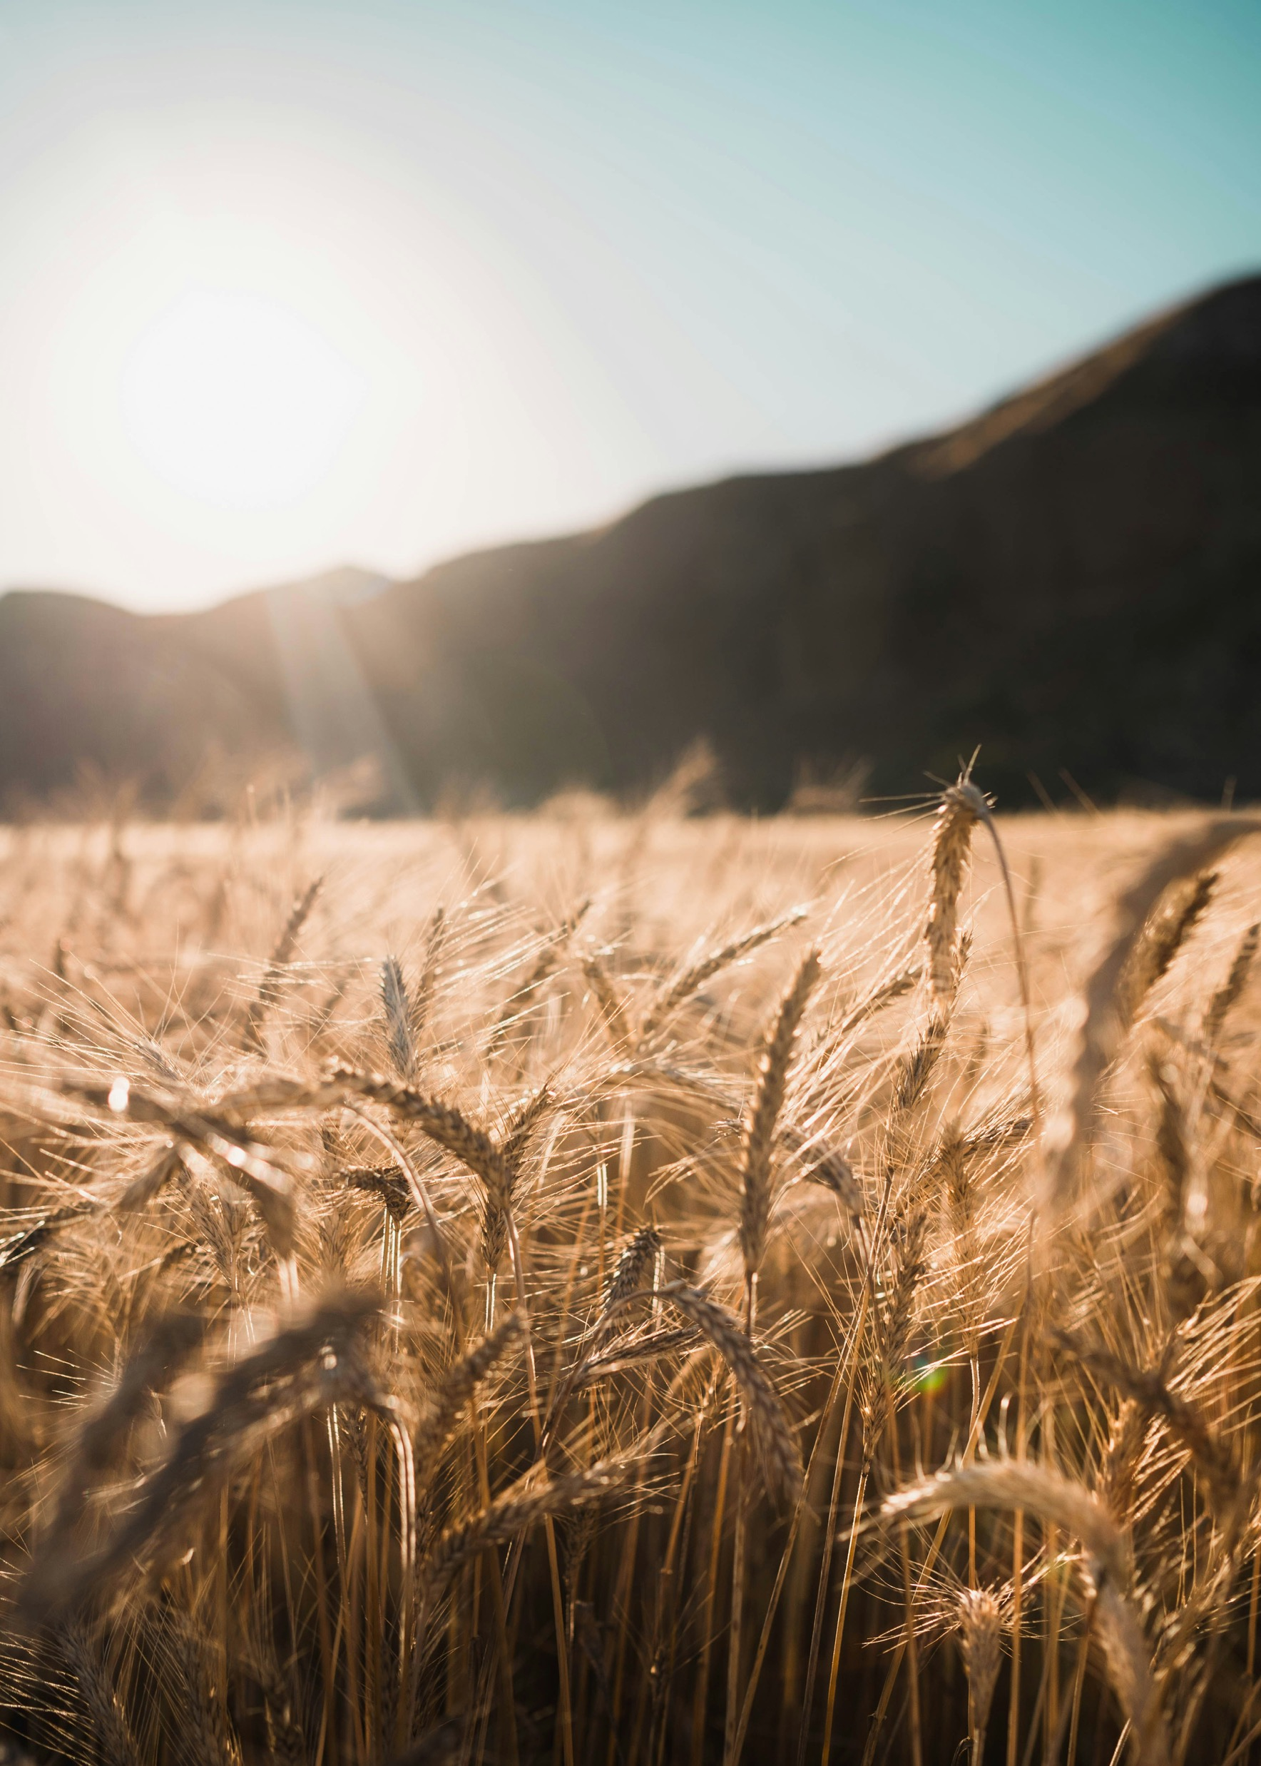
Wisdom 16:20
‘You nourished your people with food of angels and furnished them bread from heaven.’

