Slide 1
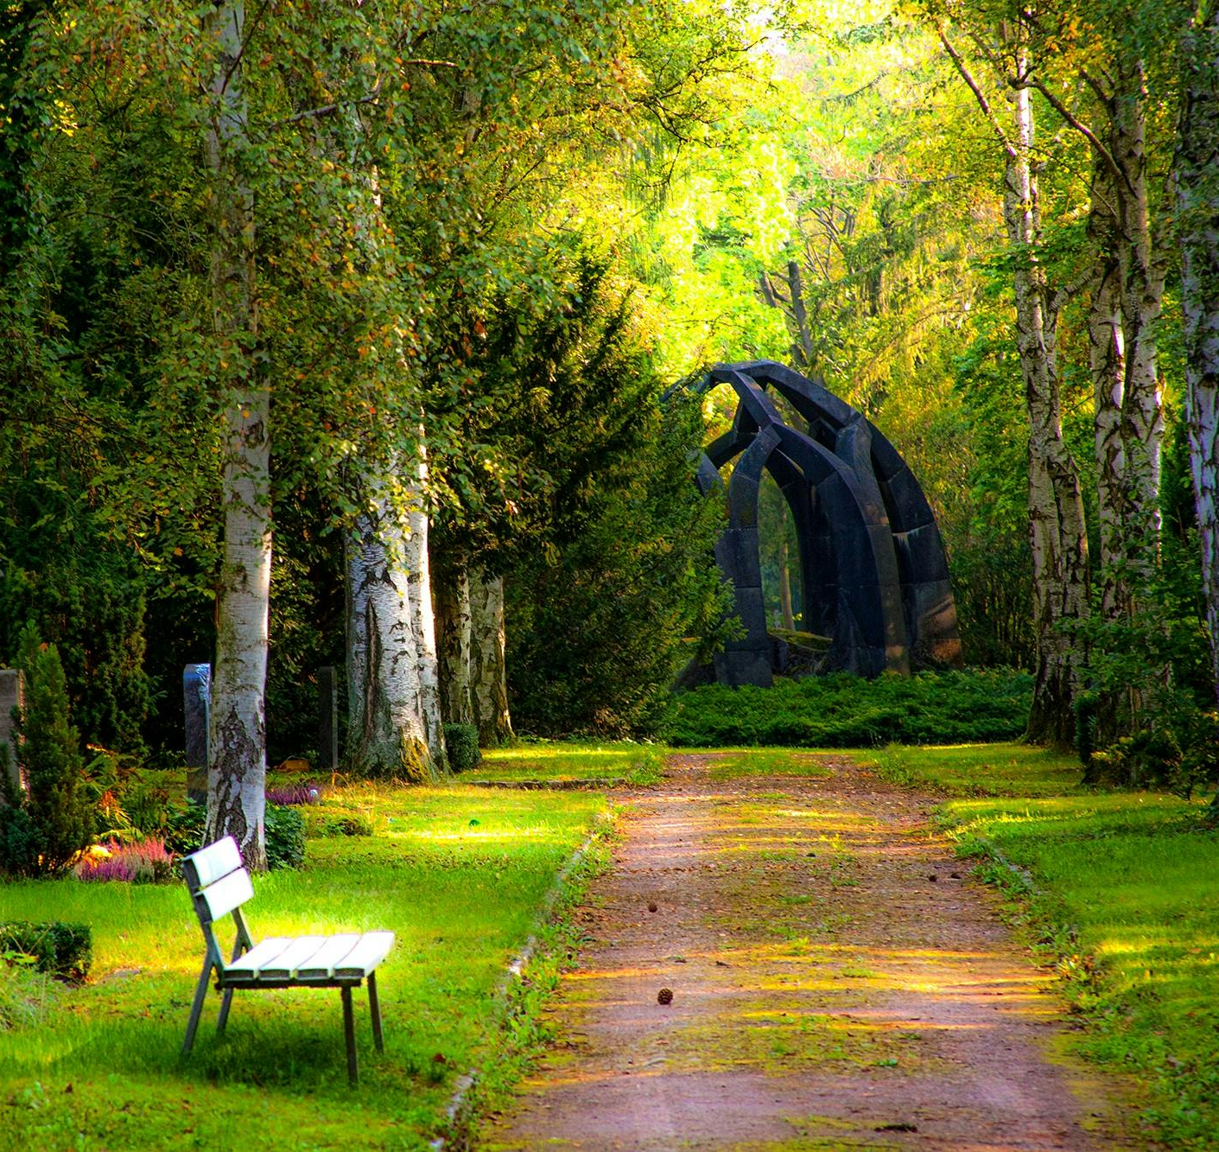

Lord help us open our hearts to Your presence in this sacred space.
We thank You for the gift of our parish family and ask Your blessing upon every soul gathered here today.
We pray especially for our visitors and those who are new to our community; may they feel the warmth of Your love through our welcome and find here a true spiritual home.
Strengthen the bonds of our parish, that we may grow together through Your grace in faith and service.
Amen.

Slide 2

The Kingdom of God is a hidden treasure, priceless and found by hearts that truly seek.

Slide 3

FAITH:
More valuable than gold.

Slide 4
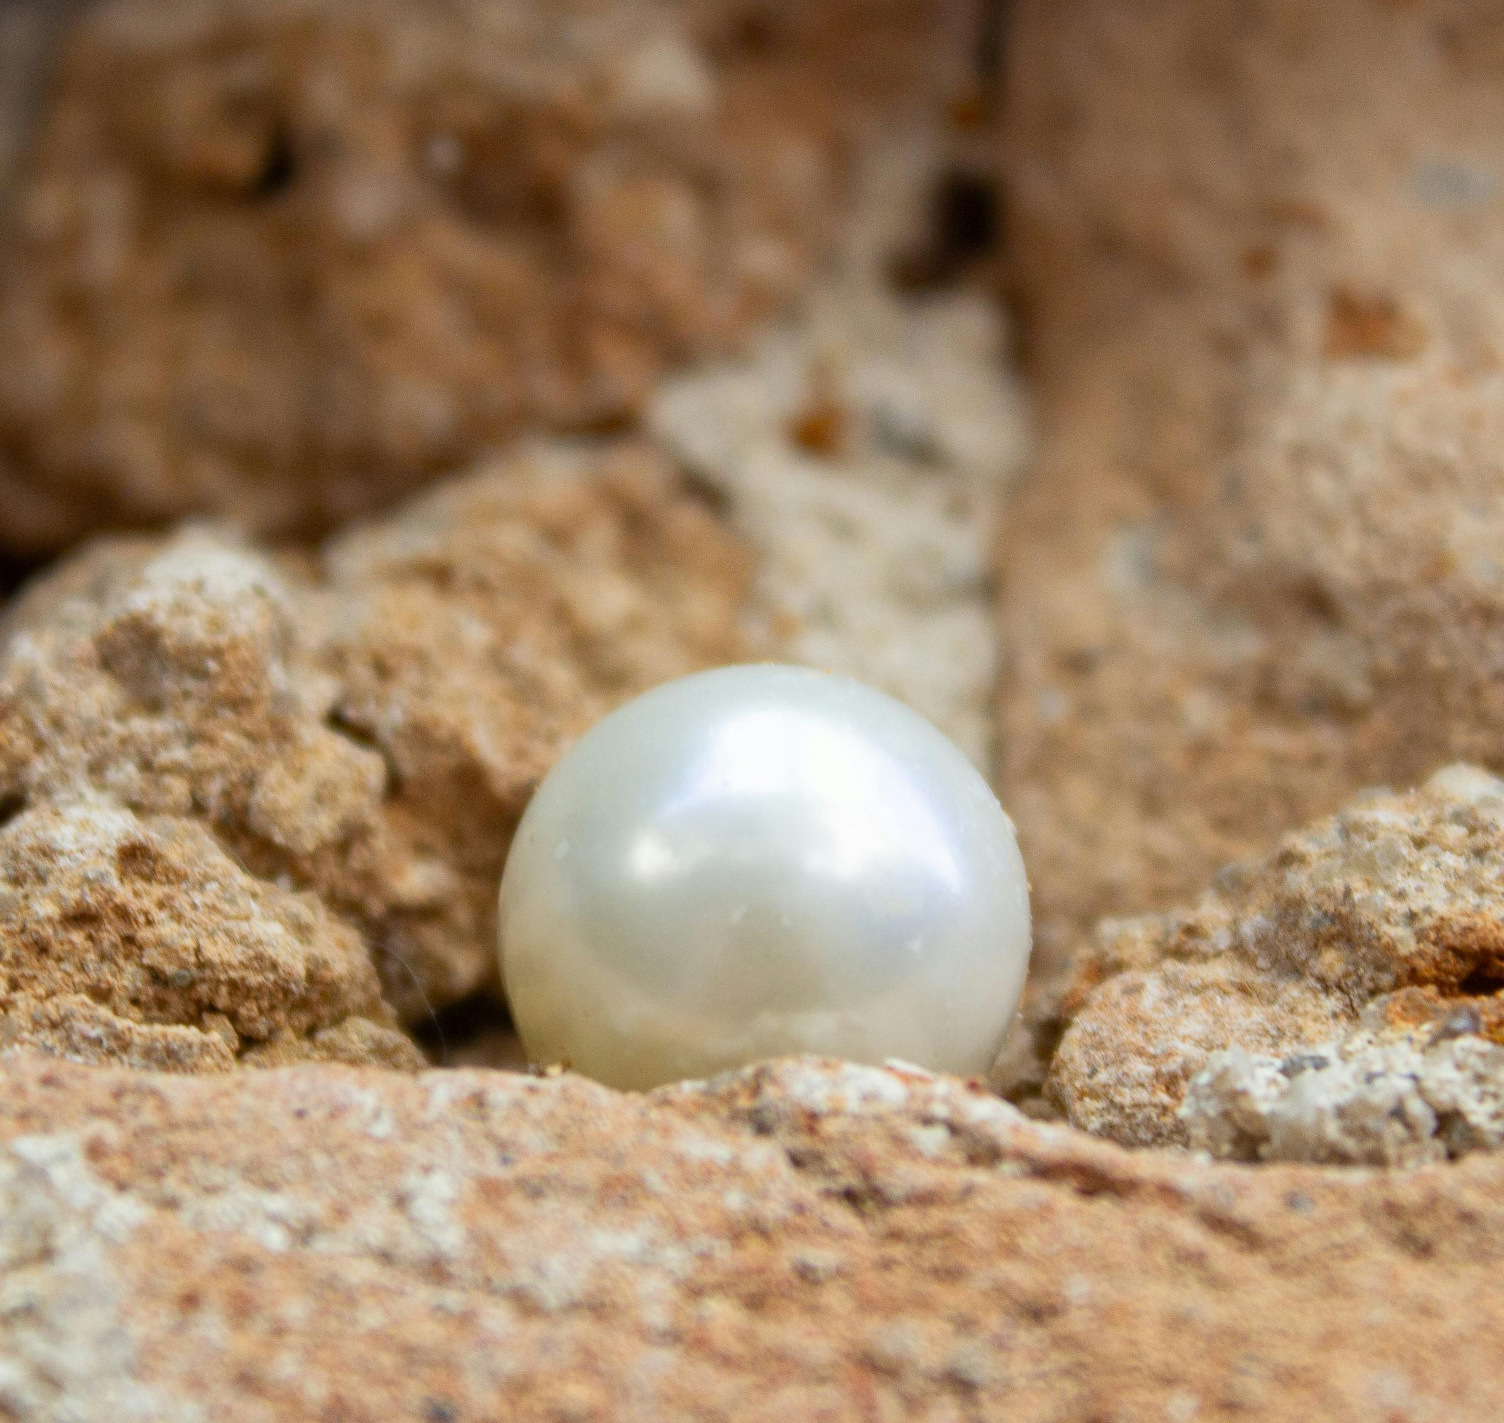
Jesus calls us to dive beneath the surface to find unseen treasure, hidden pearls, and the true nature of divine reward.

Slide 5
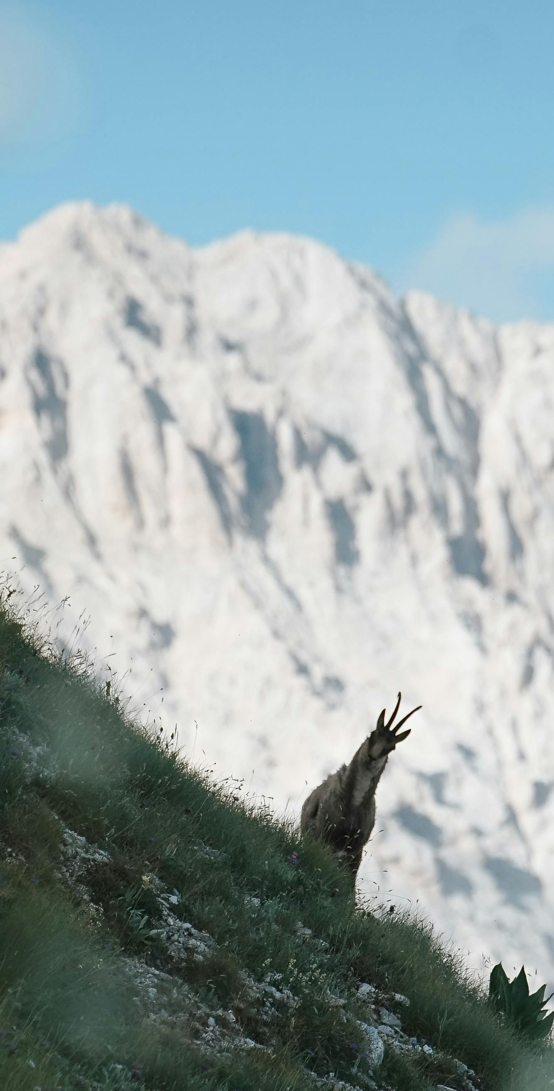

Faith leads us beyond comfort, teaching us to surrender our priorities for a trust that brings heaven into the ordinary.
Pastor Burt Schwab

Slide 6
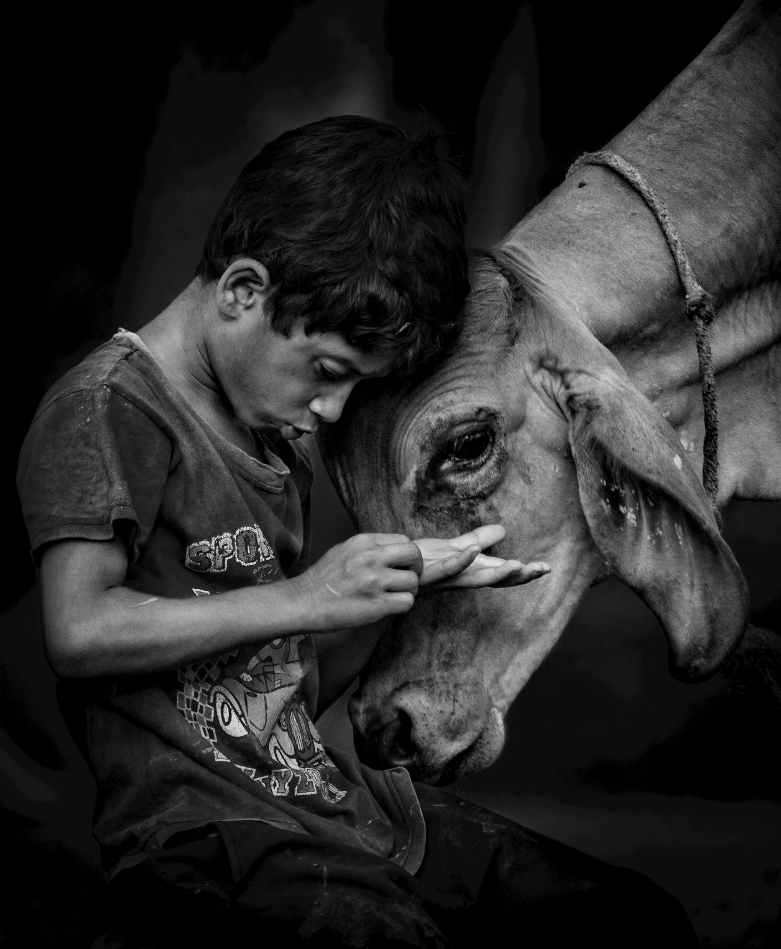
Become a ‘Treasure and Pearl’ community, freely following Jesus and championing the God-given worth of every person.

Slide 7

How does being a ‘some of every kind’ community help us welcome and gather people?

Slide 8

What is Adsumus asking of me?

