Slide 1
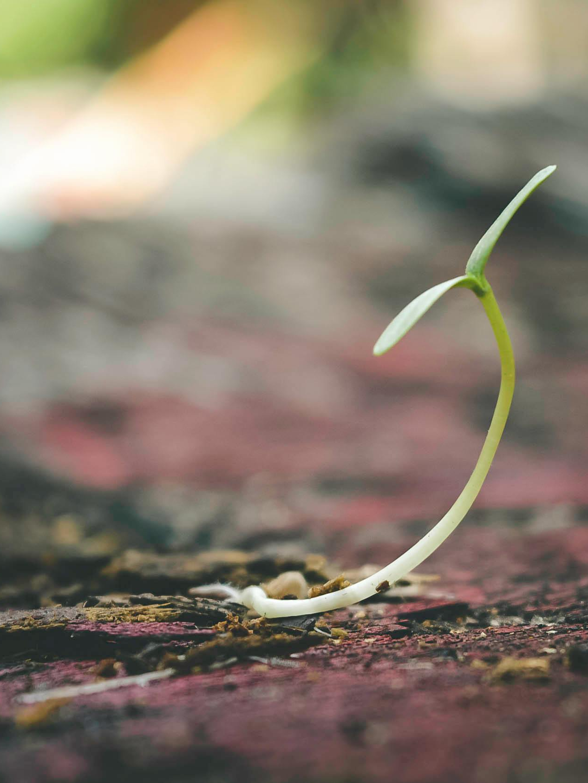

‘The condition of the heart determines the fruitfulness of God’s Word.’
Lord,
Please nourish the seeds You have sown in my heart through Your Word.
May Your Word within me help to cultivate Your Kingdom on this earth.
Amen.

Slide 2
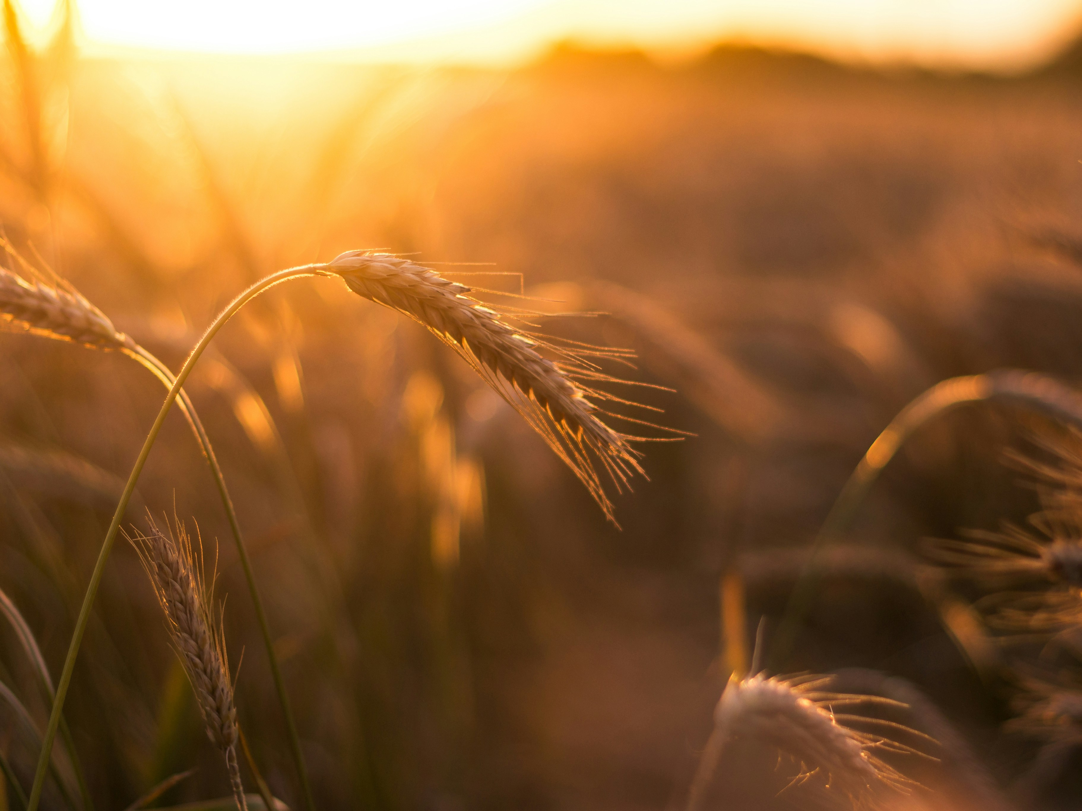
Like wheat, wisdom wins by quietly taking root until there’s no room left for weeds.

Slide 3
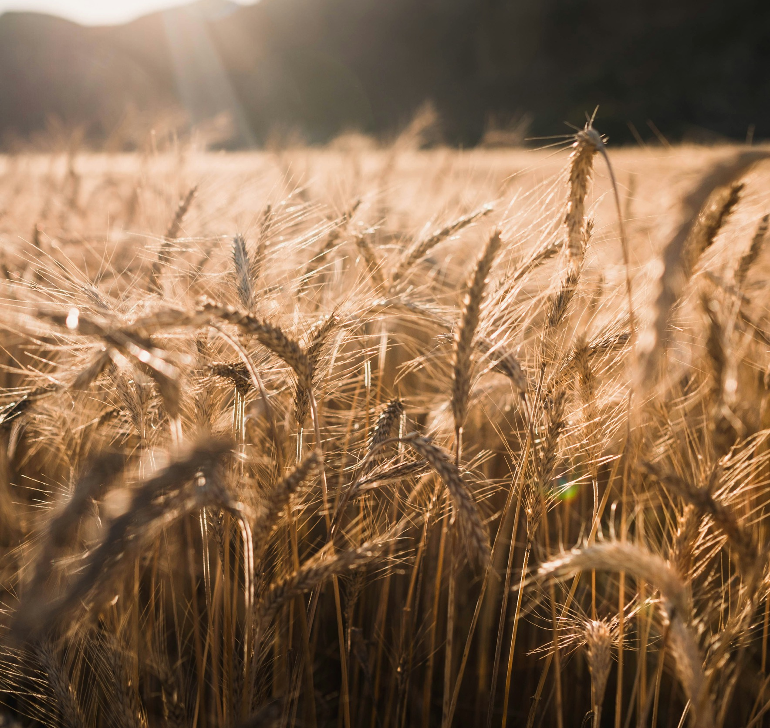
When the season turns, it’s the deep‑rooted, true, and kind that stand tall in the harvest.

Slide 4

Trusting divine timing is hard, but God always carries us forward.

Slide 5

Together we can create new paths that open up trust, hope, and an exciting sense of possibility.

Slide 6
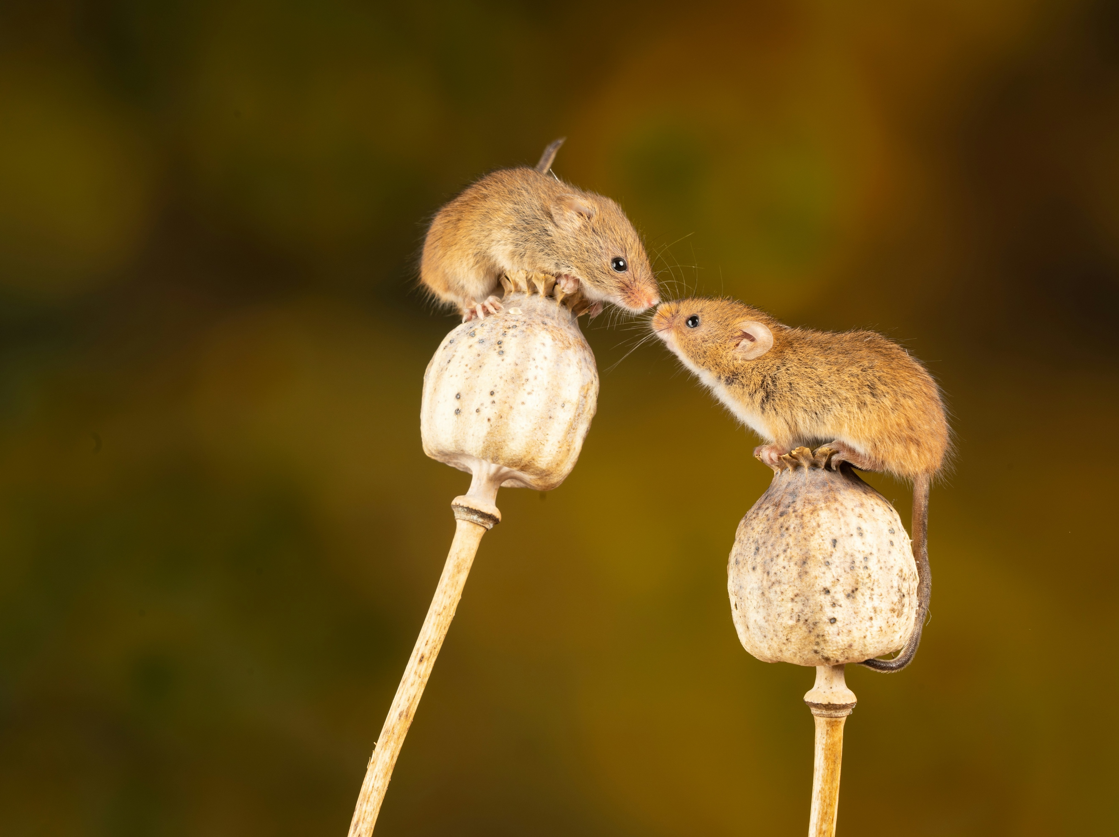
‘Let us grow together until the harvest’ Mat 13:30

Slide 7

What attitudes and actions help us grow as ‘wheat’?

Slide 8

As individual Christians, how do we stay grounded in times of chaos?

Slide 9
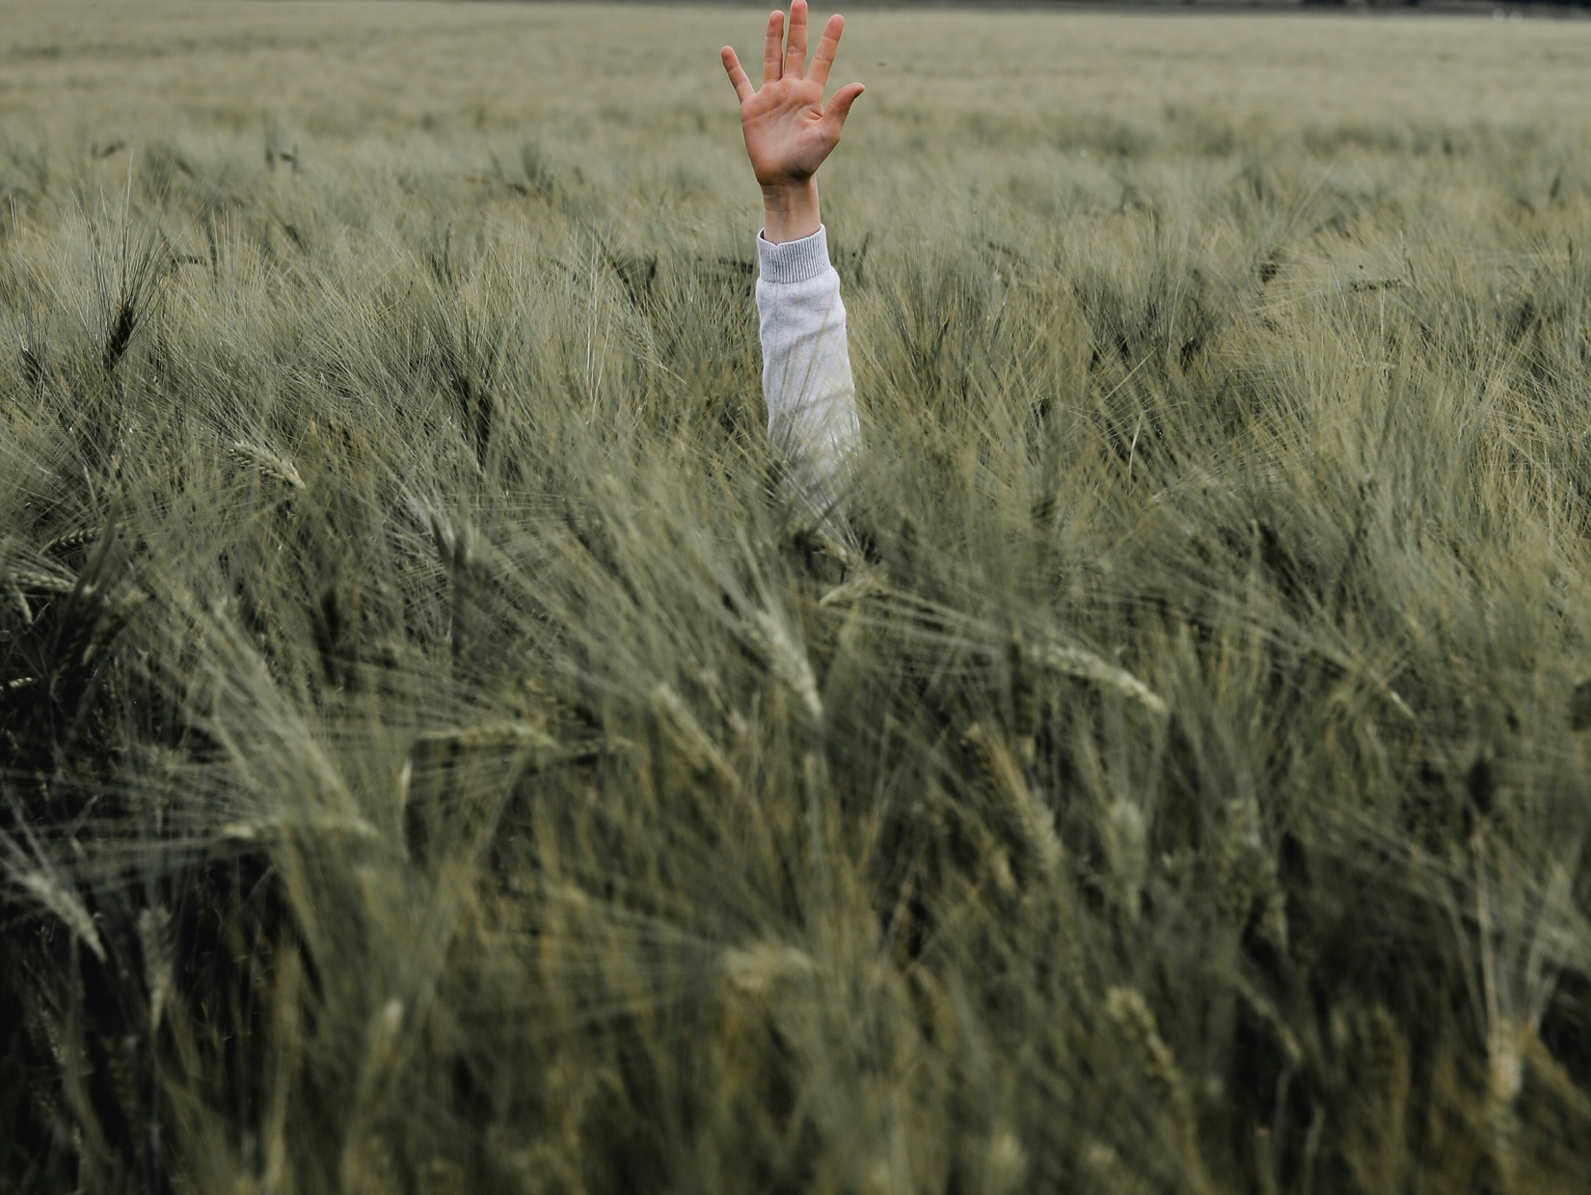
What is Adsumus asking of me?

