Slide 1
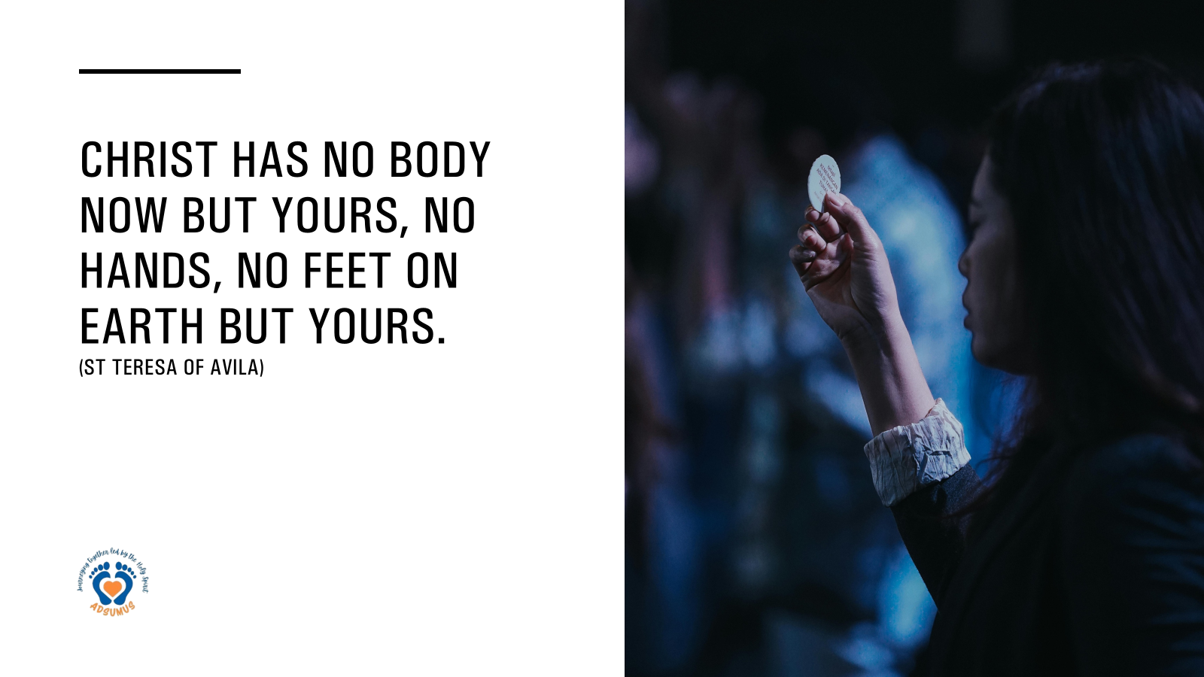

Slide 2
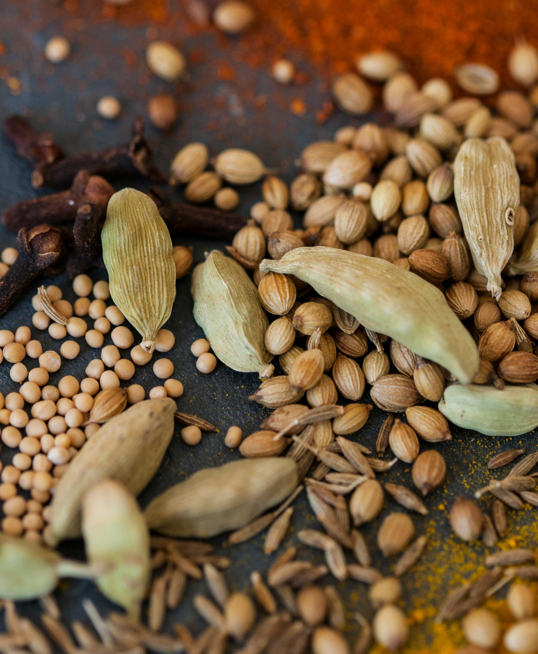

In every seed, the future quietly takes root.
Vandana Shiva

Slide 3
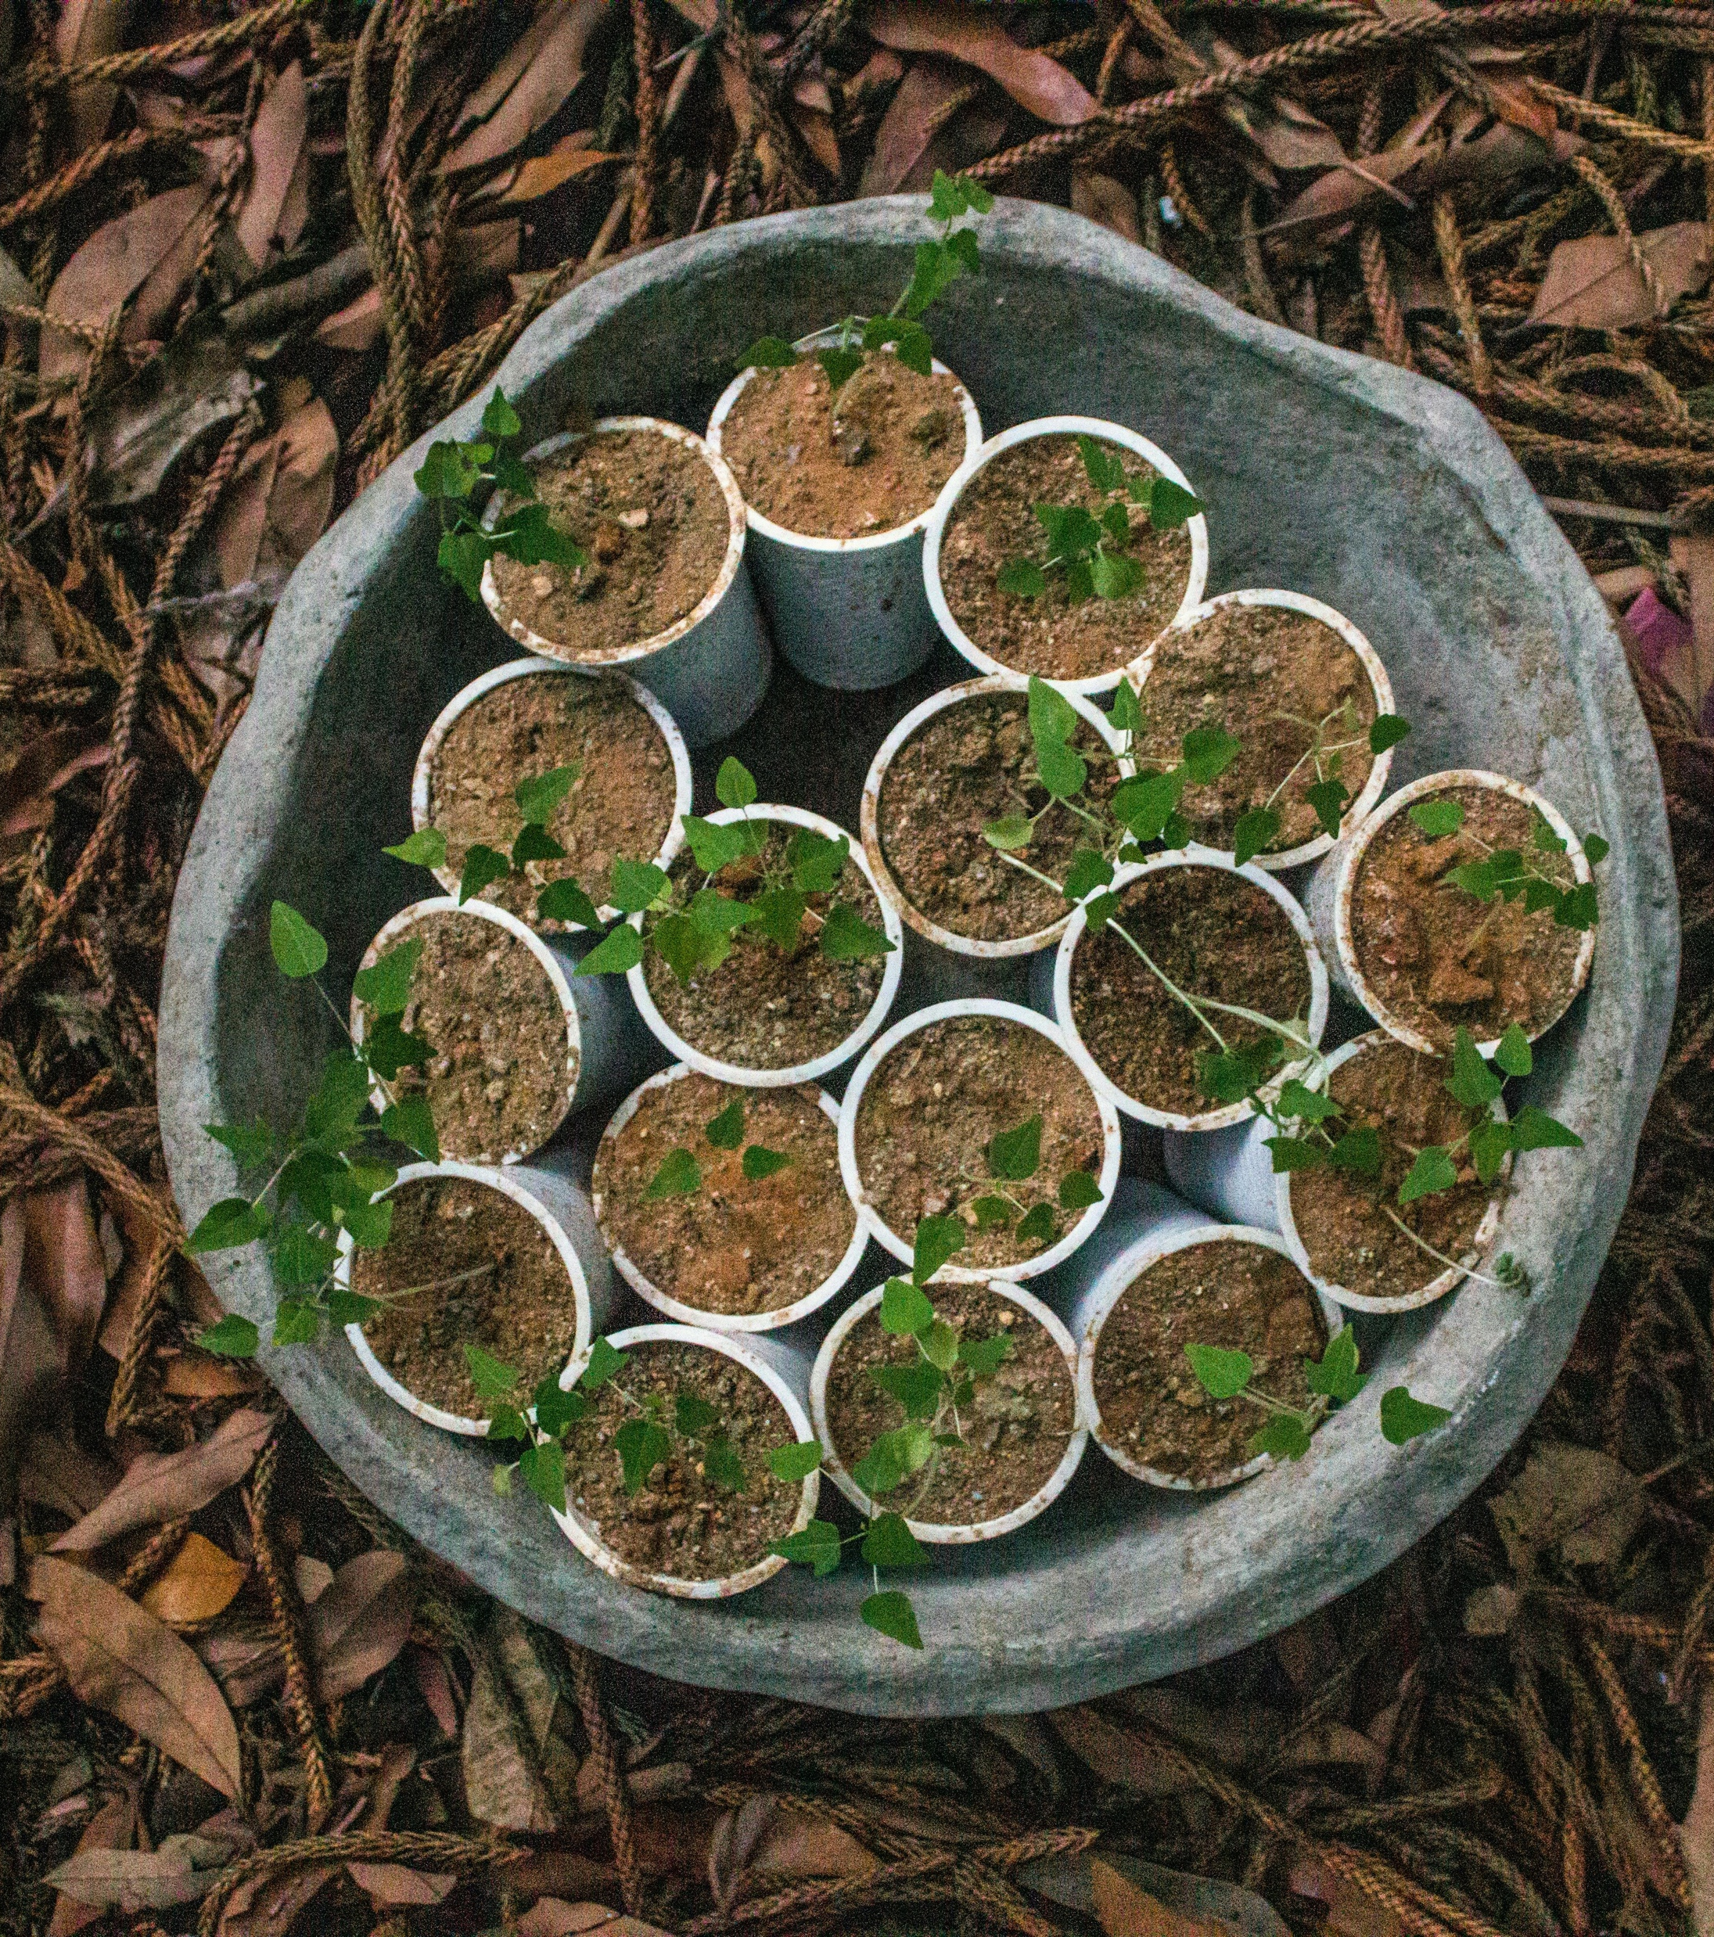
The Gospel reveals God’s open hand and invites our open heart.

Slide 4

It’s not where our seeds land that matter as much as, the heart that throws them. Becky Hemsley

Slide 5
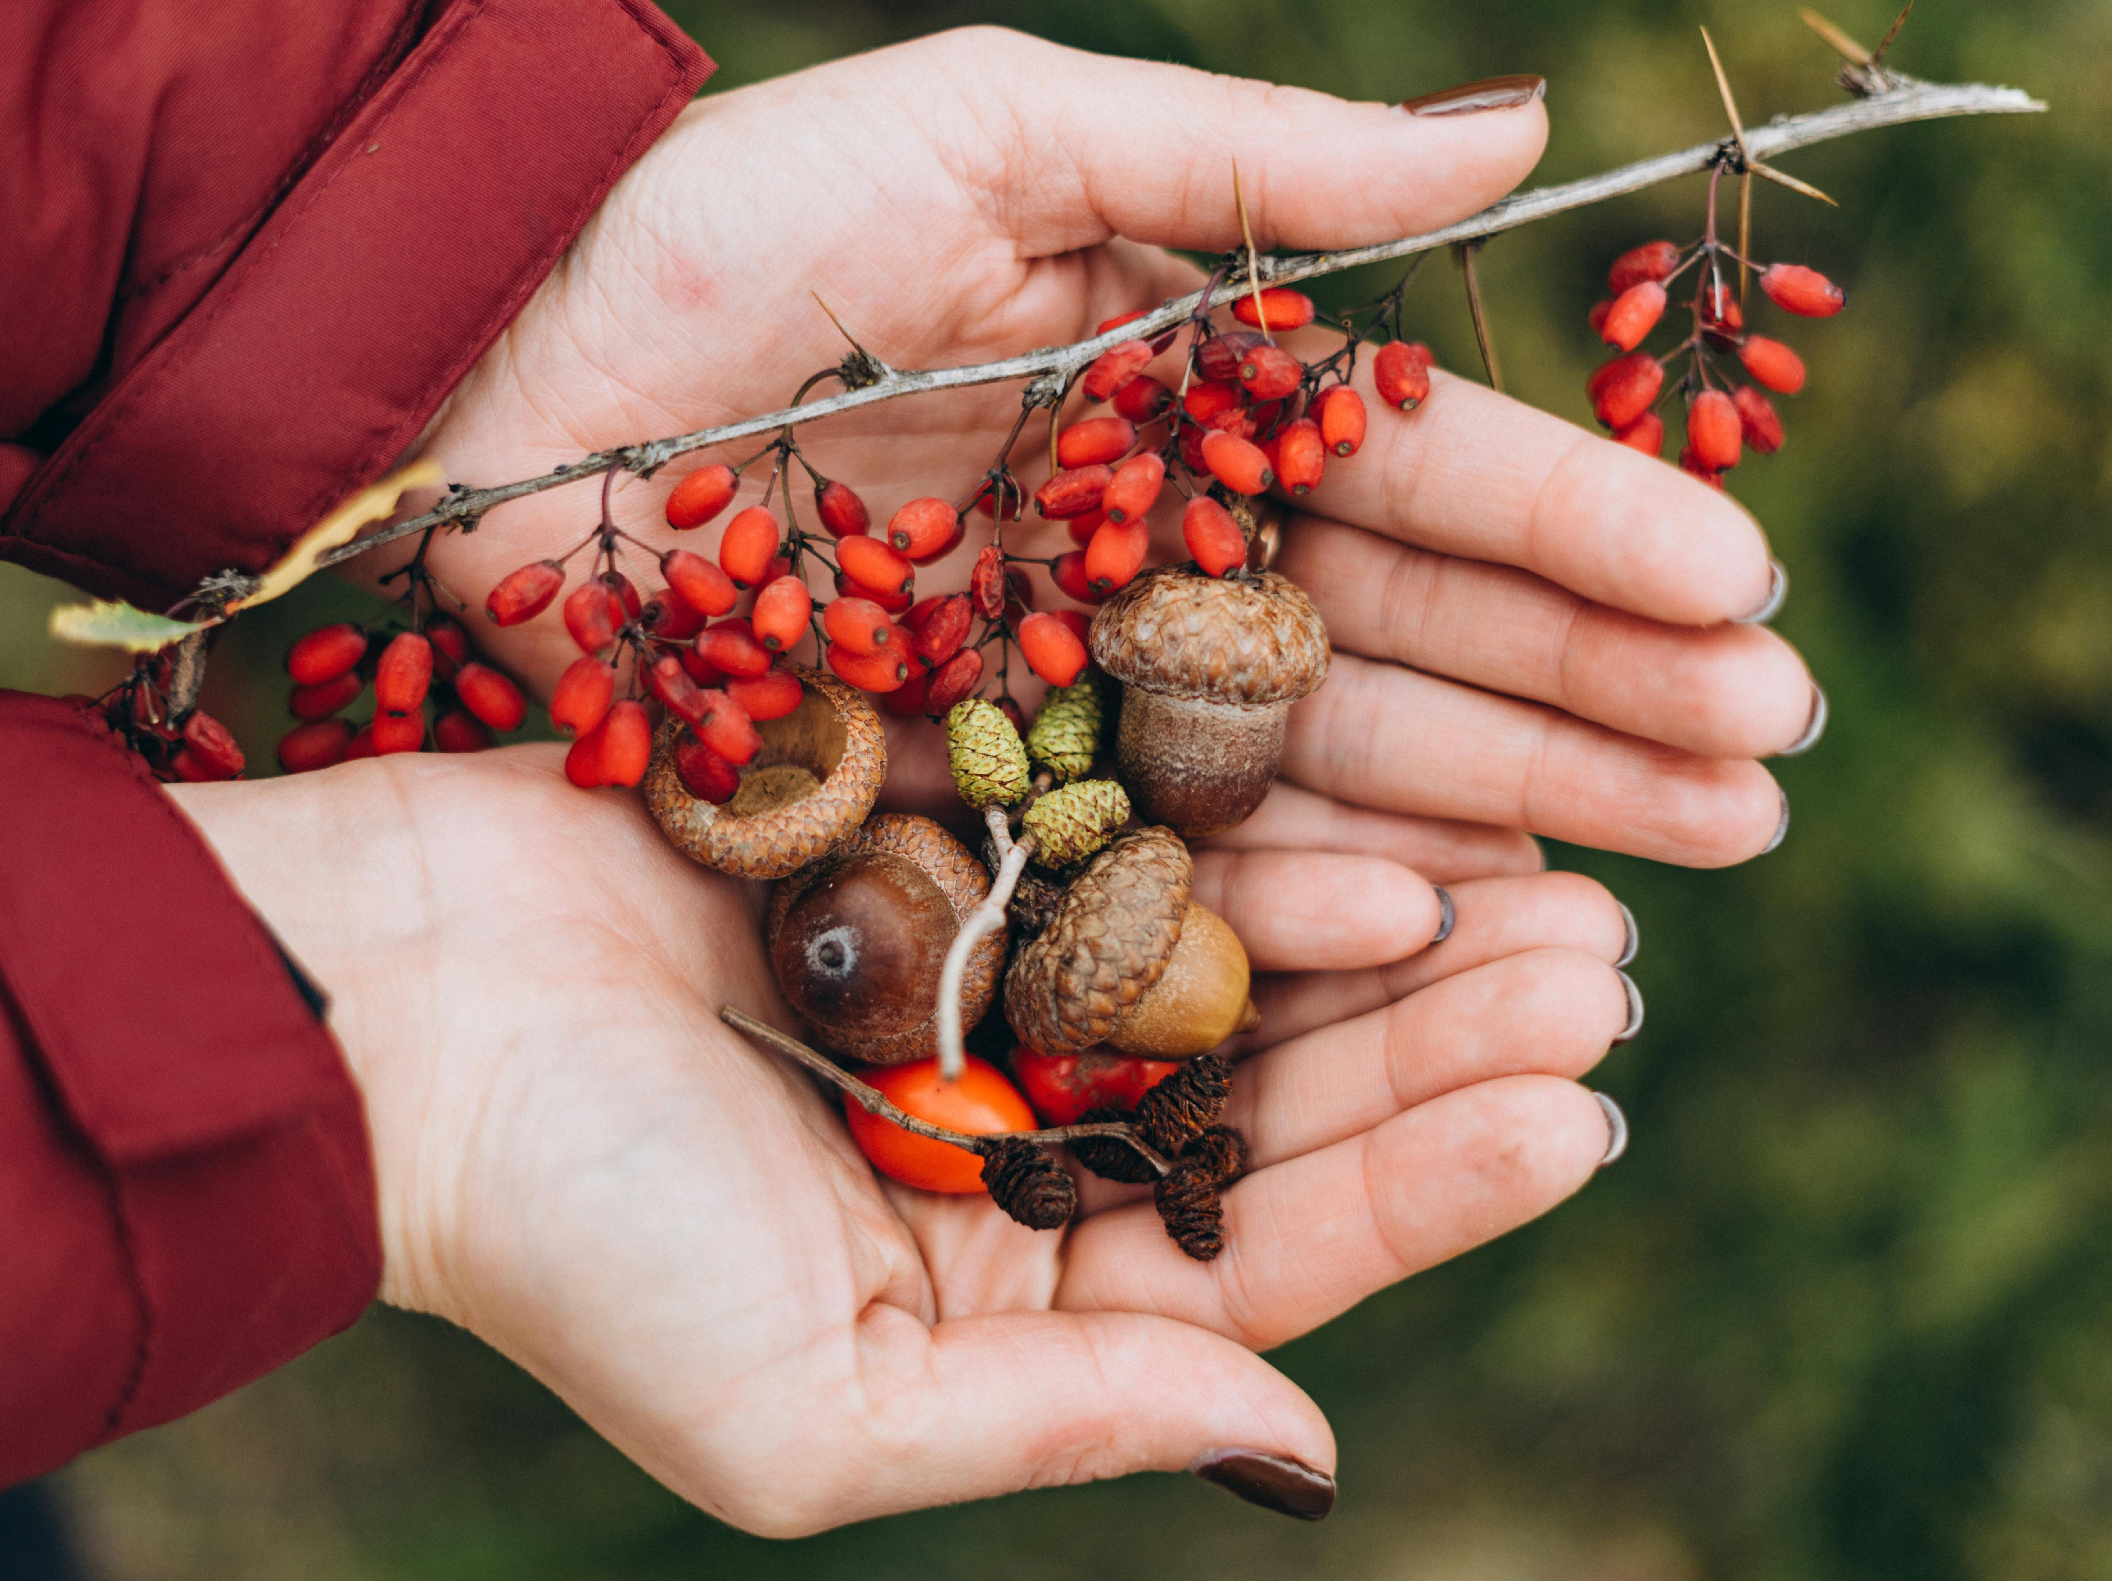
It’s not about our gritty, hard‑won successes and failures—but about the extravagance of the sower.

Slide 6
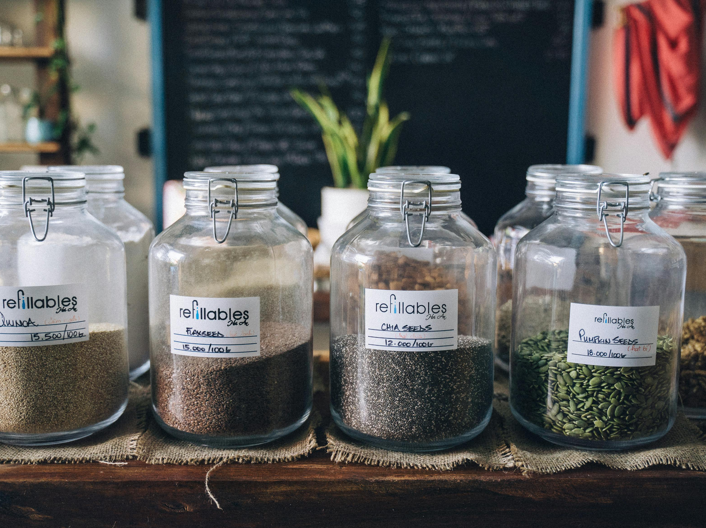
What everyday actions help new seeds take root in our parish?

Slide 7
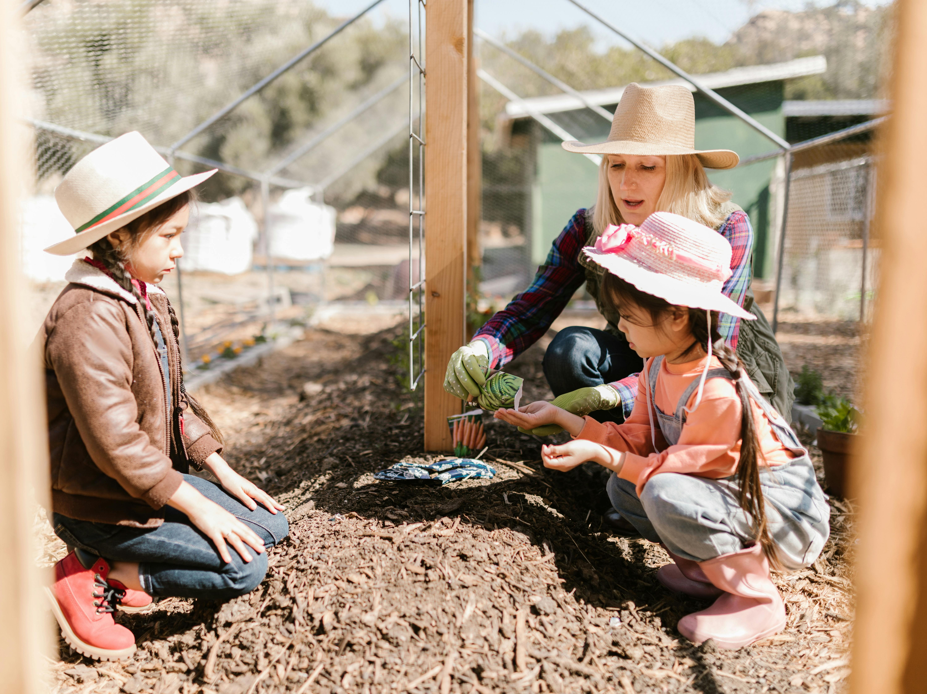
What is Adsumus asking of me?

