Slide 1
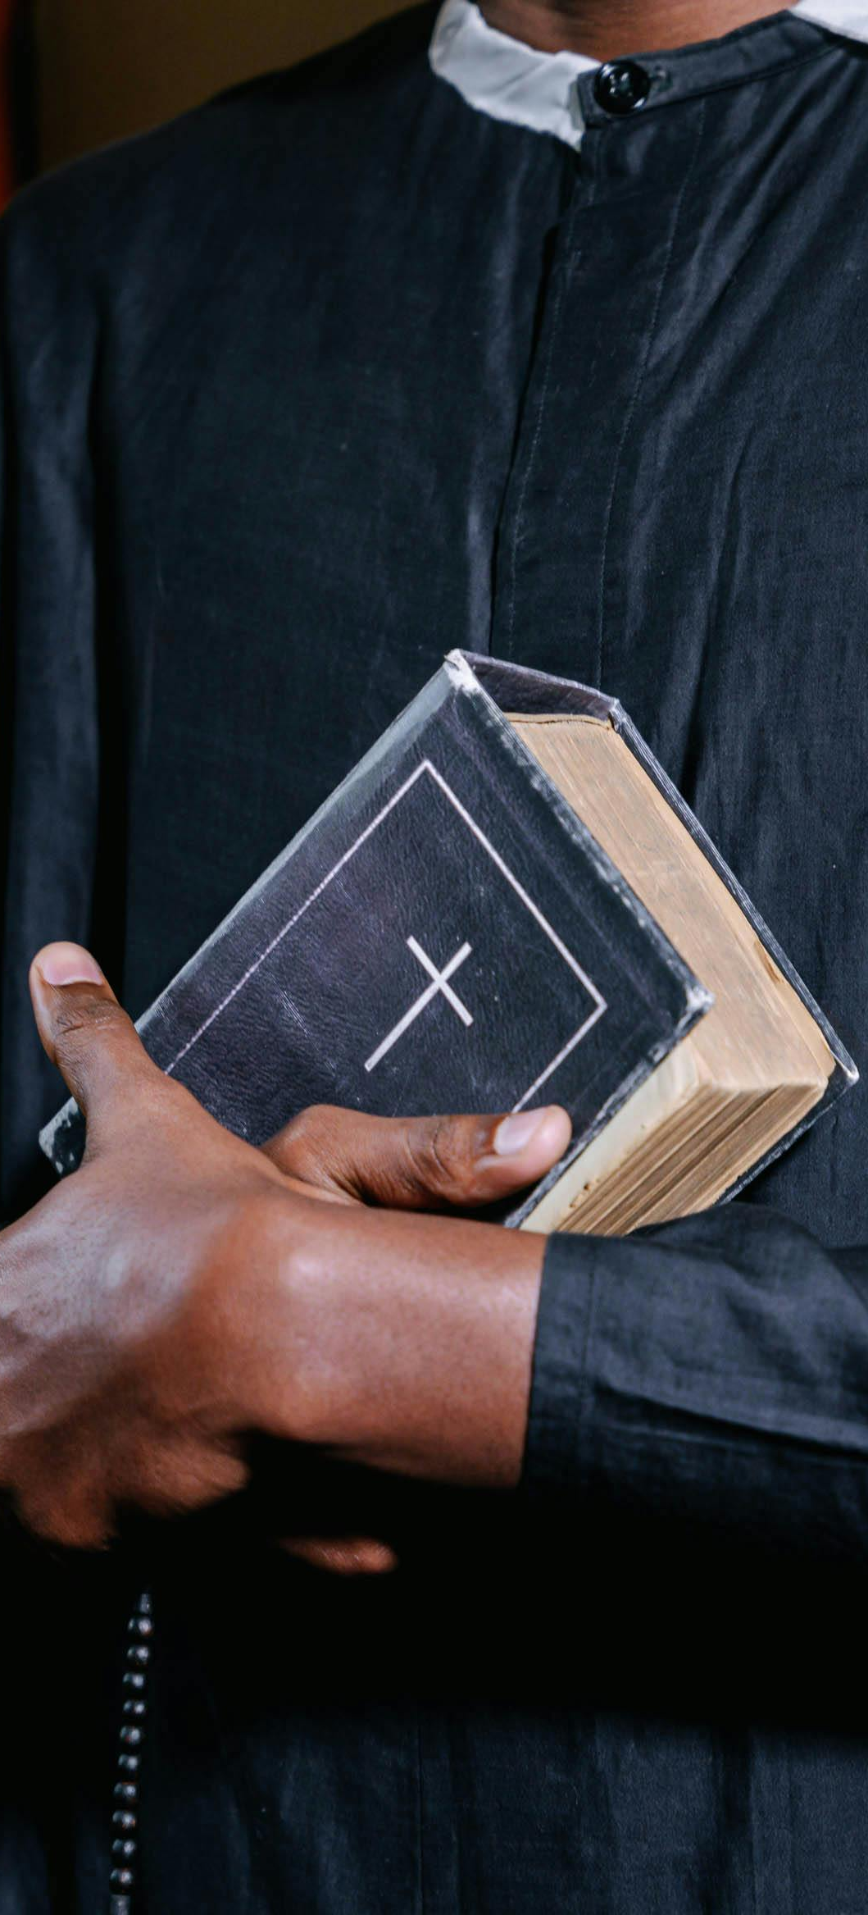

Loving God,
We thank you for our priest, who helps us discover the hidden treasure of Your Kingdom.
As Solomon asked for an understanding heart, we pray that You grant our priest wisdom and discernment.
Set his heart on fire with love for You, that he may lead us closer to Christ in the Eucharist and continue to be a wise steward of the mysteries of faith.
Strengthen him in his vocation, that his life may reflect the joy of the Gospel.
Through Christ our Lord.
Amen

Slide 2
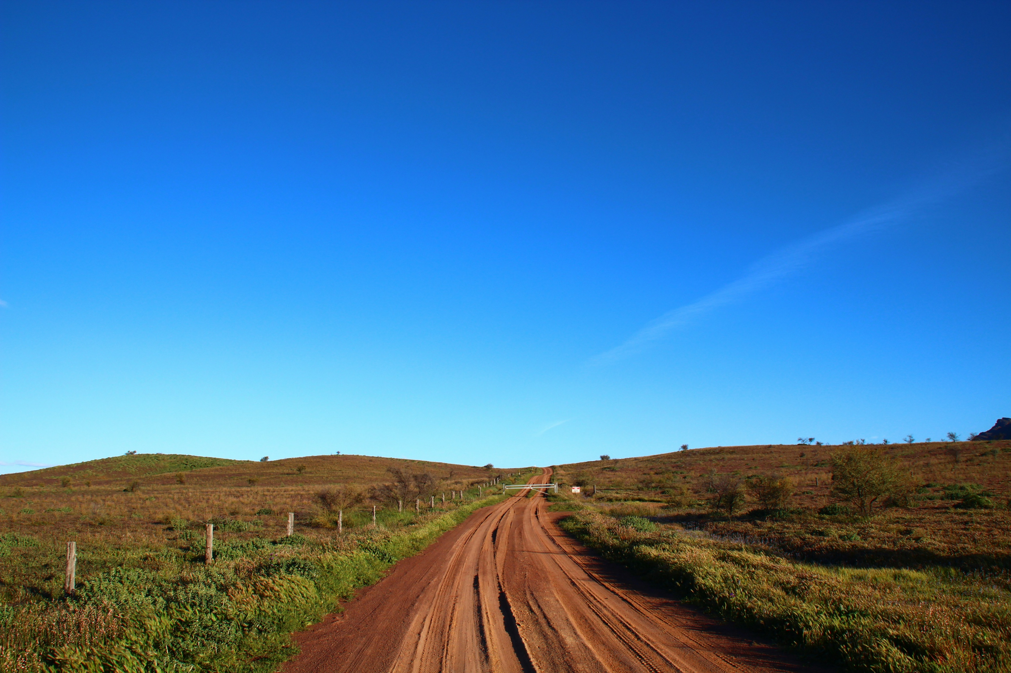
PRAYER OF THE
ABORIGINAL PEOPLE
Father of all, you gave us the Dreaming.
You have spoken to us through our beliefs.
You then made your love clear to us
in the person of Jesus.
We thank you for your care.
You own us.
You are our hope.
Make us strong as we face the problems of change.
We ask you to help the people of Australia
to listen to us and respect our culture.
Make the knowledge of you
grow strong in al people,
so that we can make a home
for everyone in our land.
Amen

Slide 3

‘What the Church needs most today is the ability to heal wounds and warm the hearts of the faithful; it needs closeness, real proximity. I see the Church as a field hospital after battle.’
Pope Frances (Sept 19th, 2013)

Slide 4
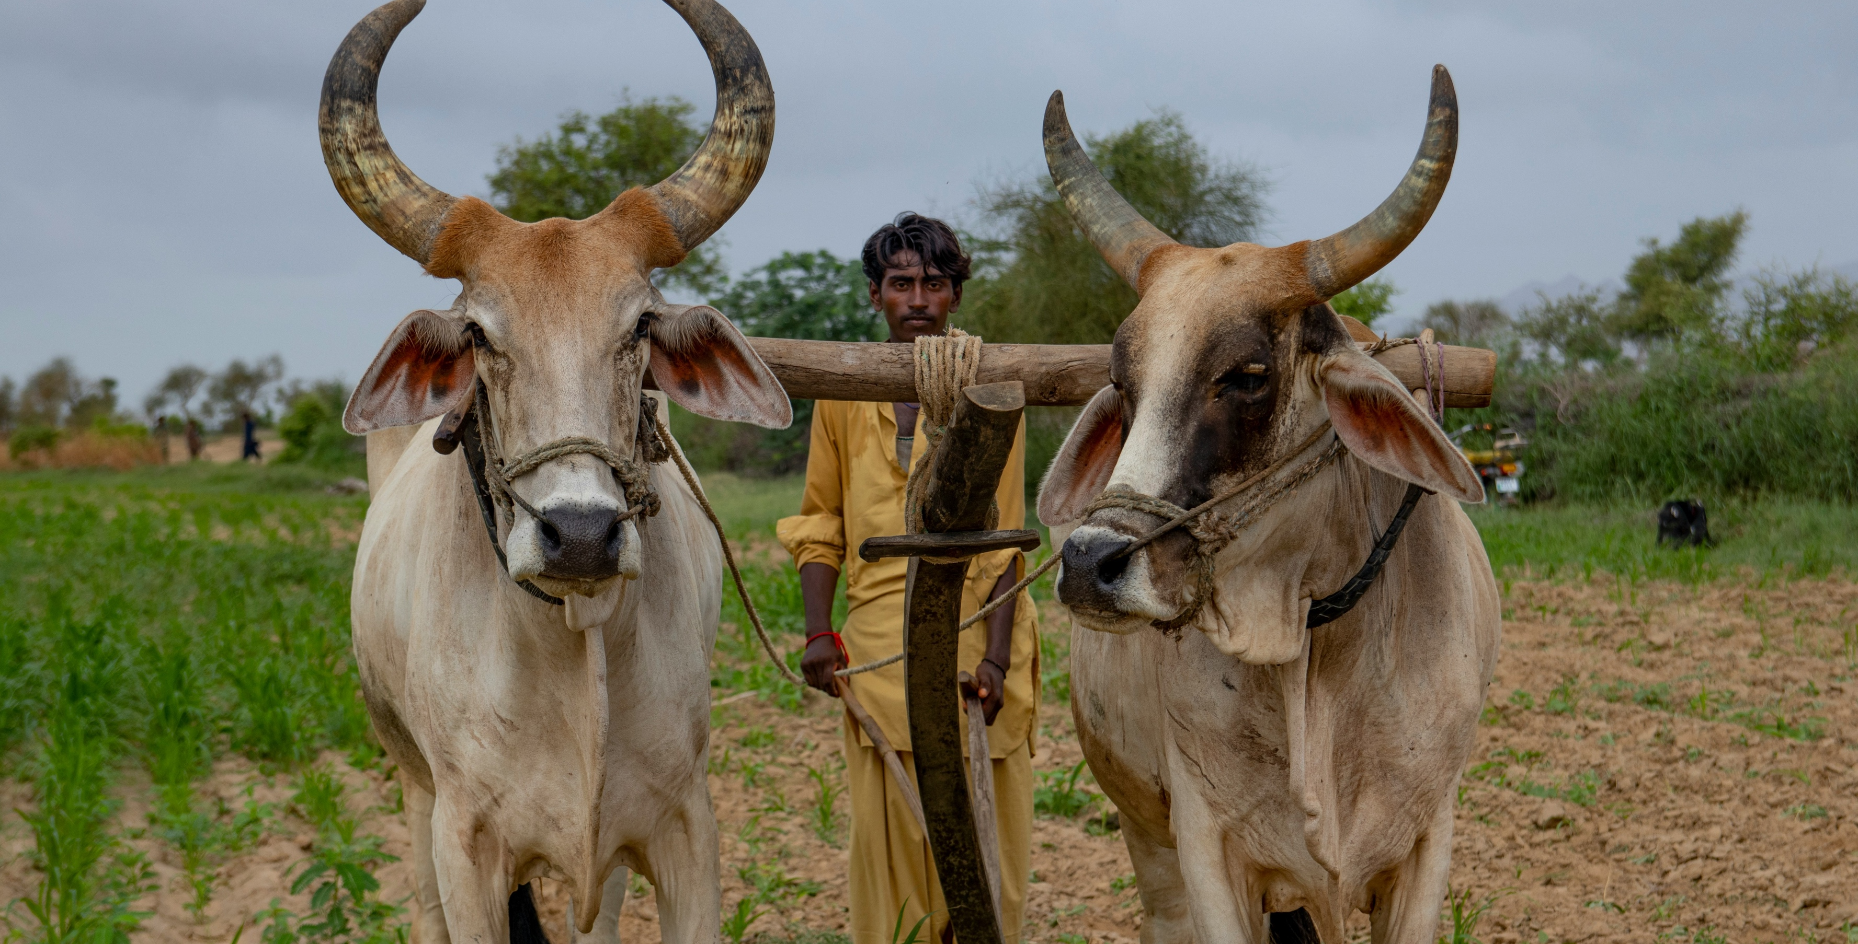
Jesus’ wisdom strengthens us amid our problems. It does not take away the burdens of life, but it lifts the anguish from our hearts.
Pope Francis

Slide 5
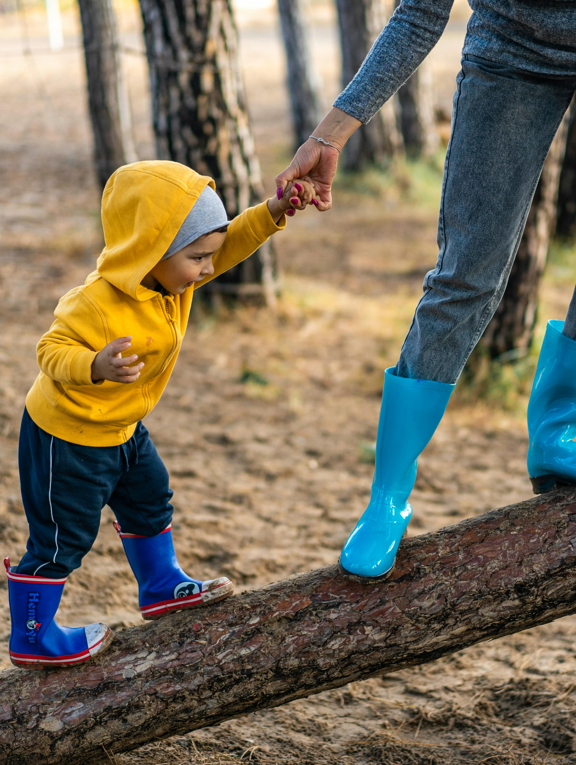
How does Jesus’ shared yoke redefine rest—as escape from work or as shared burden-bearing?

Slide 6

In what ways do I see our parish operating as a ‘field hospital’?

Slide 7
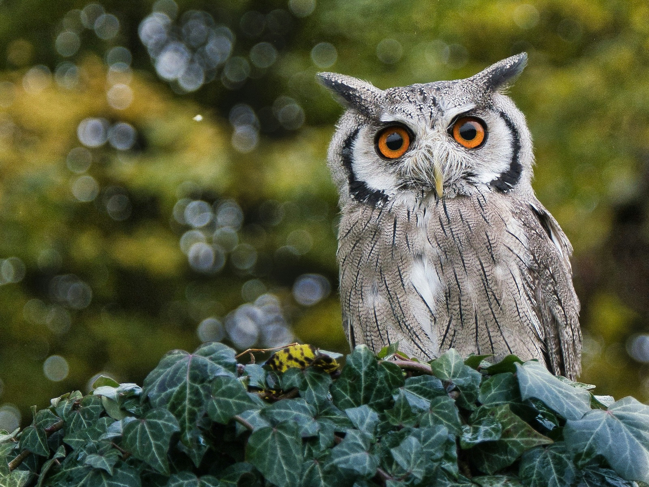
What is Adsumus asking of me?

