Slide 1


Adsumus, Sancte Spiritus
We stand before You, Holy Spirit, as we gather together in Your name.
With You alone to guide us, make Yourself at home in our hearts; Teach us the way we must go and how we are to pursue it.
We are weak and sinful; do not let us promote disorder. Do not let ignorance lead us down the wrong path nor partiality influence our actions.
Let us find in You our unity so that we may journey together to eternal life and not stray from the way of truth and what is right.
All this we ask of You, who are at work in every place and time, in the communion of the Father and the Son, forever and ever.
Amen.

Slide 2

The Shepherd is in our midst.

Slide 3

Wherever we live, God’s Kingdom is here—and everyone’s invited.

Slide 4
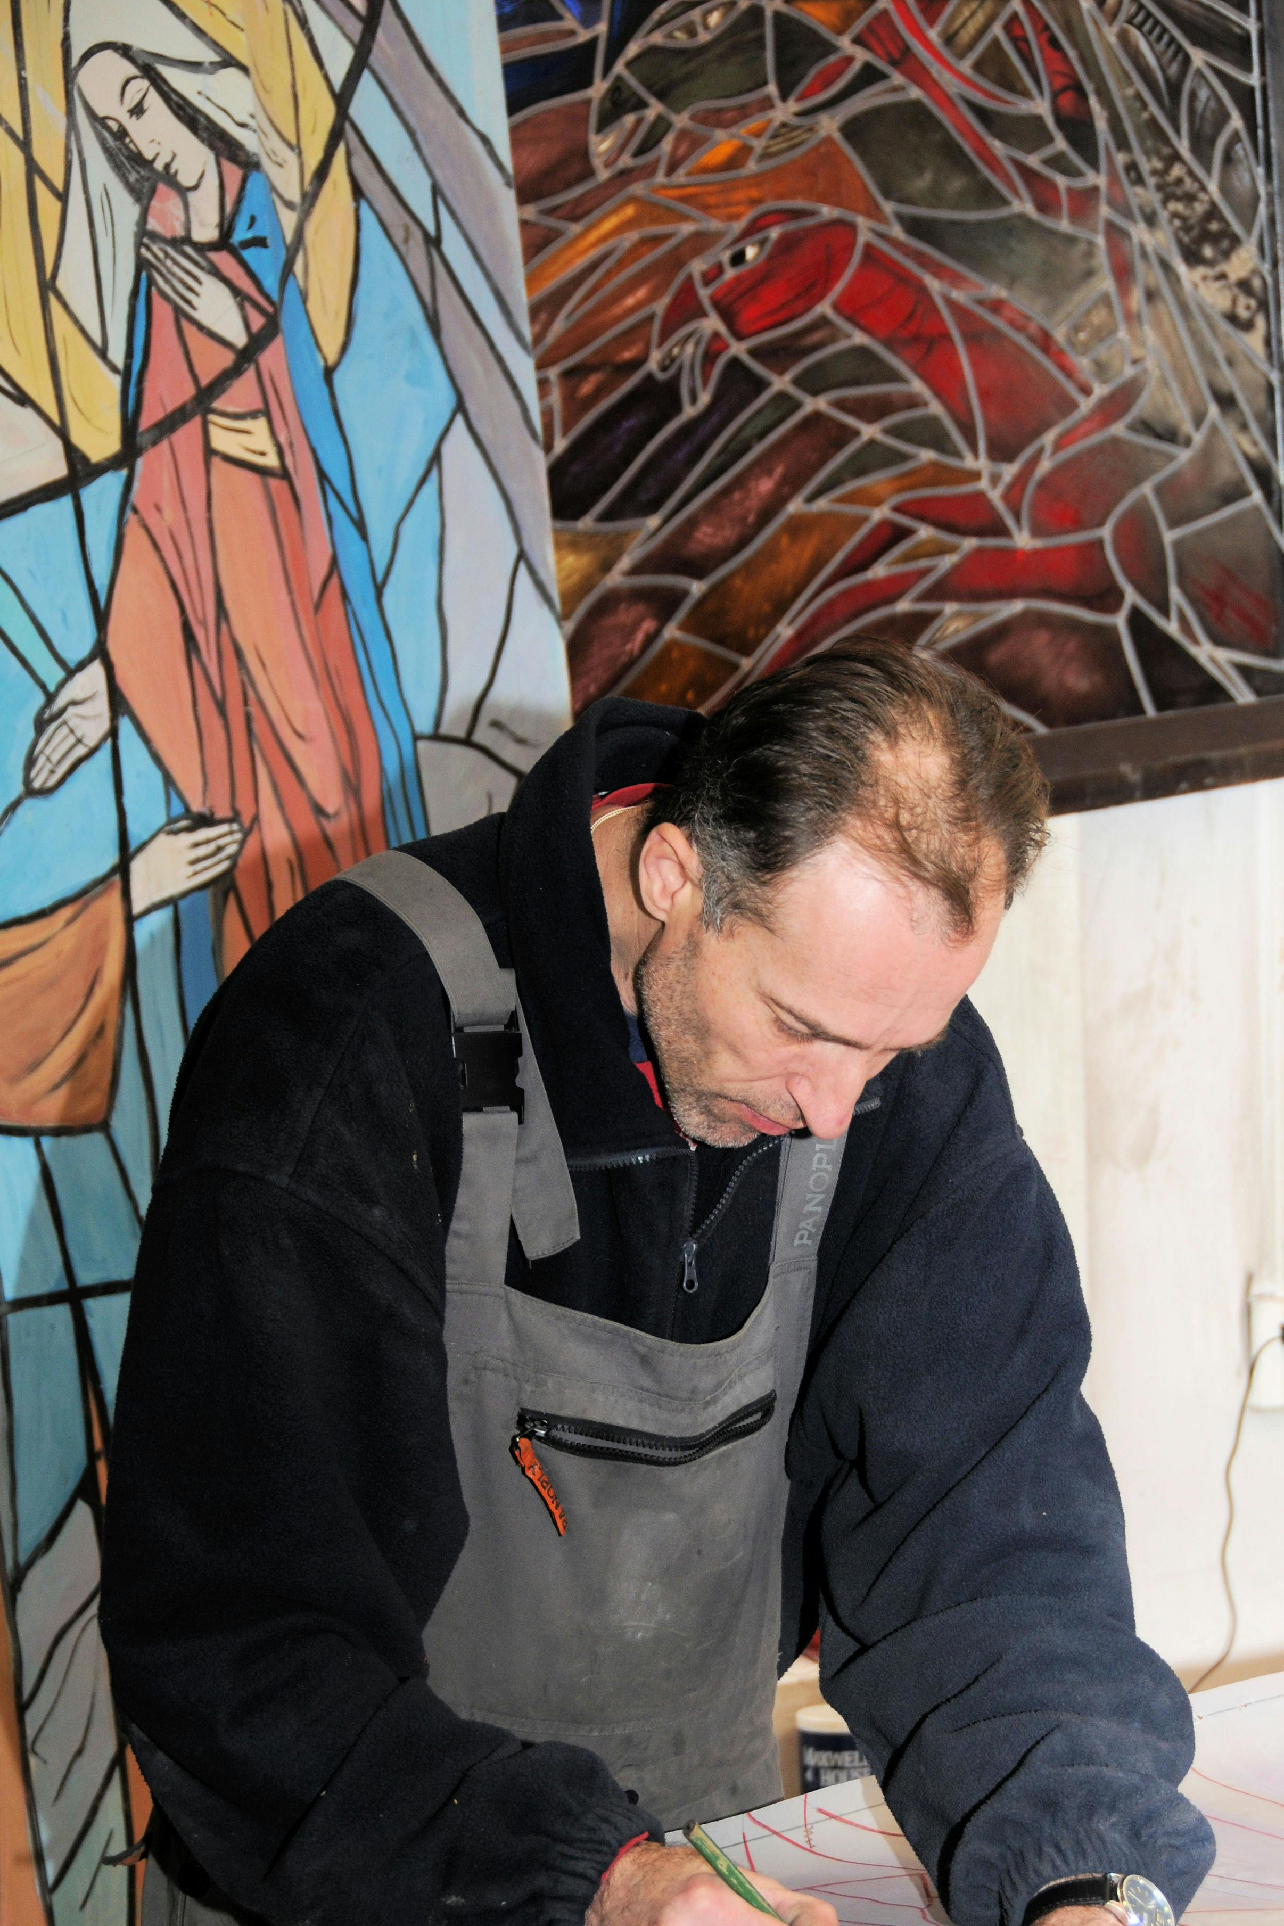
Ministry isn’t a ‘stained-glass’ word; it’s Spirit-filled service in real life.

Slide 5

Do I seek ways of contacting those in need?

Slide 6

How does Jesus empower me to help my community?

Slide 7
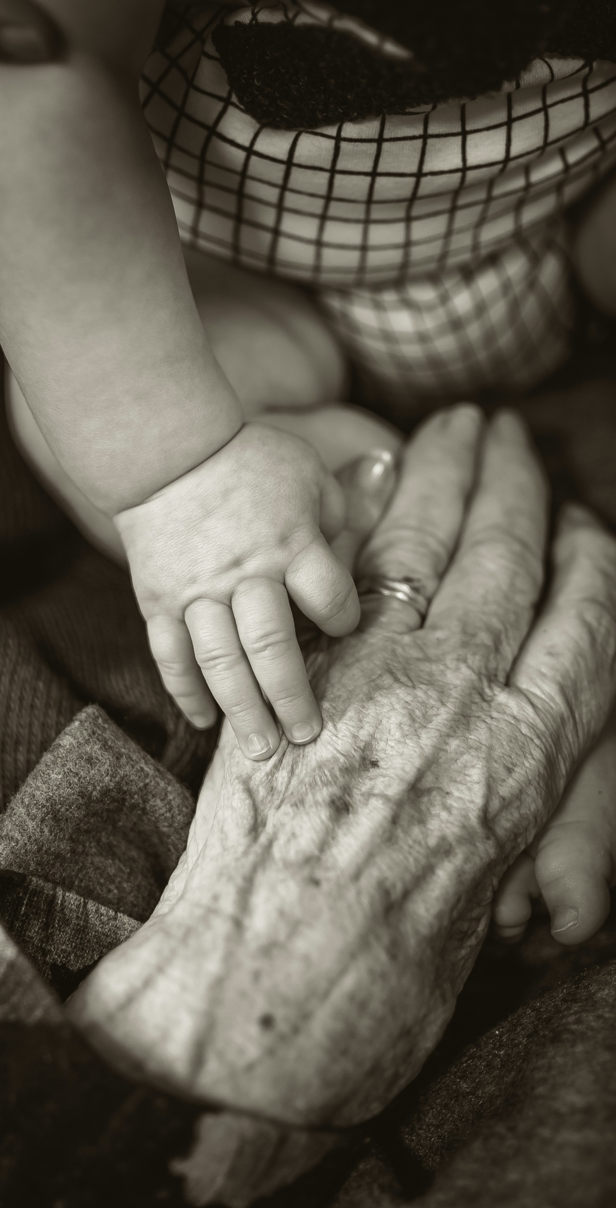
What is Adsumus asking of me?

