Slide 1




Parish Pastoral Council Formation
Parish Pastoral Council
Formation
October 1 2022
Day 1

Slide 2

The Catholic Archdiocese of Perth acknowledges the Whadjuk Nyoongar people, the Traditional Owners who have walked upon and cared for this land for thousands of years.
We acknowledge the continued deep spiritual attachment and relationship of
Aboriginal and Torres Strait Islander peoples
to this country and commit ourselves to the ongoing journey of Reconciliation.

Slide 3

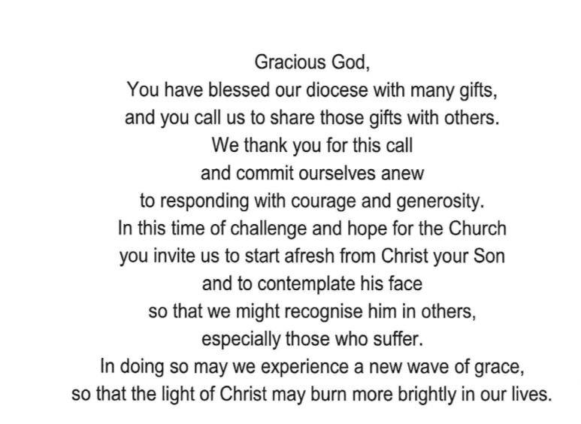
Prayer for the Archdiocese of Perth

Slide 5

10.00 Prayer and Welcome
10.05 Review of the role and nature of the Parish Pastoral Council Constitution
10.35 Pastoral Planning
Who is your
Priority areas
key strategies
Actions/ activities
Responsibility
Timeline
Measurables - Identifying progress
12.15 Q and A Session
12.30 Parish Hubs
12.55 Blessing
Overview for the day

Slide 6
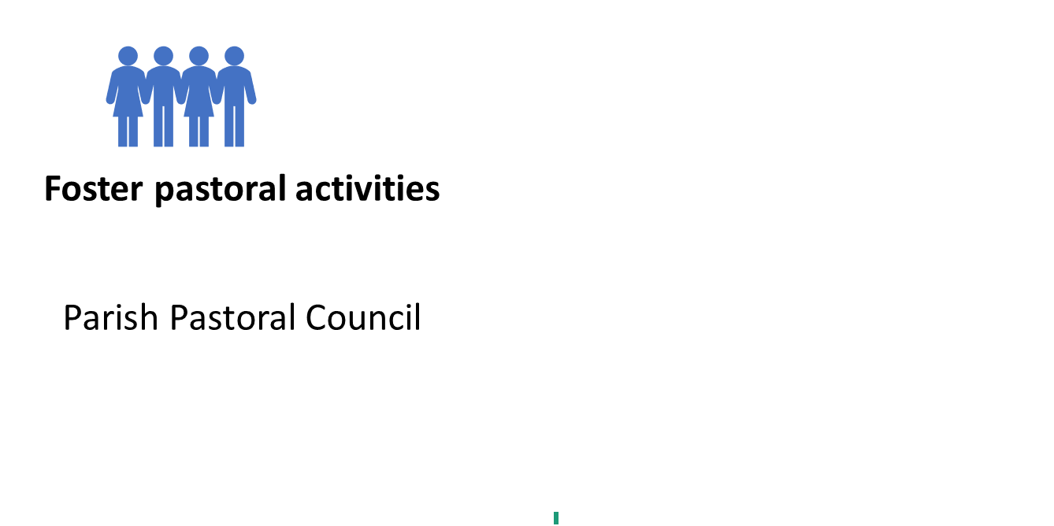
What does a Parish do?
Administer goods
Finance Committee
e)
Parish Finance Council
Notes:
The Parish Pastoral Council does NOT make decisions about finance.
Canon law actually states that every parish needs to have a finance committee to look after the ‘goods ‘ of the parish.

Slide 7

The Primary
Role and Function of the
Parish
Pastoral Council
Notes:
Each parish and cluster of parishes is unique. Yet all parishes, wherever they are, have the same mission. That mission is to continue the work of Christ within the local area
Council members need to gain insight into the people who make up their communities. As you can see from the previous section, Jesus and the Eucharist are at the center of every parish. Every parish has to provide parishioners with opportunities to experience the person of Jesus Christ. Without this experience of profound faith, people may become members of the parish but not necessarily disciples.
Parishes and councils, then, must be aware that the parish should invite people into a deeper relationship with Jesus and the community of disciples as well as provide opportunities for this to happen. As part of the annual evaluation of parish mission activity in a parish, this is one of the most important activities for councils to monitor and keep in focus.
The first thing to understand about parish and, for that matter, the Church, is it is PEOPLE. The Church and the parish are the people of God. Jesus came to bring life and salvation to people not buildings or a parking lot or the parish office. Everything we do in the parish should be for people.

Slide 8
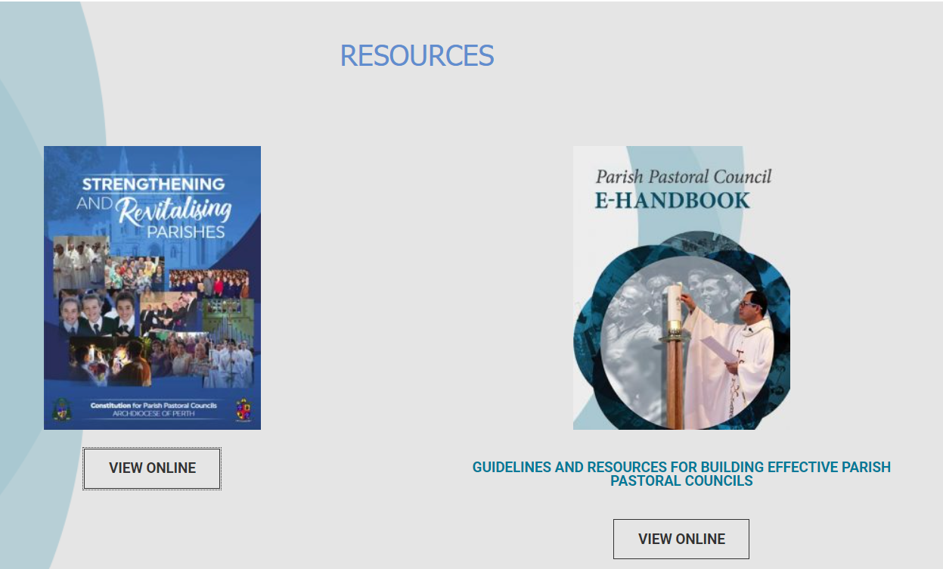
When looking at an organisation: corporate, charitable or the Church.

Slide 9
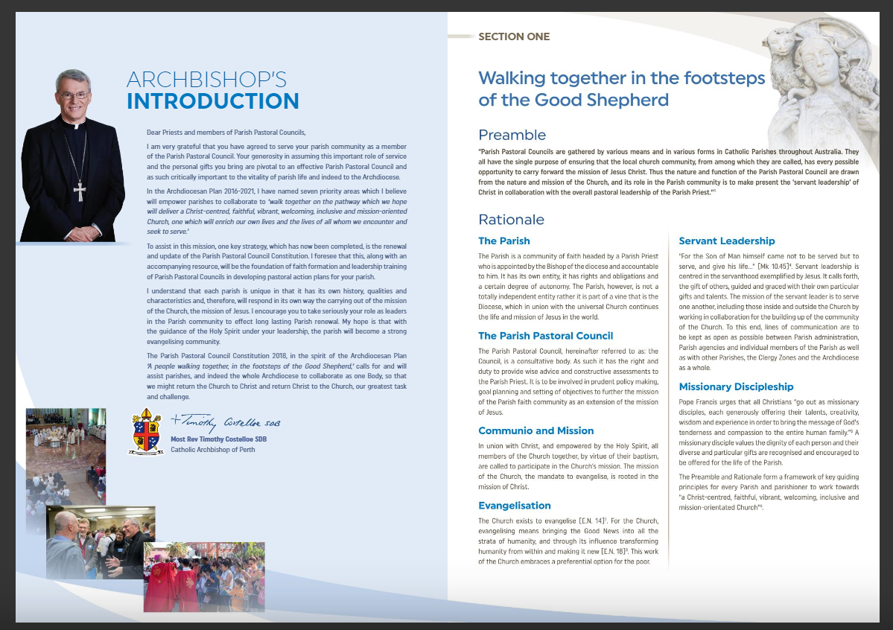

Slide 10
A Parish Pastoral Council is …
An elective body
A consultative body
A collaborative body
A representative body
‘
Notes:
1. Members of the Parish Pastoral Council are Chosen from the parish by the parish
2. The pastor consults, not because he wants to surrender responsibility for the parish, but because he wants to exercise it wisely. The advise centres on the pastoral care of the parish.
3. PPC work in collaborative relationship with pastors, with the Collaborates with finance council, parish ministries, catholic school, neighbouring parishes, diocesan agencies and the wider community
4. PPC makes present’ the wisdom of the community

Slide 11
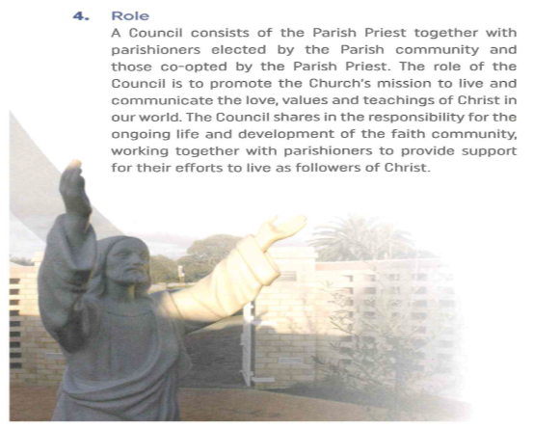
The Role of the PPC
Notes:
Pastoral care is shepherding
We have no powers!
To have a spiritual basis
To be a conduit of life in the parish
To be enablers, not doers, allowing solidarity in
balance with subsidiarity
To have appropriate membership

Slide 12
The Role of the PPC
Is ministerial not merely functional
To promote the Church’s mission
To live and communicate the love, values and teachings of Christ in the world
Shares the responsibility for the ongoing development of faith in the Parish
To provide support parishioners in their efforts to live as followers of Christ

Slide 13


Function of the PPC

Slide 14
Key function of the PPC

Slide 15

Pastoral Actions
Parish PASTORAL Council
Pastoral Action/Activity

Slide 16
Pastoral Actions
A pastoral action is inspired by the Gospel
The aim is to ….
build warm human community
nourish the faith of its members
enable members to celebrate worship together
enable members to give witness to their faith in daily life
Notes:
Pastoral Action is …
inspired by the Gospel
Action that is intended to …
build warm human community
nourish the faith of it members
enable members to celebrate their lives in liturgical worship
enable members to give witness to their faith in daily life

Slide 17

Parish Pastoral Plan

Slide 18
Parish Pastoral Planning
Why Plan?
What are the benefits of planning?
Steps in the planning process
What does the PPC plan for?
Example of a Parish plan

Slide 19


The task of the PPC
Strategic
Operational
Thinkers -
Parish Pastoral
Council
Doers –
Finance Council
Parish Ministries
  big world view of the parish
  visionary in nature
  the nitty gritty
  getting it done
Doers

Slide 20
?
What is a Parish Pastoral Plan?
Strategic
.
Pastoral Planning is a process by which a faith community seeks to respond to the spiritual and pastoral needs of people within, and beyond, the community.
.
Thinkers -
Parish Pastoral
Council
  big world view of the Parish
  visionary in nature
Pastoral planning is an ongoing Parish activity.

Slide 21
Benefits of Planning
Pastoral planning
increases clarity about the mission and priorities of the Parish
provides a framework for examining how the Parish is living out the mission of Christ
enhances the quality of Parish life and promotes Parish vitality
encourages the participation and support of the Parish members
affects the way in which the resources of the Parish are used

Slide 22
Benefits of Planning
Pastoral planning enables a Parish to become ever more fully a portion of the people of God sharing
in the mission of Christ, and developing the structures necessary for supporting its community life and carrying out its mission.

Slide 23
1. Listening and exploring
2. Reflecting
on these in the light of the Gospel
3. Planning
come to appropriate pastoral actions
the hopes, needs and gifts of the community
A Pastoral Plan begins with
Identify the priority areas
SWOT Analysis
Identify key strategies
Notes:
How
To fulfill this role, which is a sharing in the role proper to the pastor, the CouncilTo fulfill this role, which is a sharing in the role proper to the pastor, the Council will listen to, and explore, the hopes, needs and gifts of the community, reflect on them in the light of the Gospel, and come to appropriate pastoral action.
Code of Canon Law(canons 528-530) lists normative pastoral activity in every parish. The Pastor is responsible for seeing that the activities are carried out…

Slide 24


Step One: Know who we are as a parish

Slide 25
Parish Name
Parish Pastoral Council STRATEGIC PLAN 2022 - 2026
Parish logo
We the Parishioners of __________________, aim to be a vital caring community sharing Gospel values by worshipping together and reaching out in service to the wider community.
[to become] An inclusive community where all people feel welcomed, safe, loved, and supported; sharing our Christian faith journey together with joy and hope.

Slide 26
Step Two: Getting to know the parish
S
Strengths
W
Weaknesses
0
Opportunities
T (challenges)
Challenges(Threats)

Slide 27
The Priority Areas (What arises from the SWOT?)
Welcoming and Caring | Worshipping | Sharing The Good News | Fostering relationships and collaboration between parishioners and school community
Reaching out in service and strengthening our involvement in the wider community | Safeguarding | Journeying together

Slide 28
The Priority areas (What arises from the SWOT analysis?)
Welcoming and Caring | Worshipping | Sharing The Good News | Fostering relationships and collaboration between parishioners and school community
Reaching out in service and strengthening our involvement in the wider community | Safeguarding | Journeying together

Slide 29
Step Four: Identifying Key Strategies
  A Key Strategies
  a specific course of action
  that will take you from where you are now
  to where you want to be

Slide 30
The Key Strategies
Priority Area: 1. WELCOMING and CARING
Key Strategies 1.1 Welcome Before Mass
Key Strategies 1.2 Nurture Community Spirit
Key Strategies 1.3 Express Gratitude
Key Strategies 1.4 Extend welcome to new parishioners, refugees, and migrants
Key Strategies: 1.5 Maintain inviting environment

Slide 31
The Key Strategies (The How)
Priority Area: 1. WELCOMING & CARING Key Strategies: 1.1 Welcome Before Mass
ACTIONS
Priority Area: 1. WELCOMING and CARING

Slide 32
The Action (How to achieve the key strategy?)
Priority Area: 1. WELCOMING & CARING Key Strategies: 1.1 Welcome Before Mass
ACTIONS | WHO
Recruit and train new greeters
Greet Parishioners prior to the start of Mass - Commentary
Be Visible - Introduce Name Tags for PPC members and Group leaders
Priority Area: 1. WELCOMING and CARING

Slide 33
The Action (How to achieve the key strategy?)
Priority Area: 1. WELCOMING & CARING Key Strategies: 1.1 Welcome Before Mass
ACTIONS | WHO | BY WHEN
Recruit and train new greeters | Liturgy committee
Greet Parishioners prior to the start of Mass - Commentary | Hospitality Committee
Be Visible - Introduce Name Tags for PPC members and Group leaders
Priority Area: 1. WELCOMING and CARING

Slide 34
Step Five : Evidence of Progress
  A Measurable – Intended Outcome
  Naming what evidence you seek that will prove you are making progress

Slide 35
Measurables (Intended outcome)
Priority Area: 1. WELCOMING and CARING
Priority Area: 1. WELCOMING & CARING Key Strategies: 1.1 Welcome Before Mass
ACTIONS | WHO | WHEN | MEASURABLES
Recruit and train new greeters |  | September 2022 | Each mass has trained greeters
Greet Parishioners prior to the start of Mass - Commentary |  | Ongoing | Have a roster for commentators for each Mass
Be Visible - Introduce Name Tags for PPC members and Group leaders |  | May 2022 | Members of the PPC and Group Leaders have been supplied a name tags

Slide 36
So what’s next?
Make a start on your Parish Pastoral Plan, no matter how small.
Run a SWOT analysis / survey as a tool for collecting information
Arrange the data collected into Priority areas
Identify key strategies for each priority area
Add the necessary actions for each key strategy
Allocate who is to be responsible for coordinating each action
Timeline the actions
Identify ways in which you will map out the progress made
Visit the website at parishrenewal.com.au for support materials.

